Slide 1
Thank you for attending! The presentation will begin soon.

Slide 2
Want to Ask a Question?
Audience questions will be answered during the Q&A session at the end of the presentation.
Instructions on how to submit questions:
Webex Q&A panel
Please feel free to submit questions throughout the presentation

Slide 3
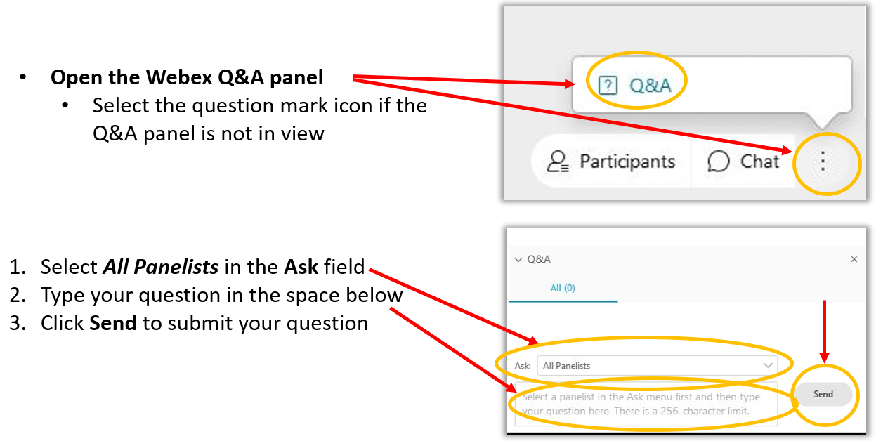
Want to Ask a Question? Webex Q&A Panel

Slide 4
Electronic Clinical Quality Improvement (eCQI) Resource Center Updates– MMS Information Session
Speakers
Vidya Sellappan, MS, CMS
Kathy Lesh, PhD, RN-BC, CPHQ, FAMIA, ICF/Battelle
Meridith Eastman, PhD, MSPH, Battelle

Slide 5
Agenda
Learning objectives
Brief overview of the Electronic Clinical Quality Improvement (eCQI) Resource Center
Live demonstration of the eCQI Resource Center focusing on newer functionality
Questions and discussion

Slide 6
Learning Objectives
Discover and use the eCQI Resource Center’s varied functionality to support electronic clinical quality improvement
Recognize how to use the new electronic clinical quality measure (eCQM) Compare tool
Identify how to suggest an eCQM Concept and/or share feedback on an existing suggested eCQM concept
Understand how to submit or respond to an eCQM Testing Opportunity

Slide 7
eCQI Resource Center Overview
Created in 2015 in response to stakeholder request to have a single place to find eCQI resources
Replaced the eCQM Library on CMS.gov as the source of truth for CMS eCQM specifications and CMS Quality Reporting Document Architecture (QRDA) Implementation Guides
Do not recreate information, but rather point to other resources pertinent to eCQI
Constantly undergoing review and update to remain current and accurate
Always looking for stakeholder feedback to better meet stakeholder needs
Usability Analyst essential member of the team

Slide 8
Brief Introduction to the eCQI Resource Center
The ‘one-stop shop’ for stakeholders engaged in electronic quality improvement
eCQM-related news and events
Home to eCQM specifications for CMS programs – currently categorized as eligible clinician or eligible hospital – with implementation resources
Home to CMS QRDA Implementation Guides – current and versions
Information and links to resources about eCQM standards – current and emerging
eCQI Tools & Key Resources - including standards and tools versions used for each eCQM reporting/performance period
Measure Collaboration Workspace – Concepts, Testing Opportunities, and eCQM Data Element Repository (DERep)

Slide 9
eCQI Resource Center Measure Compare

Slide 10
Measure Compare Functionality
Available from any individual eCQM page
From Home page
From Eligible Clinician or Eligible Hospital pages
Compares header information for two years, currently 2020/2021, 2021/2022, and 2020/2022
Does not compare logic or value sets

Slide 11
eCQI Resource Center Measure Collaboration (MC) Workspace Updates

Slide 12
Measures Collaboration (MC) Workspace Background
In 2019 CMS engaged with stakeholders to get an understanding of eCQM implementation and reporting burden and asked for recommendations for improvement in the use of eCQMs in CMS quality reporting programs.
The MC Workspace is a web-based tool that brings together a set of interconnected resources, tools, and processes to promote transparency and better interaction across stakeholder communities that develop, implement, and report eCQMs.

Slide 13
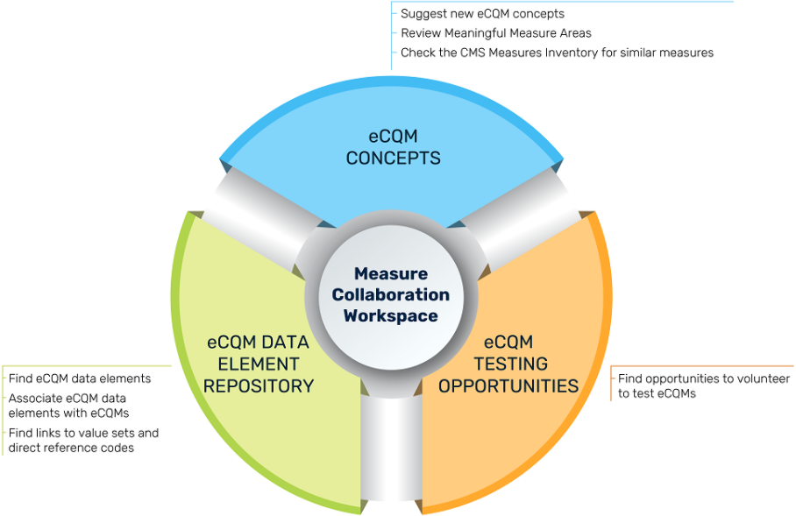
Measures Collaboration (MC) Workspace Modules
The MC Workspace has three modules designed to engage stakeholders in the different stages of the Measure Lifecycle
eCQM Concepts Module – Gives users the ability to search for eCQM concepts suggested by others and comment on those suggested eCQM concepts, submit new eCQM concepts, describe the population(s), and assign a care setting.
eCQM Testing Opportunity Module – Provides stakeholders with available opportunities to participate in eCQM testing.
The eCQM Data Element Repository (DERep) – Provides detailed information about data elements used in eCQM in CMS programs.
Notes:
The Measure Collaboration Workspace is a collaborative portal that supports quality and IT staff at hospital and provider organizations to more easily implement and use eCQMs. It is hosted on the eCQI Resource Center.
The workspace brings together interconnected resources, tools, and processes to promote transparency and interaction across stakeholders that develop, implement, and report eCQMs.
The MC Workspace is made up of three modules to support measure collaboration:
eCQM Concepts allows users to search existing measure inventories and submit new measure concepts for consideration
eCQM Testing Opportunities provides transparency into measure testing and allow users to express interest in participating in eCQM testing activities
The eCQM Data Element Repository provides data definitions to aid in measure implementation and data mapping

Slide 14
MC Workspace Concepts Module
eCQM Concepts module gives users the ability to comment on suggested eCQM concepts or suggest new eCQM concepts.
The suggested eCQM concept author may request the concept is shared with CMS.

Slide 15
MC Workspace Testing Opportunities Module
The eCQM Testing Opportunities module allows eCQM developers to announce opportunities to test eCQMs.
eCQM developers may seek volunteers at different stages of the Measure Lifecycle.
eCQM developers may use the announcement template and send to ecqi-resource-center@hhs.gov.

Slide 16
Demonstration
Live Demonstration
4/27/2022
Notes:
https://ecqi.healthit.gov/mc-workspace-2
https://ecqi-stg.healthit.gov/

Slide 17
Questions
Vidya Sellappan – Vidya.Sellappan@cms.hhs.gov
Kathy Lesh – lesh@battelle.org
eCQI Resource Center – eCQI-resource-center@hhs.gov
Thank you for your time!

Slide 18
Fully Developed Measure Definition
Fully Developed Measure Criteria:
Patient/encounter-level testing for each critical data element has been completed and no changes to specifications are needed
Reliability testing at the accountable entity level has been completed and no changes to specifications are needed
Empiric validity testing at the accountable entity level has been completed and no changes to specifications are needed
Completion of face validity testing as the sole type of validity testing does not meet the criteria for Fully Developed. However, face validity will be accepted for new measures only.
Additionally, for measures based on survey data or patient-reported tools:
4. The survey or tool has been tested and no changes to the instrument are needed based on the results
Notes:
Measures that are fully developed are highly preferred. If you wish to proceed with the submission for a measure that is not Fully Developed, please provide additional details regarding development status in CMS MERIT.
If any one of the above statements is not true at the time of the 2022 MUC List submission deadline (see specific guidance above for survey- and assessment-based measures), you must indicate that the measure is at one of the following stages of development: Conceptualization, Specification, or Field (Beta) Testing.

Slide 19
Announcements
In case you missed it
March Information Session on “Improving the Way We View CMS Measures: A CMS Measures Inventory Tool (CMIT) Demo”
https://www.youtube.com/watch?v=GtJh3A7JCMo
Upcoming Information Session
May 25th from 2 – 3 p.m. ET
We will demonstrate and discuss the new Measures Management System website, the MMS Hub, during this presentation.

Slide 20
Pre-Rulemaking Announcements
Reminders
CMS MERIT will close for measure submissions on May 20th at 8:00 PM, ET
Stay up-to-date! Visit the CMS Pre-Rulemaking Website

Slide 21
CMS
Kimberly Rawlings (CMS COR)
Contact: Kimberly.Rawlings@cms.hhs.gov
Battelle
Contact: MMSSupport@battelle.org

