Slide 1

Improving the Way We View CMS Measures
A CMS Measures Inventory Tool (CMIT) Demo
Maureen Hammer, Battelle
Stephanie Zias, Battelle

Slide 2
Overview
What is CMIT?
CMIT 2.0 Features
CMIT 2.0 Demonstration
Home Page Highlights
Inventory Views
Measure Comparison
Single Measure View
Saved Views/Preferences
Questions

Slide 3

What is CMIT?

Slide 4
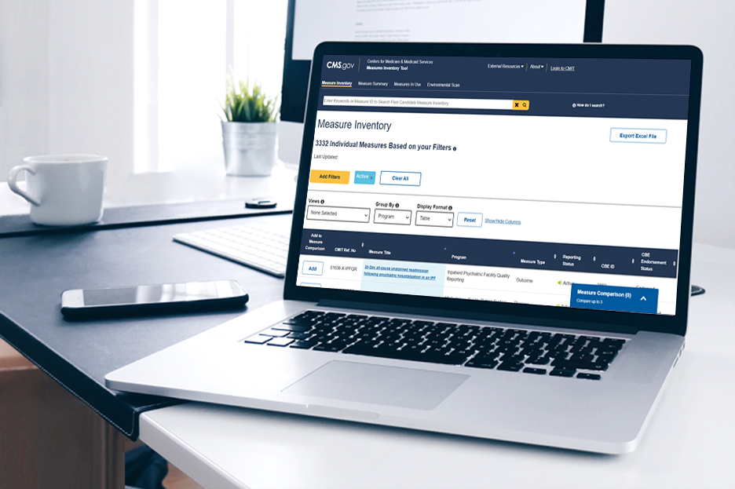
CMS Measures Inventory Tool (CMIT)
Host site for the CMS Quality Measures Inventory
Agency-level repository of record for information about the measures CMS uses to promote healthcare quality and quality improvement

Slide 5
Purpose of CMIT
Provide stakeholders access to information about quality measures
Promote transparency
Coordinate quality improvement efforts
Enable public participation in quality measurement
Assist in management of the CMS quality measure information
Foster measure harmonization and alignment
Identify redundancies
Identify measurement gaps

Slide 6

CMIT Data
The CMS Quality Measures Inventory includes:
Measures in CMS programs that are subject to the federal rulemaking process and have been proposed, finalized, implemented, or removed
Measures under Development (MUD) and Measures under Consideration (MUC) for the above programs
Measures used in many programs and initiatives that are not subject to the federal rulemaking process, including measures that may be a part of CMS models or initiatives
Data sources include Federal Rules, measure specification manuals, CMS Program and Measure Leads
Data are updated on a rolling-basis
Measure information is validated by CMS Program and Measure Leads

Slide 7

CMIT 2.0 Features

Slide 8
CMIT 2.0 - Improvements
New CMIT ID format
More flexible infrastructure to support future needs
Usability and customization features
New views for easy grouping and counting
Refined and standardized data fields
Additional data fields

Slide 9
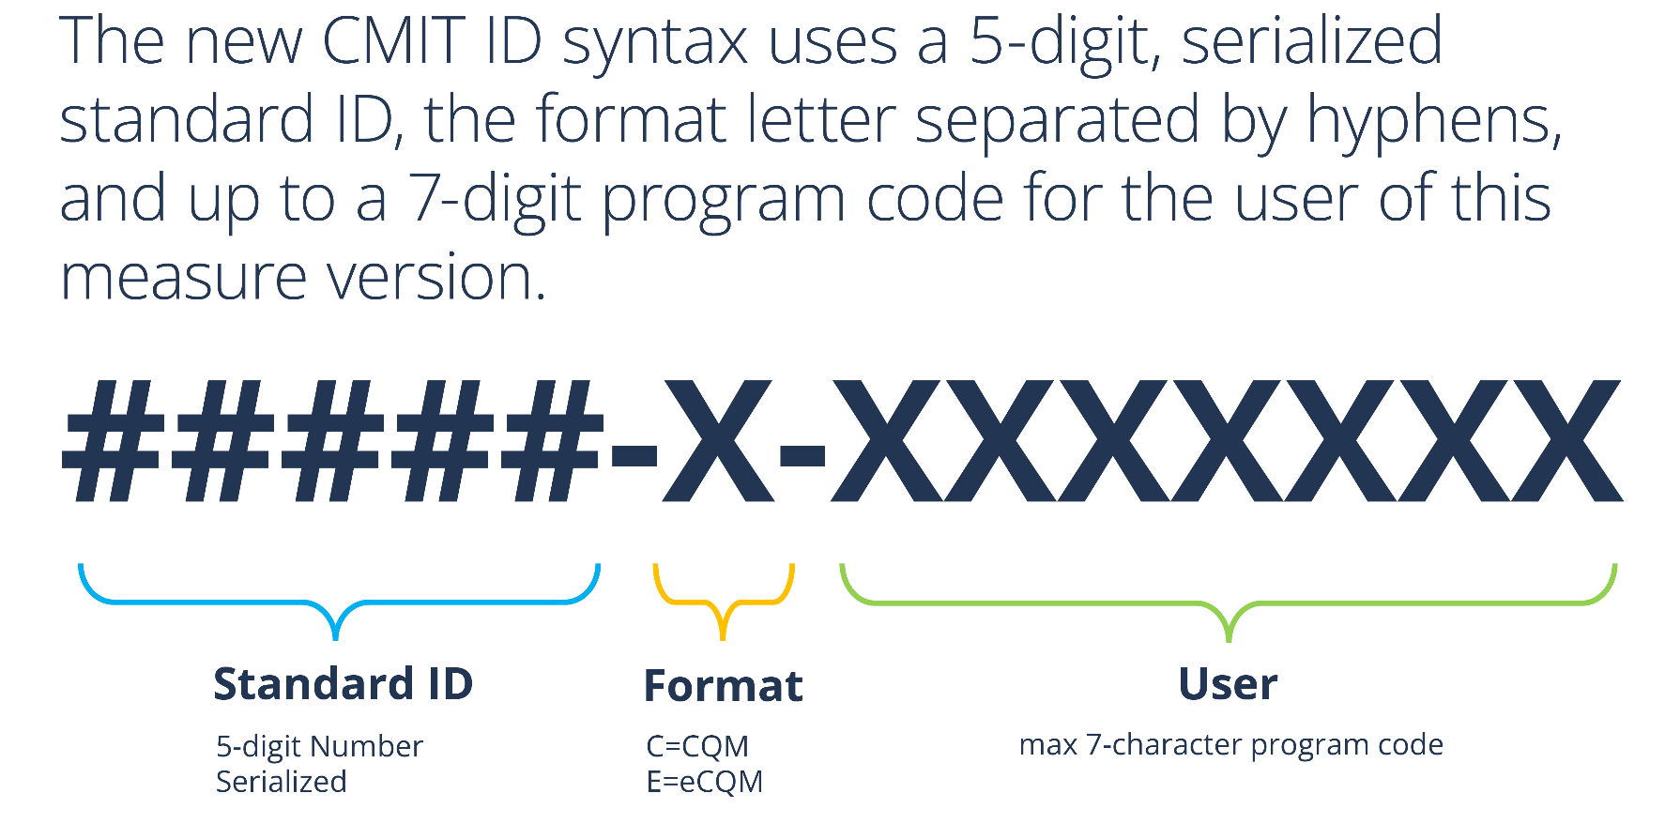
CMIT 2.0 - ID Format

Slide 10
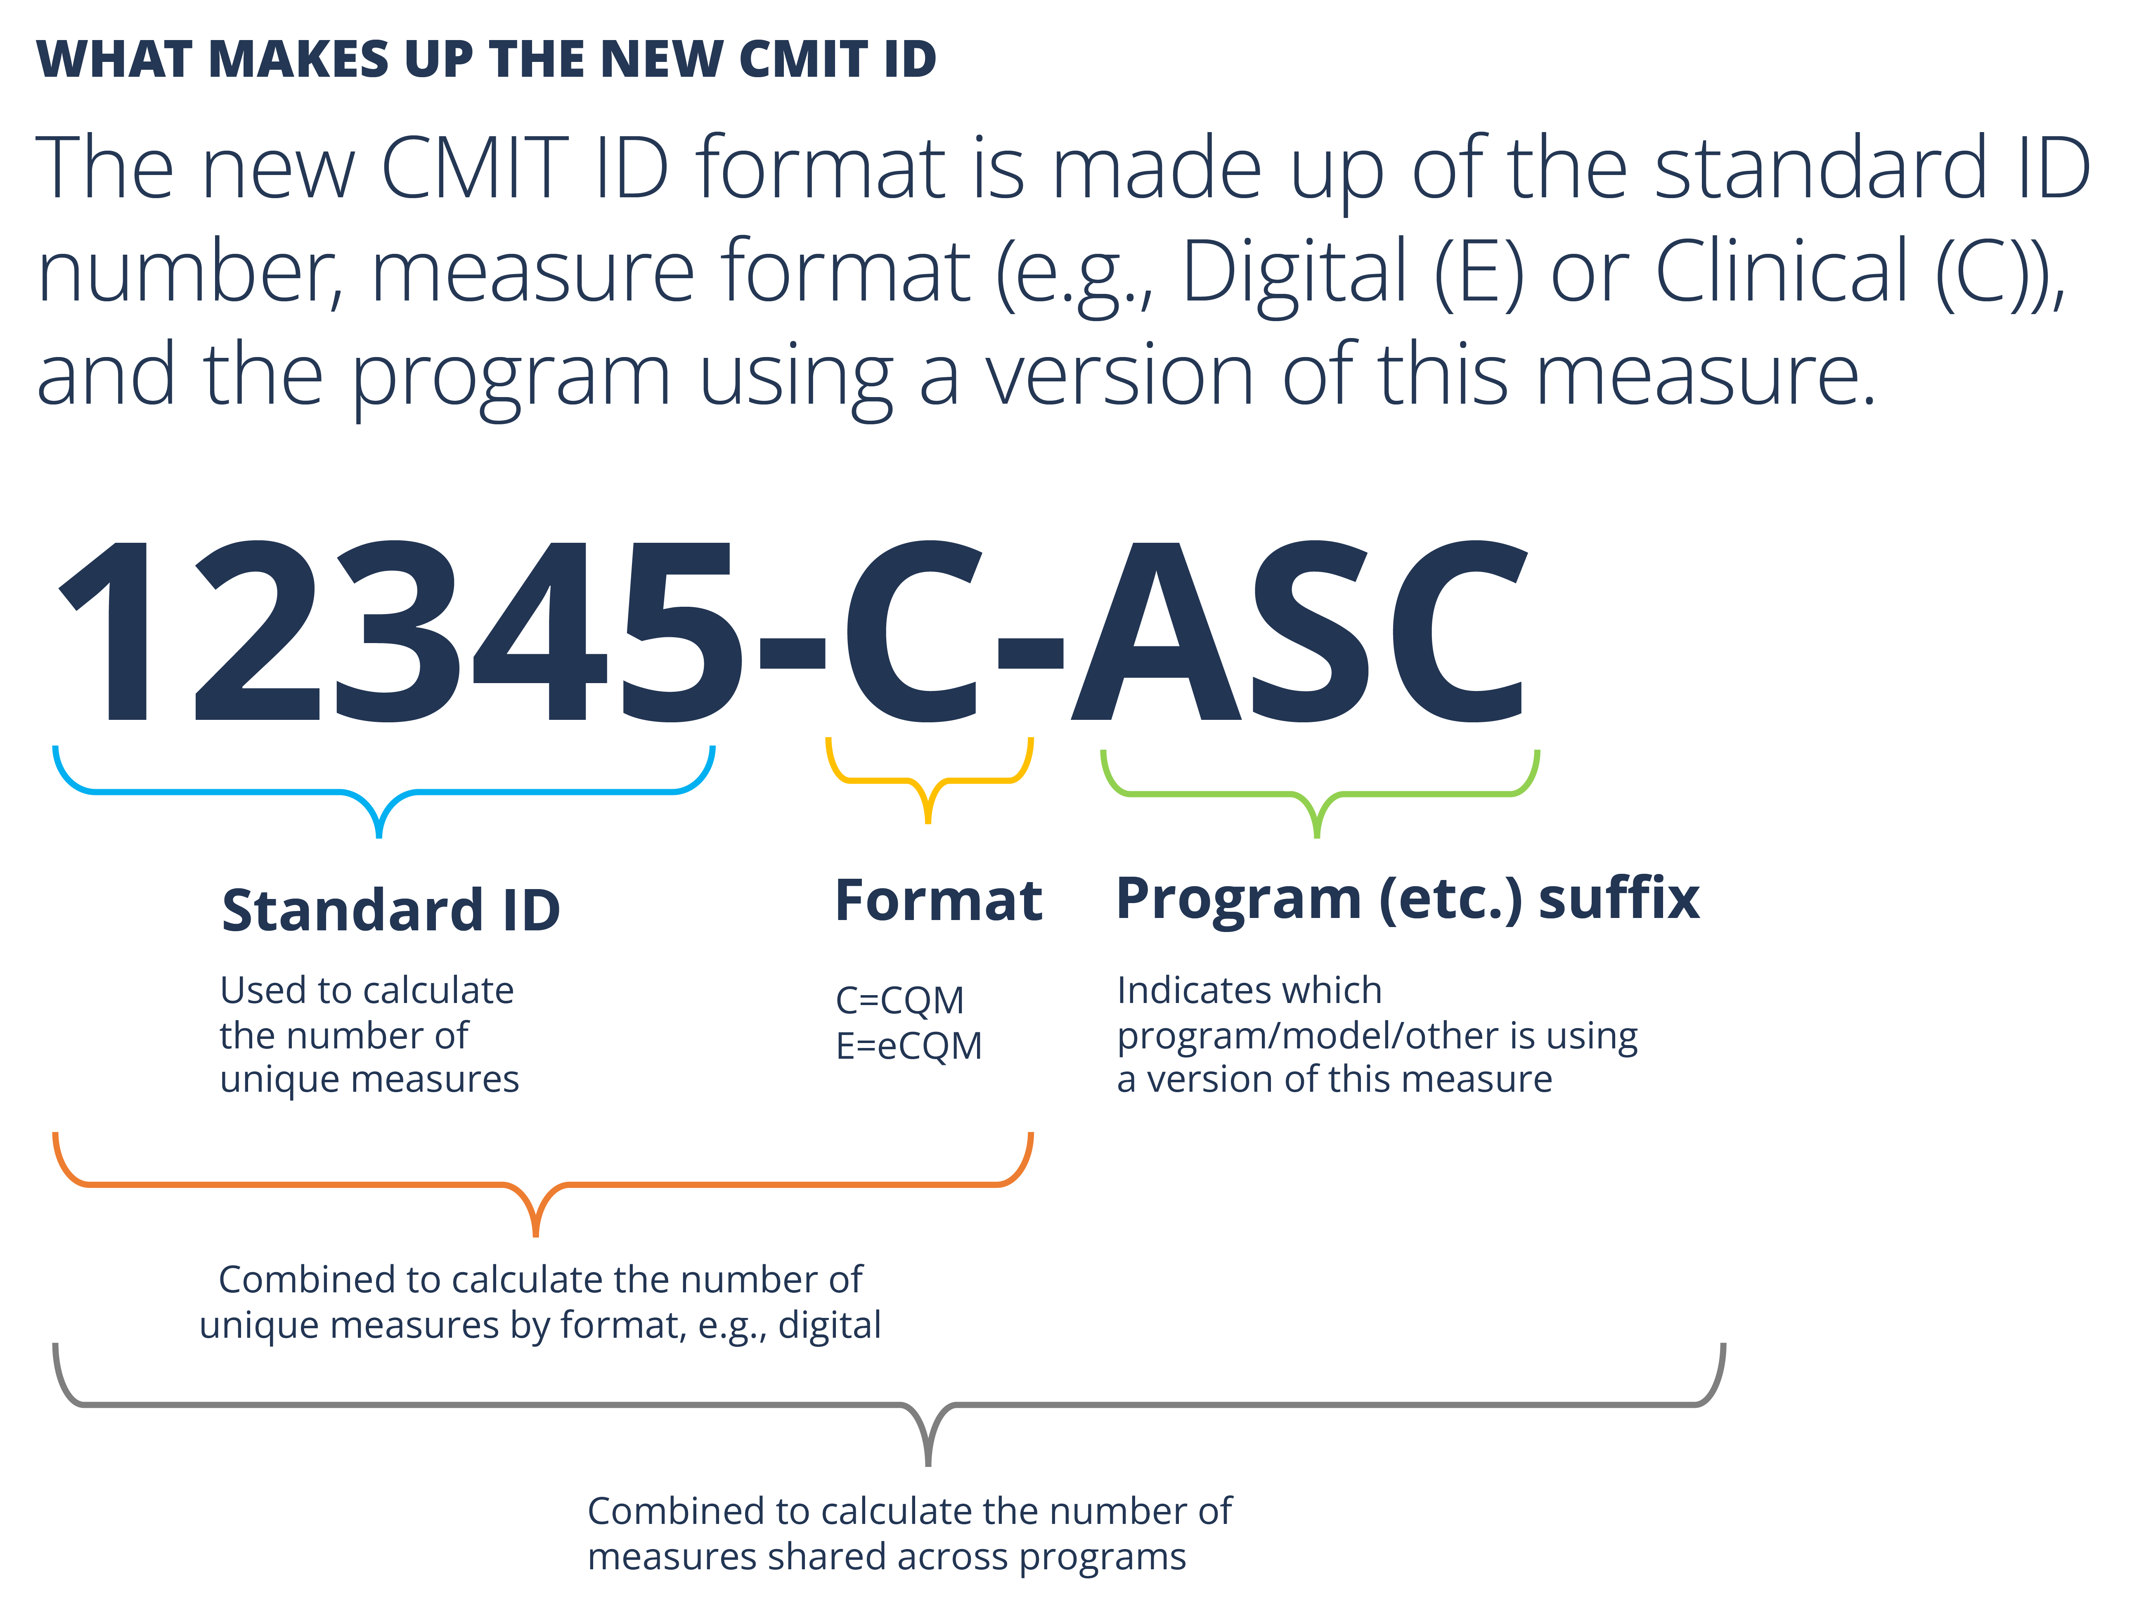
CMIT 2.0 - ID Format
Changing IDs
In most cases, the standard ID will include the old CMIT ID.

Slide 11
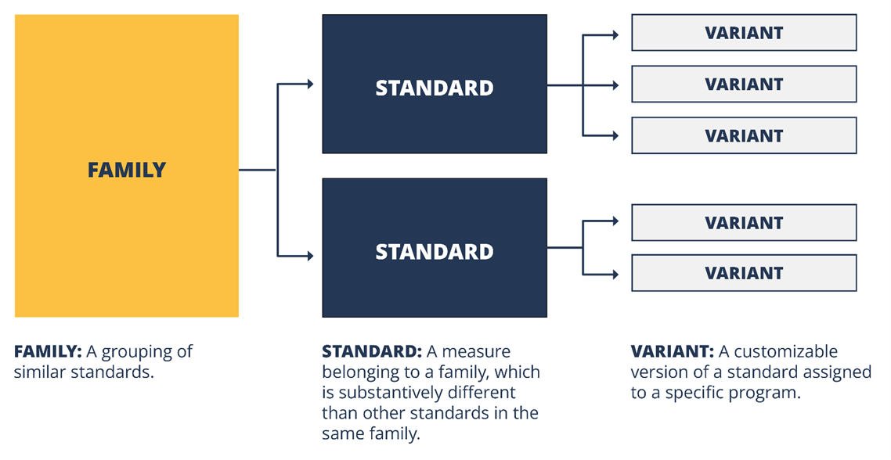
CMIT 2.0 - Infrastructure

Slide 12
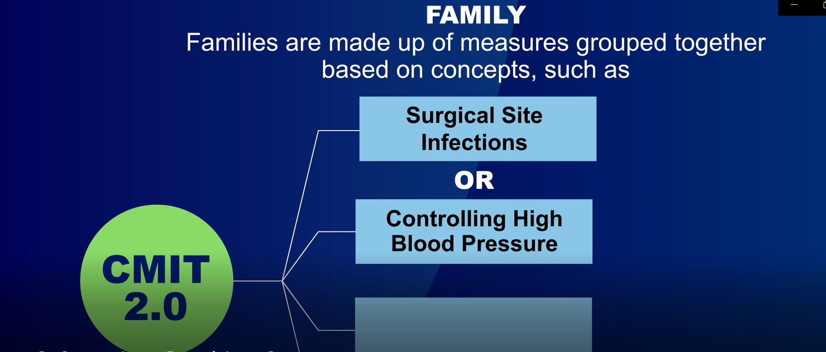
CMIT 2.0 - Infrastructure

Slide 13
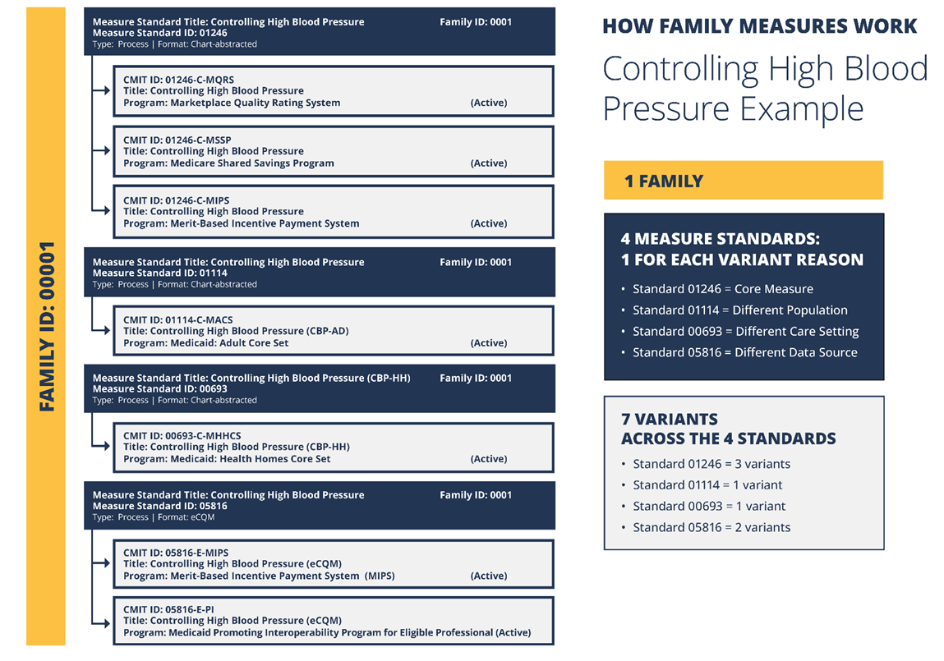
CMIT 2.0 - Infrastructure

Slide 14
CMIT 2.0 - Infrastructure

Slide 15
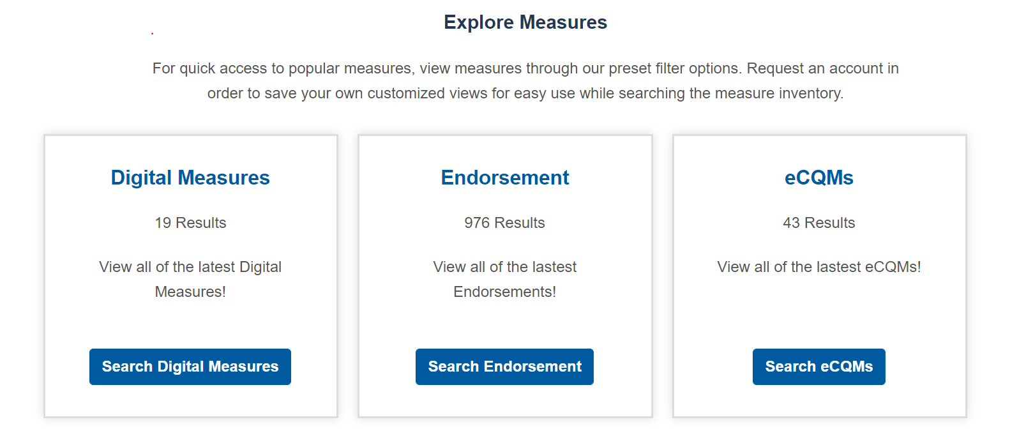
CMIT 2.0 - Usability
New home page includes pre-filters so you can quickly see a set of measures
Retained ability to save views (customizable by user), but added new, more flexible options

Slide 16
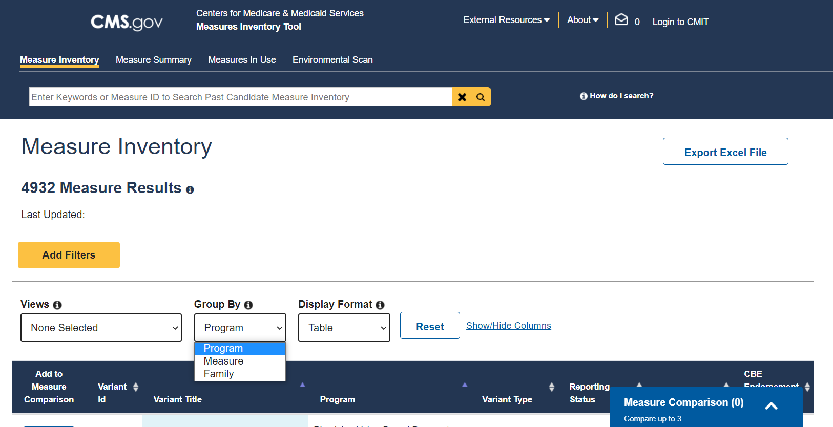
CMIT 2.0 - Views
New "group by" feature allows the user to determine how search results are presented
Program
View results by program to see variants and compare across programs
Measure
View results by standard to see
substantively different measures
Family
View results by family to see "unique measures" in the Inventory

Slide 17
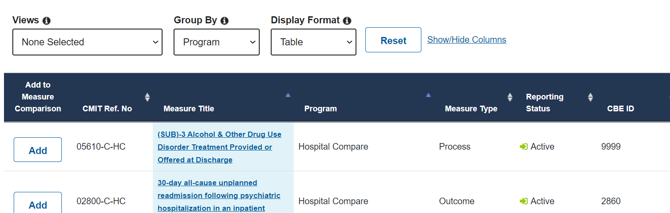
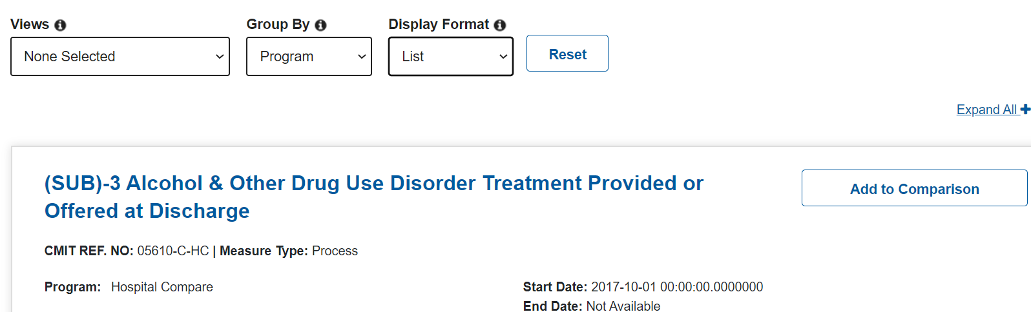
CMIT 2.0 - Views
Two options to view search results
Table View
List View

Slide 18
CMIT 2.0 - Standardized Data Fields
CMIT 2.0 includes standardized data for existing fields
Standardization intended to improve search and filter functionality
Aligned with the MMS Blueprint
Most notable improvements are:
Conditions/Subconditions
Care settings
Level of analysis

Slide 19
CMIT 2.0 - New Data Fields
Additional data fields and/or filters are available:
Format type (CQM, eCQM)
Year of CBE Endorsement Removal, when applicable
Risk-adjusted (Yes/No)
CMS-funded (Yes/No)
Component specifications for composite measures

Slide 20

CMIT 2.0 Demonstration
03/30/2022

Slide 21
Questions
Thank you for your time!

Slide 22
Announcements
In case you missed it:
February Information Session on “2022 MERIT Demonstration and From PROMs to PRO-PMs: Developing Patient-Reported Outcome Performance Measures (PRO-PMs)”
Upcoming Information Session
April 27th from 2 – 3pm ET on “Updates to eCQI Resource Center”

Slide 23
Pre-Rulemaking Announcements
Events
Join CMS for the 2022 Pre-Rulemaking Season Kick-off Webinar on Thursday, March 31 from 2:00 PM - 3:00 PM, ET to learn about this year’s pre-rulemaking process, requirements, and resources. Click here to register!
CMS is also offering a CMS MERIT Tips & Tricks Session on Thursday, April 29 at 2:00 PM, ET to review the ins and outs of the tool for measure submissions. Click here to register!
Reminders
CMS MERIT will close for measure submissions on May 20 at 8:00 PM, ET
Stay up-to-date! Visit the CMS Pre-Rulemaking Website

Slide 24

Upcoming Public Webinars

Slide 25
CMS
Kimberly Rawlings (CMS COR)
Contact: Kimberly.Rawlings@cms.hhs.gov
Battelle
Contact: MMSSupport@battelle.org

