Slide 1

When the Journey is the Destination
Tackling the Complexities Associated with Diagnostic Performance Measurement
Brenna Rabel, MPH, Senior Social Scientist, Battelle
Jeff Geppert, Med, JD, Senior Research Leader, Battelle

Slide 2

MMS Info Session Goals
Part of a larger effort to engage stakeholders and the public in quality measure development.
Additional activities the MMS team leads:
  Annual public webinars on high-priority CMS topics
  Outreach via our stakeholder listserv and
  the CMS MMS listserv
  MMS website updates and maintenance
  Development and promotion of emerging
  tools and resources
  MACRA-specific education and outreach
Notes:
CMS is committed to providing Education and Outreach opportunities about the quality measure development process to interested stakeholders to improve understanding of the process. CMS also seeks continual feedback to improve and/or expand its offerings to the healthcare quality measure development community and interested stakeholders.
To date, CMS has implemented an Education and Outreach webinar series and has created resource materials that break down and explain various components and challenges in the measure development process. There are dedicated websites, listservs, and roadmap documents that are available to support those that are working in quality measure development, or are just curious and want to learn more about how it is done.

Slide 3

Want to Ask a Question?
Webex Q&A Panel

Slide 4
Agenda
Importance of diagnosis in clinical quality
Overview of recent studies
Known challenges
Best practices
Using measures to drive quality improvement
Notes:
The measurement of diagnostic performance is an emerging area. Highlighted will be why measuring diagnostic performance is a challenge, has been a challenge, and continues to be a challenge, while addressing ways in which they may be addressed moving forward. Further will be the background of diagnosis and quality being addressed by recent publications on this topic. Lastly, we will share emerging best practices that facilitate driving home this connection between measurement and quality improvement.

Slide 5
Importance of Diagnostic Quality
Diagnostic errors (e.g., inaccurate or delayed diagnoses) occur in all care settings and harm an unacceptable number of patients.
Can lead to negative health outcomes, psychological distress, and financial costs.
If a diagnostic error occurs, inappropriate or unnecessary treatment may be given to a patient, or appropriate treatment may be withheld or delayed.
Efforts to identify and mitigate diagnostic errors have so far been quite limited.
Problematic, since it is likely that most people will experience at least one diagnostic error in their lifetime, many of which can be deadly
Notes:
Diagnostic errors can occur in all settings — primary care, emergency departments, hospitals — and are much more common according to best estimates. There is tremendous opportunity to improve the quality of diagnostic performance to reduce harm, to enhance the patient experience, and to mitigate any financial consequences. Although a tremendous emphasis over the last 20 years has been on patient safety, the specific focus on addressing diagnostic performance has been limited.

Slide 6
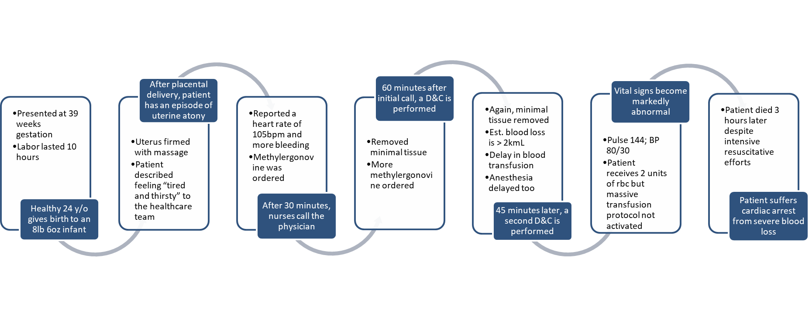
Case Study in Diagnostic Error
The Contribution of Diagnostic Errors to Maternal Morbidity and Mortality During and Immediately After Childbirth: State of the Science. Content last reviewed September 2021. Agency for Healthcare Research and Quality, Rockville, MD.
https://www.ahrq.gov/patient-safety/reports/issue-briefs/maternal-mortality-6.htm
Notes:
The case study depicted on this slide published by AHRQ investigated maternal morbidity and mortality, focusing on complications occurring immediately after child birth. This case study typifies the complexity and iterative nature of the diagnostic process where somewhat ambiguous signs and symptoms are presented, decisions are made, treatments are given and treatment responses are evaluated.
How should we think about measuring such a process that is so iterative and so potentially complex?
Here think of diagnosis in broad stages of a person’s journey being Stage A when they’re relatively healthy with a main focus on wellness; Stage B may display signs and symptoms of particular conditions but no structural change; Stage C there may be structural change to an organ along with functional status changes or chronic conditions. Stage D is in an end stage circumstance of failure to rescue or a more rapid progression towards mortality.
Diagnosis has a role to play in all four stages, but the focus historically has been on Stage A with screening activities and Stage C to address ongoing chronic conditions. Stage B has received less focus where they have signs and symptoms. There’s more of a process that needs to occur in order to identify these patient risk factors.

Slide 7
Case Study Cont’d: What Went Wrong?
Errors and oversights occurred at several steps in the diagnostic pathway
  Initial assessment: Healthcare team did not incorporate patient’s self-reported symptoms of tiredness and thirst into assessment; underappreciation of tachycardia in the context of pregnancy changes.
  Diagnostic Test Performance & Interpretation: Visual estimation of blood loss (no quantification of actual blood loss); limited physical exam and no lab tests drawn to clarify extent of bleeding.
  Follow-up Diagnostic Information: Only a few treatments tried, and then repeated even when ineffective, instead of escalating to additional medications or interventions; delays in blood administration.
  Subspeciality/Referral Issues: Delay in response from key multidisciplinary team members; lack of an organized standardized team approach.
The Contribution of Diagnostic Error to Maternal Mortality and Severe Maternal Morbidity. Content last reviewed September 2021. Agency for Healthcare Research and Quality, Rockville, MD.
https://www.ahrq.gov/patient-safety/reports/issue-briefs/maternal-mortality-2.html
Notes:
The case study identified several opportunities for improvement in the process:
The initial assessment of the patient’s self-reported symptoms,
The performance of diagnostic tests and the ways in which the tests were interpreted,
How that information was followed up on and the treatment plans that were followed, and
Lastly, the collaborative response from a multidisciplinary team.

Slide 8
Why Measure Diagnosis?
Diagnosis is a fundamental part of clinical medicine and is a prerequisite for the delivery of high-quality, effective care
  When accurate and timely, diagnosis offers patients the best opportunity for a positive health outcome
  Process measures promote adherence to clinical guidelines/best practices which, if not followed, may lead to errors or delays in diagnosis
Drive toward outcomes, intermediate outcomes, and high-value structure measures
  High quality diagnosis must be safe, effective, patient-centered, timely, efficient, and equitable
Notes:
There are multiple strategies by which one may attempt to improve diagnostic performance. There are quality improvement strategies and trainings. Those could be structure measures, process measures, outcome measures — the full gamut of measurement tools available with the end goal of increasing the quantity/quality of measures of diagnostic performance. The objective is to increase the availability of measures to be used in accountability applications or other reporting applications.

Slide 9



Diagnosis in the Literature: Featured Works
IOM Report on Improving Diagnosis in Healthcare, 2015
Challenges and opportunities from the Agency for Healthcare Research and Quality (AHRQ) research summit on improving diagnosis: a proceedings review, 2017
NQF Report “Improving Diagnostic Quality and Safety/Reducing Diagnostic Error: Measurement Considerations”, 2020 (and the previous 2019 report upon which this was built)
Notes:
The three reports depicted on this slide have been informative to our thinking regarding how best to approach diagnostic performance measurement. AHRQ had convenings and issued some reports addressing the challenges and opportunities around diagnosis. NQF as well convened TEPs and did some environmental scans that resulted in recommendations for potential opportunities for measurement.

Slide 10
Improving Diagnosis in Healthcare (IOM)
Mapped the diagnostic process (see next slide)
Concluded with eight comprehensive recommendations for the field
Developed a patient-centered definition of diagnostic error:
The failure to:
Establish an accurate and timely explanation of the patient's health problem(s)
Communicate that explanation to the patient
OR
Notes:
The IOM Report
Is foundational in this field and serves as the basis for our current understanding of how diagnosis is achieved and what it means for patient experience and outcomes.
Delivered a useful conceptual framework, to define diagnostic performance and the diagnostic process.
Illustrated a diagnostic error as the failure to establish an accurate and timely explanation of the patient’s health problem.
Defined a potential error in diagnostic performance as the inability to communicate that explanation to the patient that has both activities on the clinician side explaining the diagnostic explanation to the patient; therefore, the patient piece is often missing in the metrics under development for diagnostic performance.

Slide 11
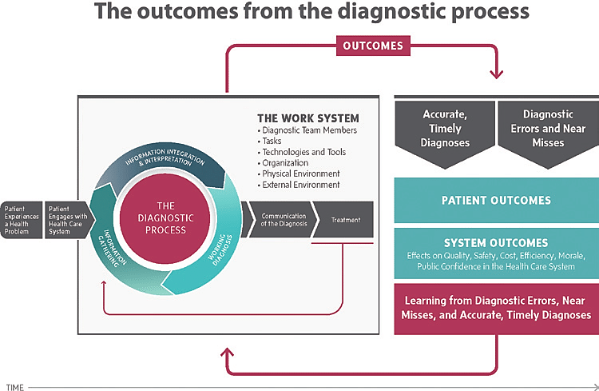
IOM Diagnostic Process
https://www.researchgate.net/figure/The-IOM-framework-describing-the-diagnostic-process-and-its-outcomes_fig2_284787463
Notes:
Prior to engagement with healthcare system—The IOM highlights the importance of patient engagement and care coordination, beginning when the patient experiences a health problem, which increasingly becomes part of the diagnosis. The patient recognizes this experience of a health problem outside the traditional brick and mortar of the healthcare system, particularly evident with COVID and home testing.
At the point of patient engagement with the healthcare system—The ability of the patient to engage with the healthcare system involves access and equity issues, which is again a point where there’s an opportunity for some measurement focus to ensure that patients have an equal opportunity to engage with the healthcare system.
The diagnostic process involves three stages—Gathering information, integrating and interpreting the information, and using the information to establish a working diagnosis. “Working diagnosis” is to emphasize the uncertainty of the associated diagnosis being communicated to the patient. There is treatment involved, but often that establishes new diagnostic information which feeds back into the process. It then repeats the outcomes of this process which potentially involve outcome measures or inaccurate and timely diagnosis.

Slide 12
IOM Recommendations
Goal 1: Facilitate more effective teamwork in the diagnostic process among health care professionals, patients, and their families
Goal 2: Enhance health care professional education and training in the diagnostic process
Goal 3: Ensure that health information technologies support patients and health care professionals in the diagnostic process
Goal 5: Establish a work system and culture that supports the diagnostic process and improvements in diagnostic performance
Goal 4: Develop and deploy approaches to identify, learn from, and reduce diagnostic errors and near misses in clinical practice
Goal 6: Develop a reporting environment and medical liability system that facilitates improved diagnosis by learning from diagnostic errors and near misses
Goal 7: Design a payment and care delivery environment that supports the diagnostic process
Goal 8: Provide dedicated funding for research on the diagnostic process and diagnostic errors
Notes:
The goals on this slide demonstrate the great work that remains. Much reflective thought should be given in terms of where to focus efforts in quality measurement. Goal 3 cites implications for what can be captured electronically and demonstrates a need for evidence-based CDS tools that could serve as the basis for future quality measures. Goals 4-7 demonstrate the importance of quality measures in use not only for accountability and payment, but for learning and quality improvement.

Slide 13
NQF Report: Improving Diagnostic Quality and Safety/Reducing Diagnostic Error: Measurement Considerations
Describes the diagnostic pathway and identify opportunities and causes for misdiagnosis through a series of Use Cases
Identifies gaps in diagnosis-related measures and pinpoints where future measures might be most beneficial
Diagnosis Subdomain | Existing Measures | New Measure Concepts
Info gathering/documentation | 0 | 2
Information integration | 0 | 0
Information interpretation | 0 | 0
Diagnostic efficiency | 18 | 8
Diagnostic accuracy | 1 | 7
Follow-up | 0 | 0
Table populated using information from the 2020 NQF Report on Improving Diagnostic Quality and Safety/Reducing Diagnostic Error: Measurement Considerations: http://www.qualityforum.org/Publications/2020/10/Reducing_Diagnostic_Error__Measurement_Considerations_-_Final_Report.aspx
Notes:
The NQF report builds upon the IOM document delving into different domains that may serve as a measurement focus. The result depicted in this table is that there are not many measures focusing on diagnostic performance.
The existing measures tend to focus on a few domains — diagnostic efficiency in particular — which refers to timing issues around were there deliverables in the time prescribed by the guidelines. There remain many opportunities for new measure development and many gaps to be identified that are well described in this analysis.

Slide 14
NQF Report: Major Conclusions
There are four high priority areas related to diagnostic error that cause patient harm:
  missed subtleties
  communication failures
  information overload
  dismissed patients
Diverse healthcare stakeholders (including clinicians, administrators, patients, EHR vendors, medical specialty societies, payers, etc.) must work together to take actionable steps to improve accurate diagnoses and reduce diagnostic errors to improve patient safety
Notes:
This idea of missed subtleties exemplified in the case study was often an abnormal presentation, with the missed subtle queues in many different circumstances due to communication failures. This is a team-based effort with communication as central to high performance. With patients being central to the information-gathering process, it’s diagnostic performance measurement almost on “steroids,” as if every challenge and issue that exists for quality measurement and other domains is magnified in the challenges with diagnostic performance.

Slide 15
AHRQ Report: Background
The September 2016 AHRQ Research Summit on Improving Diagnosis in Health Care explored the state of the science of diagnosis and discussed ways AHRQ could contribute to improving diagnostic performance
Findings from that summit were published in a 2017 issue of Diagnosis (“Challenges and opportunities from the Agency for Healthcare Research and Quality (AHRQ) research summit on improving diagnosis: a proceedings review”)

Slide 16
AHRQ Report: Implications for Measurement
Identified three primary purposes for measurement in diagnostic safety
Establish the incidence of diagnostic error
Determine the causes and risks of error
Assess the effectiveness of strategies and interventions
Notes:
Here we seek to know how many errors there are, which oftentimes there are a lot more errors than we realize, but the fact that we don’t have measurement for it, we tend to underestimate the total number of actual errors. Once we’ve identified where there are performance gaps, we need the measures to assess why these are occurring and how to address them, and to then lastly evaluate the interventions as to performance.

Slide 17
AHRQ: Challenges in Measuring Quality
Gaps in the availability and quality of data
Methods for determining the contributing factors to diagnostic error
Establishing the effectiveness of interventions
Notes:
Data gaps will always remain, which we address these data gaps as particularly challenging with diagnostic performance. Also, because we’re dealing with systems and workflows, understanding what actually is contributing to the diagnostic performance challenges can be difficult, since it involves task and work analysis, observational techniques, which are not used in measure development, and given the evidence base for the effectiveness of these interventions is somewhat lacking.

Slide 18

Section 2: Putting it all together

Slide 19
Summary of Challenges
Complexity of the diagnostic process creates issues of attribution and accountability
As with all quality measures, the availability of accurate, current, and complete clinical data impacts the scope of what can be measured
No single entity that “owns” the diagnostic process
Notes:
To summarize diagnostic performance, diagnosis spans the full spectrum:
It’s both a safety matter, but also a quality of care matter.
It involves everything from wellness to chronic conditions and covers the gamut.
The diagnostic process and outcomes are conceptually complicated.
The process itself is very iterative and has a significant cognitive component.
The outcomes are often uncertain, not only the diagnosis, but the impact of a diagnostic performance gap.
Validity—Demonstrating validity is a significant challenge, because the evidence base available for diagnostic performance measures is limited. There are fewer guidelines to establishing causality because you’re attenuated from the outcome by the moderation of the treatment. There is not a lot of peer-reviewed literature to support the development of a quality measure.
Ownership—This issue is a particular challenge with diagnostic performance. The diagnosis could happen in primary care, in the ED, in an inpatient hospital, but primary care has many responsibilities to address. The ED does a considerable amount of rapid diagnosis, but oftentimes in the ED the goal is to stabilize patients to be transferred to the appropriate setting.
Where does the diagnosis happen?
How much burden can you place on the primary care setting? To look at diagnosis for less common presentations?
Registries—There are issues since registries are a potential data source used to improve diagnostic performance, but registries typically cover when a patient already has a condition, not usually the at-risk population for the condition, the Stage B population.
How do we create registries that could be useful?

Slide 20
Best Practices: Patient Perspectives
Focus on patient perspectives
  What makes for a good diagnosis from the patient’s perspective?
  Patient perspectives can help refine you measure concept and information how to define crucial data elements.
    For example, clinicians may struggle articulate the “time of diagnosis” most patients can articulate exactly when their life changed, having heard the words “You have ___”.
  Consider the patient’s right to refuse testing, and factor that into your measure concept/scoring algorithm.
Notes:
The ability to explain to the patient a diagnosis should be part of the measure development process. There are often patient preferences that need to be incorporated. This is often the case where the diagnostic process involves information-gathering activities where there is risk involved. It appears evident that a patient ought to be not only aware of that risk but have some say in terms of their willingness to accept that risk. So both having measures of the patient’s understanding of the diagnosis and engaging the patient in the measure development process are two sort of central best practices.

Slide 21
Best Practices: Benefit vs. Burden
Have a strong hypothesis that the measure benefit clearly outweighs the burden associated with reporting.
  Try to quantify the potential number of lives saved or morbidity avoided.
  Carefully consider what it would take for an entity to collect data and report on the measure
    What data does it rely on?
    Is it likely to be available at most sites?
Notes:
Benefit vs. burden pertains to the costs associated with everything involved with measurement from the clinician or the facility’s perspective. Measurement always involves burden; therefore, the burden to collect, report and to act on the data.
Here the focus is on areas where a quality deviation can have significant benefits to patients and to the system. That will support the development of our quality measures, but there is often a focus when developing measures on the scientific acceptability aspect — reliability and validity. Those are critical, but often the implementation side tends to be thought about afterwards. With diagnostic performance it’s particularly important to make considerations of feasibility and usability concurrent with assessments of scientific acceptability. How one does that is for feasibility you must understand the workflows involved with data collection and use. Thinking that through not only in terms of collecting data, but then acting on the data. Once it’s been reported it has an equal role to play in the justification for measurement as our traditional focus on things like reliability and validity.
What actual roles are we creating?
What tasks are we creating?
What kinds of collaboration are we requiring?

Slide 22
Evolving Evidence
Tendency in quality measurement to think of this work is sequential
  In diagnosis, an area where the evidence is still emerging, the process may need to be reversed (i.e., using measures to collect data that inform clinical guidelines)
To do this, measures may need to be used in a quality improvement context first to establish proof of concept and to rule out potential unintended consequences
Notes:
Reversed process approach—In developing measures of diagnostic performance there is this process in mind that we have data, that data is used to generate evidence, and that evidence is used to support a measure. This process is reversed where it’s about creating a measure and then having a process of using the measure to generate evidence which then establishes the business case for the data collection.
Create a roadmap—It’s important when developing a measure of diagnostic performance to reflect on how this will evolve over time, how the measurement will be used in a quality improvement context in order to generate evidence which can be used to establish a business case for data collection — which then can be used conversely to reinforce the evidence and be used in the measurement.

Slide 23
Diagnostic Measurement: A Journey
Diagnostic measures often rely on data from pathology or radiology reports, which are unlikely to be stored in a readily extractable format.
  Developers may need to employ more technical solutions, such as natural language processing (NLP), to enable the capture data.
How do you develop measures when the scientific basis is lacking?
  Measures could be used to drive better documentation, while collecting crucial information to inform future guidelines and standards.
Notes:
Diagnostic performance relies on data not readily available, or typically in structured fields, or even in structured fields it’s not reported with the degree of specificity required in order to appropriately characterize the diagnostic performance. Currently, there is success in using NLP to identify signs and symptoms and even some social determinants located in the notes.
Here we begin with NLP on matters more structured; for things less structured, we may intentionally structure them so at least the narrative is structured in a way whereby the NLP is more consistent and performs better. Eventually that structured test evolves into a structured field and a structured code that is used in a more traditional eCQM.
Often the scientific basis we seek must be developed in unison with the measure. Just as the data must evolve, the evidence needs to evolve. One practice in support of this is the simultaneous development of measures and quality improvement artifacts — so as a measure and a CDS artifact, to develop them simultaneously so they mutually support each other. The measure can rely on the CDS to help the clinician perform well on the measure, and the adoption of the CDS is used as a way to improve performance on the measure which supports the validity determination of the measure. It evolves simultaneously, and so that simultaneous development of both quality measurement artifacts and quality improvement artifacts needs to happen at the same time and more so for diagnosis than in other settings.

Slide 24
Takeaways
Evidence and data will evolve simultaneously
  Performance measurement is iterative and requires flexibility
  Data availability challenges may be addressed by new technologies (e.g., NLP to establish T0)
  Measure data can establish evidence
Notes:
Diagnostic performance measures share similar challenges to traditional CQMs, but to a greater degree.
Structure matters a great deal for diagnosis.
The availability of genetic testing, the availability of CDS or the availability of an IT system that can track referrals, matters a lot to diagnostic performance and could be a major focus area for diagnostic performance measurement.
PROMs and other measures of shared decision-making play a crucial role in diagnostic performance measurement.
Implementation needs to be considered from the very beginning of the lifecycle.
The feasibility and usability considerations are mutually supportive of the validity demonstrations.
Quality measurement and quality improvement have to be developed in parallel.
Clearly evident with diagnostic performance is the need for a significant emphasis on learning in the development of tools and artifacts that support the learning. The diagnostic has a big cognitive component to it, and so in the development the measures will be more valid, if developed simultaneously with the means and methods of reporting the information back to the clinicians in a way that supports learning, and so those in essence will be mutually supportive.

Slide 25
Discussion Questions

Slide 26
Announcements
In case you missed it:
  “CMS Measure Management System (MMS) Blueprint Version 17.0 Update” https://www.youtube.com/watch?v=daLvGRuUmLU
Upcoming
  February 23rd from 2 – 3pm ET. NQF presentation on “Building a Roadmap From Patient-Reported Outcome Measures to Patient-Reported Outcome Performance Measures”

Slide 27
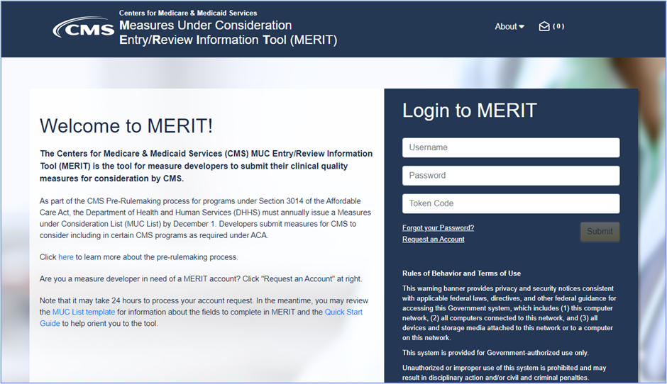
CMS MERIT: Opening Soon!
The CMS Measures Under Consideration Entry/Review Information Tool (CMS MERIT) will open for measure submissions for the 2022 MUC List on Friday, January 28!
  CMS MERIT will remain open through Friday, May 20
The MMS Info Session on February 23 will feature a brief demonstration of new features for submitters. Click here to register!
Visit the Pre-Rulemaking Website to stay up-to-date on all things pre-rulemaking!

Slide 28
Final Slide with Battelle & CMS Contact Information
Battelle
Kate Buchanan (MMS Information Session Lead)
Contact: BuchananK@battelle.org
Feedback: MMSSupport@battelle.org
CMS
Kim Rawlings (CMS COR)
Contact: Kimberly.Rawlings@cms.hhs.gov

