Slide 1

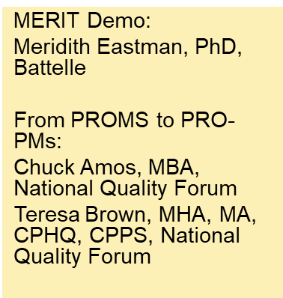
2022 MERIT Demonstration and
From PROMs to PRO-PMs
Developing Patient-Reported Outcome Performance Measures (PRO-PMs)

Slide 2

MMS Info Session Goals
Part of a larger effort to engage stakeholders and the public in quality measure development.
Additional activities the MMS team leads:
  Annual public webinars on high-priority CMS topics
  Outreach via our stakeholder listserv and
  the CMS MMS listserv
  MMS website updates and maintenance
  Development and promotion of emerging
  tools and resources
  MACRA-specific education and outreach

Slide 3
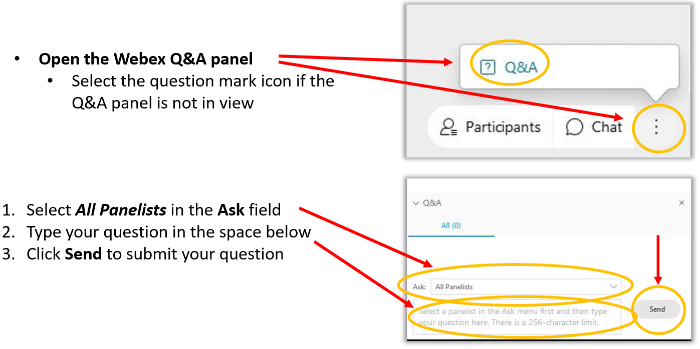
Want to Ask a Question?
Webex Q&A Panel

Slide 4
Agenda
Overview and demonstration of CMS MERIT
Presentation on NQF Report, “Building a Roadmap From Patient-Reported Outcome Measures to Patient-Reported Outcome Performance Measures”

Slide 5
CMS MERIT Overview
What is CMS MERIT?
CMS MERIT Features
CMS MERIT Demonstration
  Logging into MERIT
  Submitting a measure from a previous measure (new for 2022!)
  Other functions
    Changing information you saved (prior to submission)
    Adding or deleting an attachment (prior to submission)
    Viewing the information you submitted
    Exporting/printing a copy of your submission
    Changing the information you submitted
    Adding a co-submitter (new for 2022!)
Help Resources

Slide 6
What is CMS MERIT?
The Centers for Medicare & Medicaid Services (CMS) MUC Entry/Review Information Tool (CMS MERIT) is the tool for measure developers to submit their clinical quality measures for consideration by CMS.
CMS MERIT is also used for facilitating searches of measures from the current and previous years and structuring the workflow for CMS review of measures submitted to the MUC List.

Slide 7
CMS MERIT Features
CMS MERIT offers several features that will improve the MUC List entry and review process, including:
  Automatic check of completeness for required measure information;
  Ability to save partial information and log back in at a later time to finish the submission;
  Ability to track submissions through the review process; and
  Easy-to-navigate interface.
Required Fields are marked with an *
  Information in the mandatory fields will be used to enhance CMS and the Measure Application Partnership’s (MAP) assessment of measures.

Slide 8

CMS MERIT Demonstration
Navigate to https://cmsmerit.cms.gov/ for demonstration

Slide 9
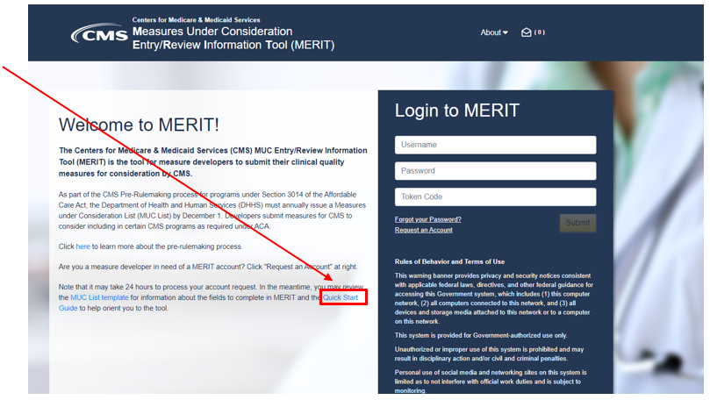
Help Resources
Quick Start Guide available for download on CMS MERIT log in page
Contact MMSsupport@battelle.org for:
  Questions about MUC List requirements
  CMS MERIT technical issues

Slide 10
Measures Management System Information Session
Building a Roadmap From Patient-Reported Outcome Measures to Patient-Reported Outcome Performance Measures
February 23, 2022
http://www.qualityforum.org

Slide 11
The National Quality Forum: A Unique Role
History: Established in 1999, NQF is a nonprofit, nonpartisan, membership-based organization.
Consensus-Based Entity (CBE): NQF brings together public and private sector stakeholders to reach consensus on healthcare performance measurement. The goal is to make healthcare in the U.S. better, safer, and more affordable.
For more than 20 years, National Quality Forum and our members have been at the forefront of advancing healthcare quality while tackling the healthcare system’s most urgent needs.

Slide 12

OUR MISSION
The trusted voice
driving measurable health improvements

Slide 13

OUR VISION
Every person experiences high value care and optimal health outcomes

Slide 14

OUR VALUES
Collaboration
Leadership
Passion
Excellence
Integrity

Slide 15
Background

Slide 16
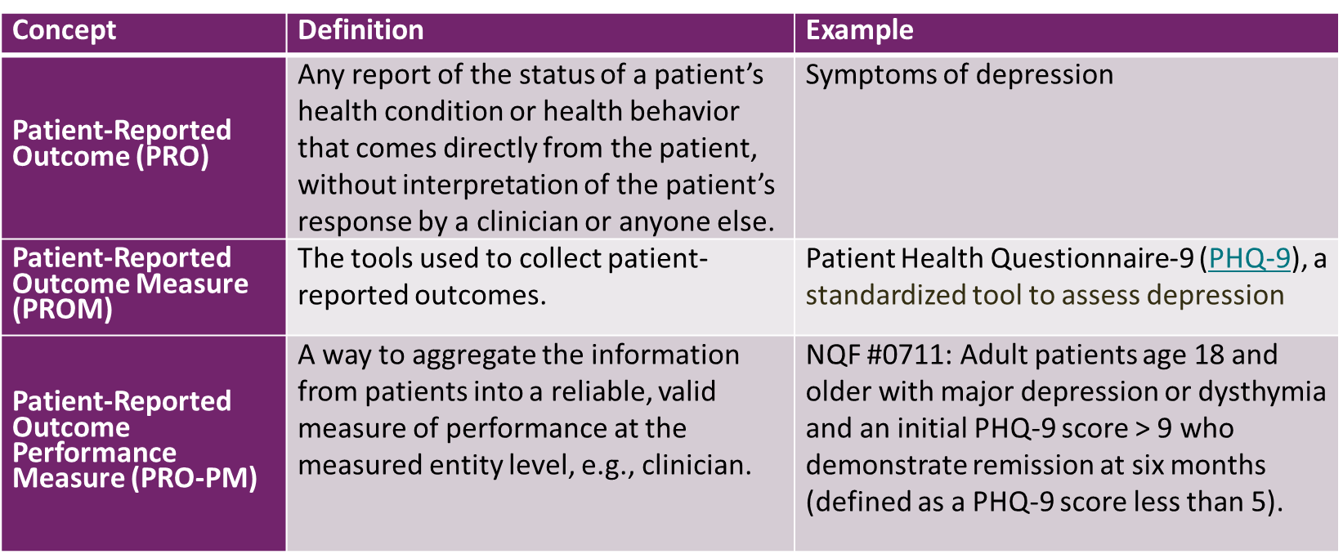
Background: Terminology
CMS. Supplemental Materials to MMS Blueprint: Patient Reported Outcome Measures.; 2021:6. https://www.cms.gov/files/document/blueprint-patient-reported-outcome-measures.pdf.

Slide 17
Background: NQF/CMS PRO Collaborations
2012: Two NQF-commissioned papers, one on methodological issues in PRO-PMs and one on PRO-PMs for healthcare accountable entities
2013: Final report, Patient Reported Outcomes (PROs) in Performance Measurement, from NQF Technical Expert Panel (TEP); articulates guiding principles and a detailed pathway of taking a PRO to a PRO-PM, steering toward a person-centered approach
2019: Final report, PROs: Best Practices on Selection and Data Collection, from NQF TEP; focuses on selecting and using PROs and PROMs in clinical settings
2020-2022: Building a Roadmap From PROMs to PRO-PMs (project page for current initiative)

Slide 18
Building a Roadmap From PROMs to PRO-PMs

Slide 19
Building a Roadmap: Purpose
There is currently a gap between hundreds of existing PROMs and only a few dozen PROM-based PRO-PMs. This project will provide guidance to developing PROM-based PRO-PMs for use in CMS accountability programs by identifying key attributes of high-quality PROMs and creating guidance on utilizing these PROMs to develop fully tested digital PRO-PMs.
As of today, measures with current NQF endorsement include:
  More than 200 process measures
  Nearly 150 outcome measures
  Only 28 PRO-PMs

Slide 20
Building a Roadmap: Overview
Convened Technical Expert Panel (TEP) of multistakeholder experts to guide the development of three reports throughout 2021:
Environmental Scan Report: current-state of high-quality PROMs and digital PRO-PMs
Interim Report: attributes of PROMs suitable for use in high quality digital PRO-PMs
Technical Guidance: a roadmap for developing fully tested digital PRO-PMs that are suitable for use in CMS Value-Based Purchasing (VBP) programs and Alternative Payment Models

Slide 21
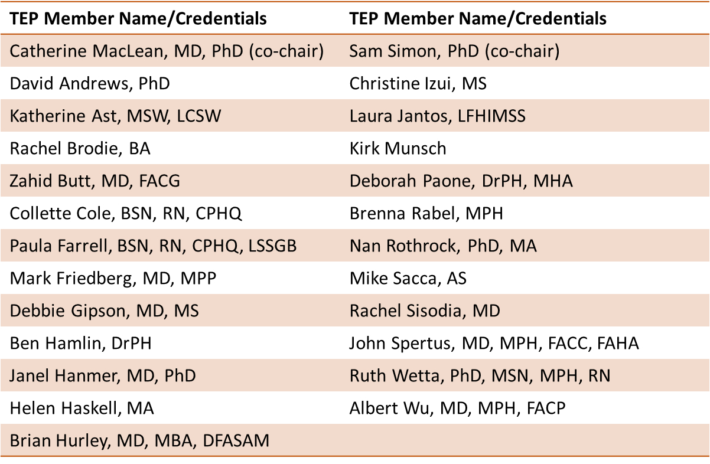
Building a Roadmap: TEP Members

Slide 22
Interim Report: Attributes of High Quality PROMs

Slide 23
Interim Report: Goals
Help measure developers understand what defines a high quality PROM for use in performance measures and what attributes of a high quality PROM are most conducive to the development of a digital PRO-PM that is appropriate for regulatory purposes
The Building a Roadmap initiative does not recommend any PROM, nor does it identify any specific PROM as being “high quality”; NQF does not currently endorse, recommend, rank, or prioritize PROMs
The Interim Report is available on the NQF website

Slide 24
Interim Report: Attributes of PROMs for High Quality PRO-PMs
Covers desired PROs from patient and/or caregiver perspective
Outcome measured in PROM is result of care for which relevant clinical quality is being measured
Interpretable scores, defined and actionable cut points or targets, and anchors and/or defined meaningful change
Clear conceptual and measurement models
Psychometric soundness:
  Reliability
  Validity
  Responsiveness

Slide 25
Interim Report: Attributes (cont.)
Usability/Feasibility of use:
  Low burden (e.g., length, time/effort to complete) and feasibility
  Fits with standard of care and related workflows (e.g., actionable; incorporated and discussed at point of care)
  Cultural appropriateness, language, and translations with culturally appropriate items
  Availability of standardized clinical terminology and codes
  Guidance on standardized data collection (including modes and methods)

Slide 26
Interim Report: Priority Domains for High Impact PRO-PMs
Prioritized Domains:
Health-Related Quality of Life
Functional Status
Symptoms and Symptom Burden
Rationale:
Representation in NQF-endorsed PRO-PMs
Direct assessment of healthcare entity performance
Healthcare entity access to underlying data

Slide 27
Interim Report: Expansion on Past Attributes
The TEP agreed the eight attributes identified in NQF’s 2012 “Methodological Issues” report remain significant, and provided additional explanations and supporting information related to these attributes
The TEP identified additional attributes that have emerged during the past decade as important criteria when selecting PROMs for use with digital PRO-PMs, including the attribute “Availability of Standardized Clinical Terminology and Codes”
Cella D, Hahn EA, Jensen SE, et al. Methodological issues in the selection, administration and use of patient-reported outcomes In performance measurement in health care settings. September 2012. http://www.qualityforum.org/WorkArea/linkit.aspx?LinkIdentifier=id&ItemID=72156

Slide 28
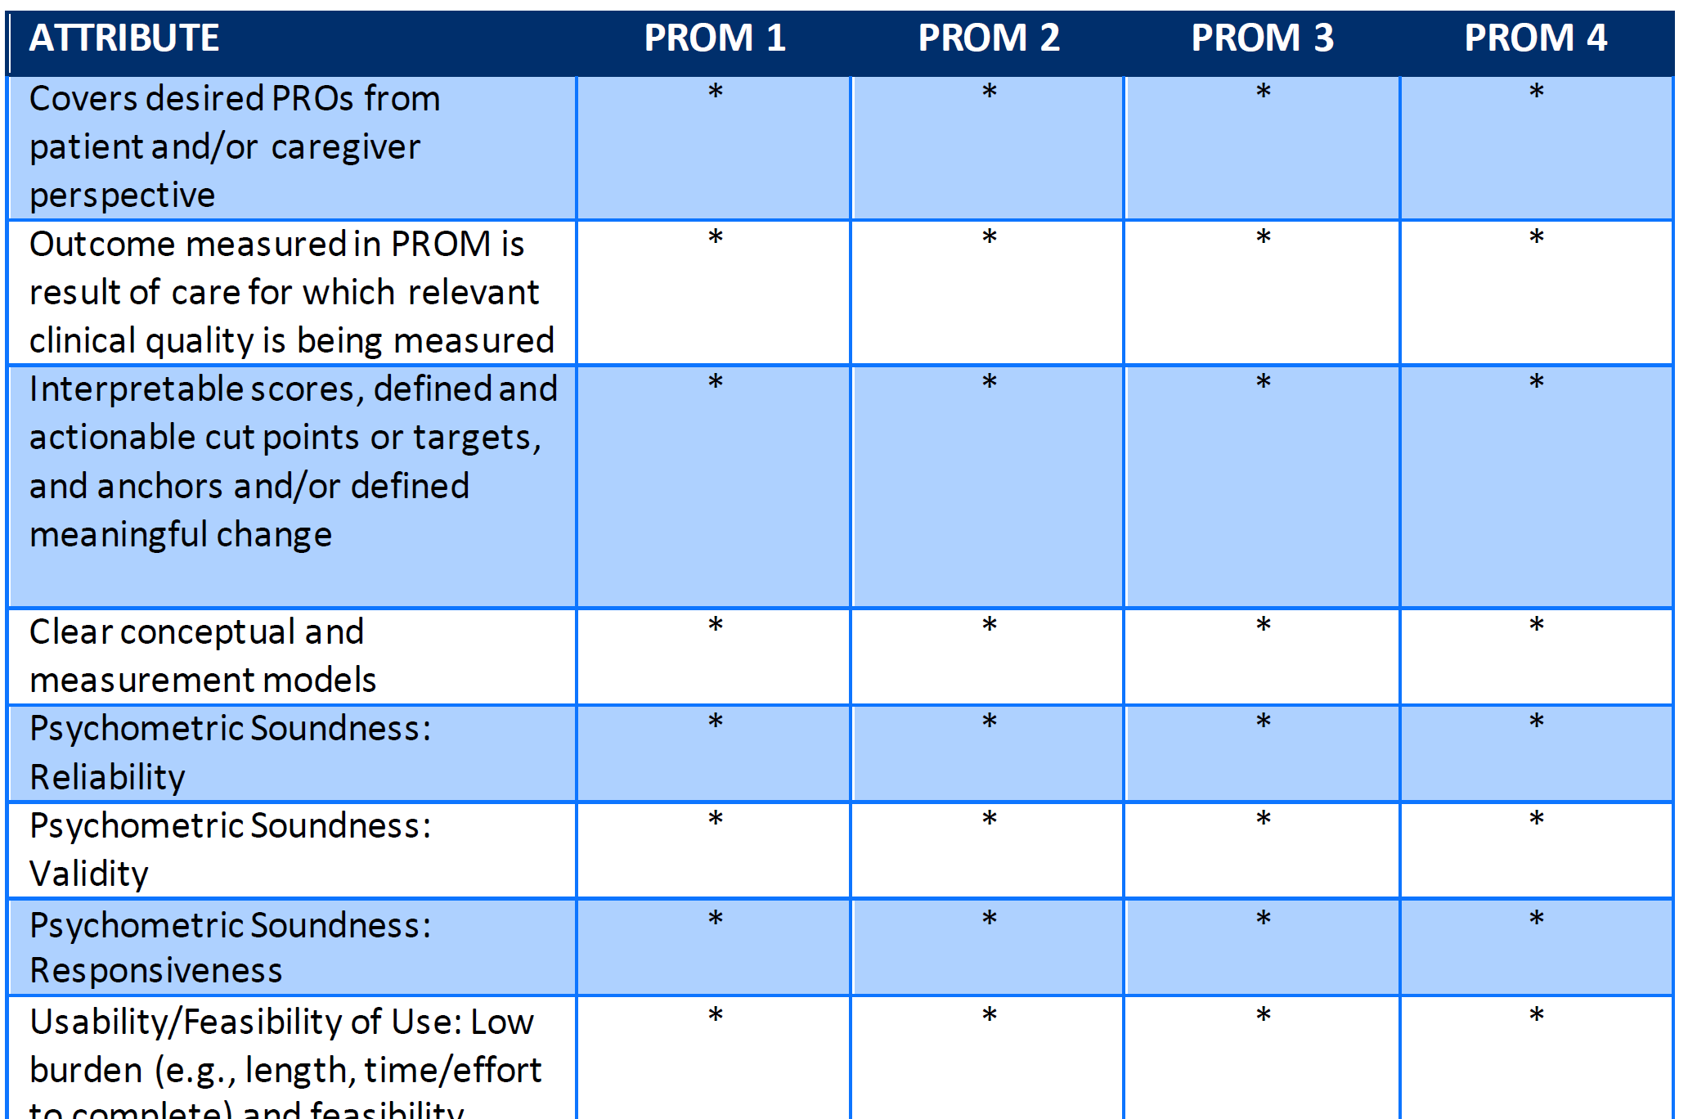
Interim Report: Attribute Grid
The Interim Report presents the attributes in a format that allows measure developers to directly compare and contrast different PROMs to assess suitability for use in digital PRO-PMs
Two Use Cases were prepared by the TEP, using the Patient Health Questionnaire-9 (PHQ-9) and the Kansas City Cardiomyopathy Questionnaire (KCCQ)

Slide 29
The Roadmap From PROMs to PRO-PMs

Slide 30
The Roadmap: Goals
Provide guidance on developing digital PRO-PMs, from the identification of a measure concept and the establishment of a stakeholder advisory group to the preparation for submission for NQF endorsement
Be meaningful to novice and advanced measure developers alike
Present recommendations in a way that allows for flexible development approaches
The Technical Guidance Report is available on the NQF website

Slide 31
The Roadmap: Relationships Between PROMs and PRO-PMs
Most NQF-endorsed PRO-PMs utilize data from a single PROM
  Allows measure developers to select one PROM that is well suited to performance measurement
  Enables specification of the PRO-PM based on the PROM’s data structure, scoring, and cut points (potentially simplifies development)
  Provides for potentially less burdensome maintenance of the PRO-PM
  Requires clinical settings to use a specific PROM regardless of its suitability for the population
There is growing interest in PRO-PMs that utilize data from several different PROMs
  Enables clinical settings to choose the best PROM for the population
  Provides flexibility to use data from multiple PROMs that measure different domains (e.g., health-related quality of life and functional status)
  Requires crosswalks to ensure consistency

Slide 32
The Roadmap: Stages and Tasks
The Roadmap is organized into four stages
  Stage 1: Definition of Measurement Goals
  Stage 2: Exploration and Assessment of PROMs
  Stage 3: Development and Testing of the PRO-PM
  Stage 4: Finalization and Implementation of the PRO-PM
A series of 16 tasks occur within the four stages
Tasks can move across stages, depending on:
  Specific needs of the PRO-PM
  Preferences of the development team
  Policies of the organization

Slide 33
The Roadmap: Stages and Tasks (Visualization)

Slide 34
Year Two Work on The Roadmap

Slide 35
Year Two: Goals
The second year of Building a Roadmap From PROMs to PRO-PMs will revisit and update the first year’s work with additional information on:
  Digital quality measures (dQMs) and digital PRO-PMs
  Mode of PROM administration
  Expanded definitions
  Other information to be determined
Up to nine measure developer reviewers will be invited to suggest improvement opportunities to the Roadmap

Slide 36
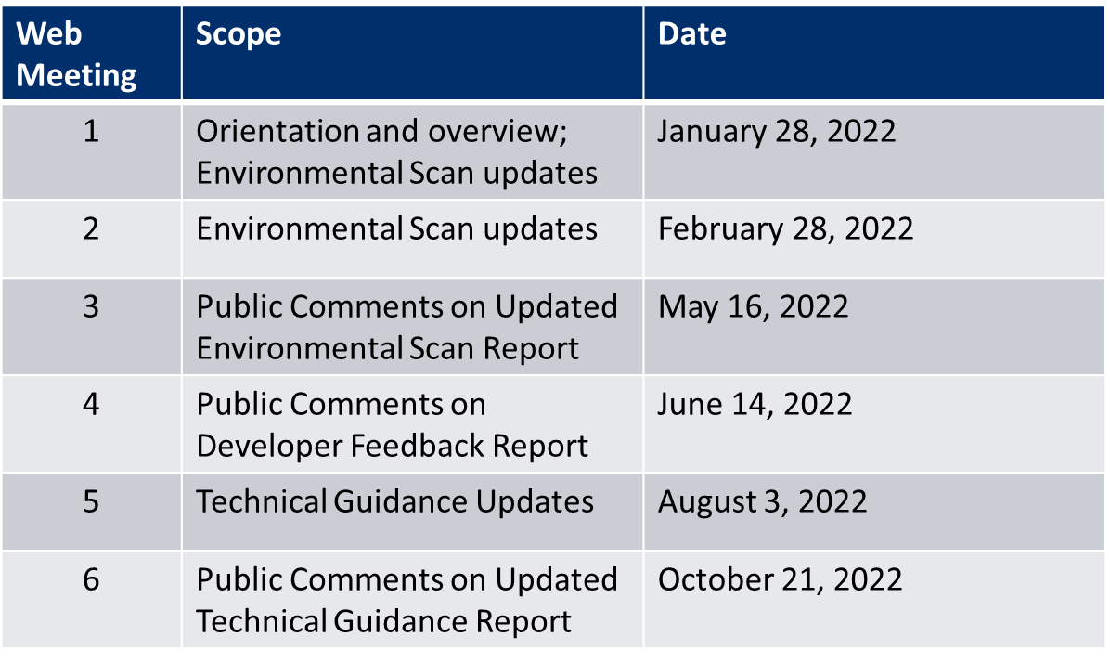
Year Two: TEP Meetings

Slide 37
Year Two: Key Deliverables
Updated Environmental Scan Report: current-state of high-quality PROMs and digital PRO-PMs for CMS regulatory purposes; primary focus for updates will be the current-state of digital measurement
Developer Feedback Report: discussion of user experience with the Technical Guidance and suggestions for new topics to be included in an updated version of the guidance
Update Technical Guidance: revised version of the Technical Guidance Report, or Roadmap; key changes will be based on recommendations from measure developers and expanded information on digital measure development

Slide 38
Questions?

Slide 39

Contact Information

Slide 40

THANK YOU.
NATIONAL QUALITY FORUM
http://www.qualityforum.org

Slide 41
Discussion Questions

Slide 42
Announcements
In case you missed it:
  “Tackling the Complexities Associated with Diagnostic Performance Measurement” https://www.youtube.com/watch?v=JkILFf4QINg&list=PLaV7m2-zFKphUtJHX-mLzNWCMj630UdeF&index=20
Upcoming
  March 30th from 2:00 – 3:00 pm ET learn about CMIT 2.0!

Slide 43
Final Slide with Battelle & CMS Contact Information
Battelle
Kate Buchanan (MMS Information Session Lead)
Contact: BuchananK@battelle.org
Feedback: MMSSupport@battelle.org
CMS
Kim Rawlings (CMS COR)
Contact: Kimberly.Rawlings@cms.hhs.gov

