Slide 1

Meaningful Measures 2.0 + Cascade of Measures
Meridith Eastman, PhD, MSPH, Battelle
Kim Rawlings, CMS
6/29/2022

Slide 2
What is the Cascade of Measures?
The Cascade is a tool for measure prioritization, supporting CMS’s efforts to:
Align or reduce measures where there are too many
Identify gaps where new measures may need to be developed
Help programs move toward measurement of Cascade of Measures Goals and Objectives (e.g., through use of composites)
Notes:
Align/Reduce Measures—The Cascade of Measures tool is a taxonomy for prioritizing measures and supporting different strategic initiatives around alignment and the reduction of measures; a framework to gauge room for alignment in one particular area. For an area with 20 measures under one objective/goal, this signals perhaps we can align some measures and reduce it from 20 to 5.
Identify Gaps—Helps programs in meeting goals/objectives under quality domains towards larger measures such as composites or outcome measures, which previously were process or intermediate outcome measures and therefore measuring larger areas of focus and larger quality topics.

Slide 3
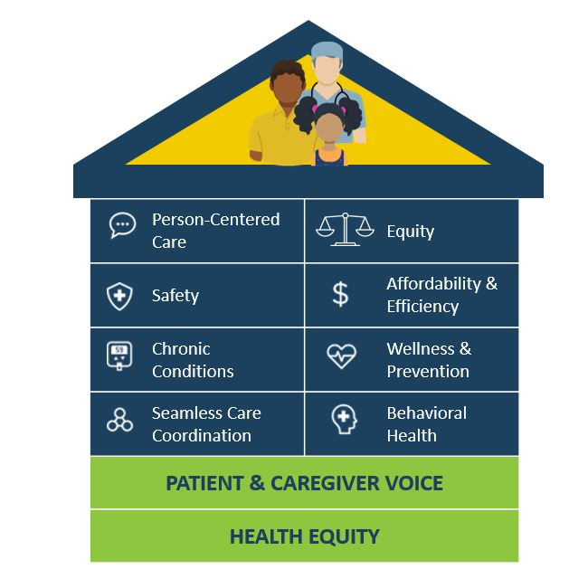
Understanding the Cascade
The Cascade starts with the eight Healthcare Priorities of Meaningful Measures 2.0
Provides a matrix for categorizing critical components of the healthcare system at increasingly granular levels of detail
Notes:
What exactly does CMS means by safety?
What is meant by chronic conditions or seamless care coordination?
What’s important when measuring safety?
What are those quality topics?
What are those objectives/goals when thinking about safety that require measurement?

Slide 4
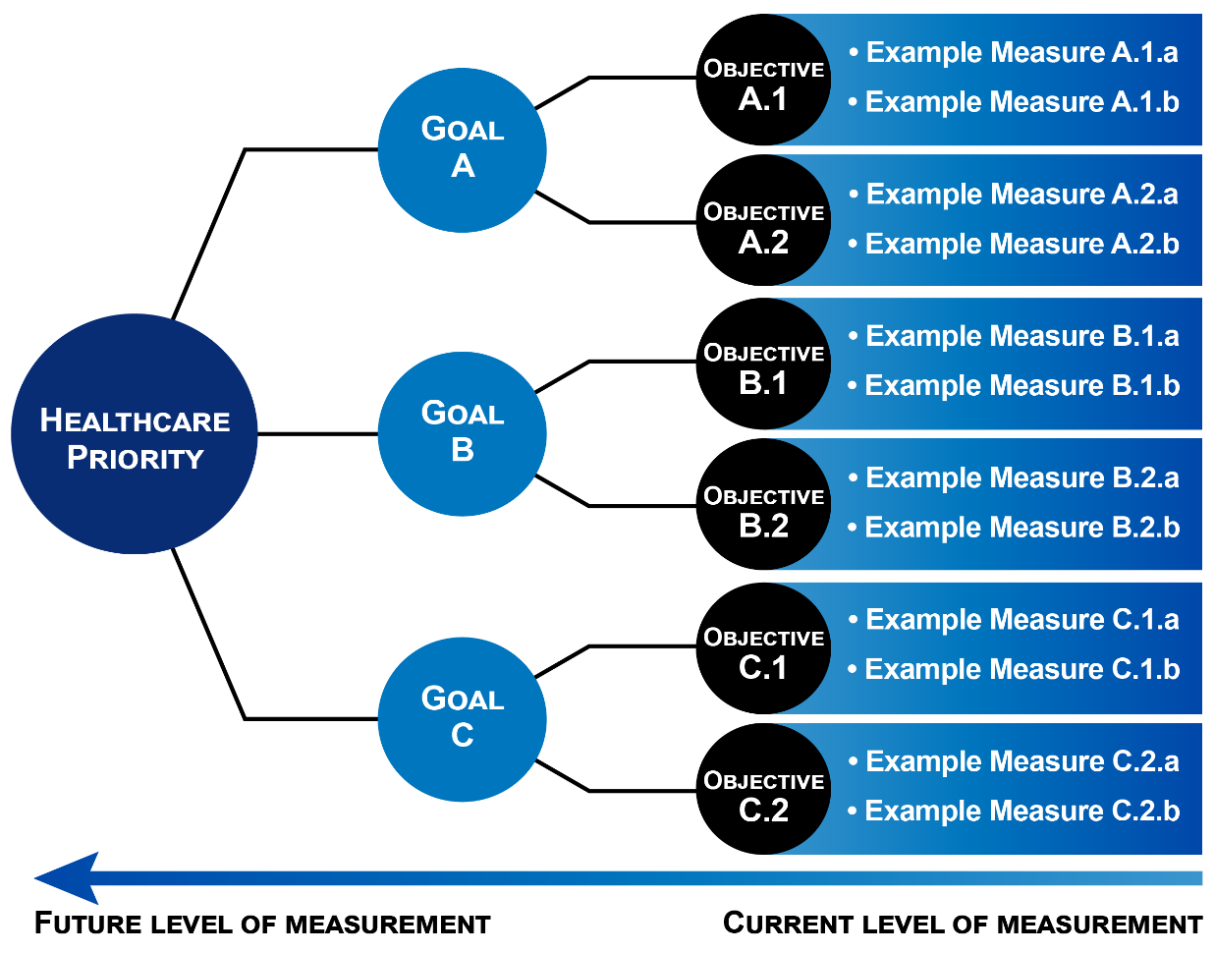
Understanding the Cascade
Each Healthcare Priority has multiple Goals
Each Goal is supported by measurable Objectives
Objectives are composed of resources, processes, and conditions (Measure Families in the CMS Measures Inventory Tool [CMIT]), that are, in turn, assessed in individual measure standards
Notes:
Depicted on the left is the healthcare priority in the dark blue circle, the Meaningful Measures 2.0 starting point. The schematic shows three different goals associated with a healthcare priority. For each goal there are multiple objectives, and for this example we’ve given each goal two objectives. Each objective is associated with measurable measure standards, as defined in CMIT. Additionally, we consulted the grey literature and the peer-reviewed literature.
What are the building blocks of quality?
What are the goals associated with each Meaningful Measures 2.0 healthcare priority?
What are the objectives that support those goals?
The blue arrow at the bottom shows the current level of measurement at this granular bottom-up level looking at the individual measures. The Cascade is a departure in thinking more of these larger categorizations of objectives and goals.

Slide 5
Example Cascade: Safety
Healthcare Priority: Safety
Goal: Reduction in national serious safety events
Objective: Reduction in healthcare-associated infections
Measure Family:
Central Line-Associated Blood Stream Infection (CLABSI) (Example Measure: National Healthcare Safety Network (NHSN) CLABSI Outcome Measure)
Catheter-Associated Urinary Tract Infection (CAUTI) (Example Measure: NHSN CAUTI Outcome Measure)
Clostridioides difficile Infection (CDI) (Example Measure: NHSN Facility-wide Inpatient Hospital-onset CDI Outcome Measure)
Surgical Site Infection (SSI) (Example Measure: Surgical Site Infection)
Methicillin-Resistant Staphylococcus aureus (MRSA) (Example Measure: NHSN Facility-wide Inpatient Hospital-onset MRSA Bacteremia Outcome Measure)
Sepsis (Example Measure: Severe Sepsis and Septic Shock: Management Bundle)
Notes:
Depicted is an example of a safety healthcare priority for a particular goal where the healthcare priority in dark green is safety. The first goal associated with that healthcare priority is the reduction in national serious safety events where one objective in support of this goal is the reduction in HAIs. This is one example of the Cascade.
There are a number of measure families that specify which infections contribute to a reduction in HAI objectives — CLABSI, CAUTI, CDI, SSI, etc. Each may be measured with an individual quality measure in the CMS portfolio.

Slide 6
Cascade Walkthrough
Notes:
Next we will cover the goals and objectives that support the eight priority areas of Meaningful Measures 2.0. We will not cover however the measure family or the individual quality measure level during this presentation, instead keeping it at the level of the goals and objectives.

Slide 7


Healthcare Priority: Safety
Goals | Objectives
Reduction in National Serious Safety Events | Reduction in healthcare-associated infections
 | Reduction in healthcare-associated complications
 | Diagnostic accuracy/error
 | Reduction in medication error
 | Safety of the patient environment
Safety Culture | Electronic health record safety
Safety Culture | Culture of safety
 | Reliability/Resiliency
 | Preparedness
Goals (Cont.) | Objectives (Cont.)
Workforce and Caregiver Safety | Workforce resiliency
 | Staffing
 | Reduction in burnout and turnover
 | Prevention of workplace violence
Safety for Special Populations | Maternal safety
 | Pediatric safety
 | Elder care/Geriatrics/Nursing home residents
 | Safety for individuals with developmental or intellectual disabilities
 | Safety for populations disproportionately affected by poor health outcomes
 | Safety for individuals receiving home and community-based services (HCBS)
Notes:
Safety Culture—How a healthcare organization’s management actions, the norms, the processes and practices connect to individual safety, and measures in the culture of safety assess that organizational culture as well as organizational reliability, resilience and preparedness. EHR safety refers to the use of Health IT to minimize risk, including the generation of accurate, reliable and timely data.
Workforce/Caregiver Safety— Supported by workforce and caregiver resilience, characterized by successful adaptation to adversity and fostered by several measurable individual social and organizational factors such as psychosocial support, task mix, and working conditions. Optimal staffing as an objective includes appropriate certifications and patient-staff ratios along with a reduction in burnout and turnover and workplace violence prevention as important measurable objectives to support workforce and caregiver safety.

Slide 8


Healthcare Priority: Person-Centered Care
Goals | Objectives
Optimal Patient Experience | Access and timely care
 | Clear communication
 | Pain management
 | Price transparency and accuracy
 | End of stage/End of life care
Optimal Patient Engagement | Shared decision-making
 | Access to information
 | Care aligned with goals
Optimal Functional Outcomes | Patient-reported functional outcomes
Optimal Home and Community-Based Services | Under development
Notes:
The goals in the darker blue on the left side of the screen are about how well healthcare services and supports allow people to achieve their desired outcomes.
Optimal Functional Outcomes—Includes functional status metrics that assess an individual’s ability to independently carry out basic activities, which includes activities of daily living (ADLs) and instrumental activities of daily living (IADLs).
Optimal Home/Community-Based Services—Should support individual preferences, choice of control and dignity. “Under development” is classified for areas of consultation with stakeholders to identify important building blocks of quality and is the case for the optimal HCBS goal.

Slide 9


Healthcare Priority: Chronic Conditions
Goals | Objectives
Reduced Disease-Specific Mortality | Treatment and Management of: Hypertension Diabetes Acute and chronic kidney disease Cardiovascular disease Cancer Bone and joint Chronic obstructive pulmonary disease/Asthma Stroke/Neurology HIV Hepatitis Multiple chronic conditions Other (e.g., Ophthalmology)
Reduced Preventable Admissions/Emergency department
Evidence-Based Healthcare
Improved Disease-Specific Outcomes
Notes:
The goals and objectives for this healthcare priority are structured differently, since the treatment and management objectives apply to each chronic condition.

Slide 10

Healthcare Priority: Seamless Care Coordination
Goals | Objectives
Optimal Interoperability and Data Availability/ Reconciliation | View/Download/Transmit information
 | Information blocking
 | e-Prescribing
 | Medication reconciliation
Optimal Transitions of Care | Handoffs
 | Ensuring follow-up care
Care Coordination | Coordinated plans developed and followed
Notes:
Optimal Interoperability and Data Availability/Reconciliations—Coordination of care for a person in the healthcare system is often supported through a transfer of Health IT, or health information using EHRs, consumer portals and other technologies.
Optimal Transitions of Care—Objectives related to successful handoffs that identify patients at risk for poor transitions that include comprehensive assessments, care management plans, and communication and follow-up care.
Care Coordination—Considering all goals/objectives under this priority, the seamless care coordination priority includes efforts that leverage technology, as well as other processes and activities to ensure successful transitions of care and coordination.

Slide 11

Healthcare Priority: Equity
Goals | Objectives
Equitable Care | Under development
Equity Data Collection | Data stratification
 | Direct collection of equity data
Identification of Social Risk Factors and Mitigation | Food insecurity
 | Housing insecurity
 | Transportation needs
 | Utility needs
 | Interpersonal safety
 | Social isolation
 | Health literacy
 | Language
Notes:
Equitable Care—Support the delivery of high quality and timely care for all individuals, including individuals disproportionately affected by SDOH for all health episodes in all settings of care. The building blocks of quality for equitable care for measurement are still under consideration.
Data Collection—Support the collection of data and stratify analyses by characteristics that can track care disparities and inequities.

Slide 12

Healthcare Priority: Affordability & Efficiency
Goals | Objectives
Reduced Readmissions Including Observation | Facility-wide all cause readmissions
Readmission including Observation | Disease/Condition-specific readmissions
Appropriate Use of Healthcare Services | Disease/Condition-specific overuse or underuse of resources
 | Appropriate use criteria
Cost | Medicare spending per beneficiary
 | Medicaid spending per beneficiary
 | Total per capita cost
 | Episode-based cost
 | Individuals’ financial burden of care
Price Transparency | Price transparency and accuracy
Rebalanced Long-term Services and Supports | Optimal institutional vs. HCBS balance

Slide 13

Healthcare Priority: Wellness & Prevention
Goals | Objectives
Immunizations | Appropriate vaccination rates
Cancer Prevention | Appropriate screening and diagnostic testing
Nutrition and Physical Activity | Reduced obesity
 | Reduced malnutrition
 | Optimal physical activity
Dental Care | Under development
Contraceptive Care | Under development
Adherence to Guidelines for Preventive Pediatric Guidelines | Developmental screening
 | Anticipatory guidance
Goals (Cont.) | Objectives (Cont.)
Age-Specific Prevention Guidelines Adherence | Appropriate disease/Condition-specific screening
Wellbeing | Cantril’s Ladder/Wellbeing in Nation (WIN)
 | Family resilience
 | Health-related quality of life
Public Health | Surveillance
 | Emergency preparedness
 | Climate change response
Notes:
Here the intent is to capture a holistic view of health and wellbeing across the life course and to include preventive care services that may prevent or enable early detection of disease and reduce the impact of health conditions. The array of goals reflect prevention activities, including things like immunizations, cancer prevention, nutrition and physical activity, dental care, contraceptive care, as well as adherence to age and developmentally appropriate guidelines. icon of shield and caduceus
Wellbeing—Intended to consider national and community contexts, family resilience and individual life satisfaction and health-related quality of life.
Public Health—Delves into activities of the public health infrastructure that support community and individual health.

Slide 14

Healthcare Priority: Behavioral Health
Goals | Objectives
Suicide Prevention | Suicidality prevention and treatment
Substance Use Disorders Prevention and Treatment | Alcohol, tobacco, and illicit drug use
Opioid Use and Disorders Prevention and Treatment | Opioid use/Patient
 | Opioid prescribing/Provider
Mental Health Disorders Screening and Treatment | Depression screening and treatment
 | Anxiety screening and treatment
 | Dementia/Alzheimer’s/Altered mental state screening and treatment
 | Bipolar disorder screening and treatment
 | Schizophrenia screening and treatment
Optimal Physical Health for Individuals with Serious Mental Illness | Integrated physical and behavioral healthcare

Slide 15
Cascade of Measures Goals
Prioritize measures in development and in use
Identify opportunities for measure removal and new measure development
Shift thinking around the CMS measure portfolio
Begin thinking through measurement at the Cascade of Measures Goal and Objective levels rather than taking a ground-up approach focused on individual measures and Measure Families
Notes:
Prioritize measures in development and in use and identify opportunities for measure removal and alignment—Cases where we have multiple measures in the same goal or objective, or places where there are too many measures.
You may be aware of new goals and objectives for which we currently do not have quality measures in development. We seek areas where there are no measures/too few measures to assess the building blocks of quality. We suspect the Cascade of Measures will begin to shift this thinking around the CMS measure portfolio. The intention is that the achievement of these goals will facilitate the reduction in the number of measures in CMS programs and support the alignment and better reflect priorities overall.
Can we start thinking about measurement at the goal/objective level right off the bat?
Rather than taking a roundup approach focused on individual measures and measure families?

Slide 16
Cascade of Measures Next Steps
Continue to refine Goals and Objectives with stakeholder input
Develop definitions for Healthcare Priorities and other key terms
Programs will begin using the Cascade to analyze the portfolio and set priorities, providing feedback on draft mapping of measures to Cascade categories
Ultimately, placement of measures within the Cascade will be recorded in CMIT
Notes:
Began an examination of the peer-reviewed/grey literature to identify the goals/objectives for each healthcare priority.
Conducted multiple rounds of stakeholder input to help refine the framework moving forward by further fleshing out the objectives marked as “under development.”
Developed definitions for not just healthcare priorities — the top level of analysis — but also key terms used in the Cascade in an effort to finalize them to help convey what the healthcare priority area is intended to capture.

Slide 17
Resources and References
Meaningful Measures 2.0
https://www.cms.gov/medicare/meaningful-measures-framework/meaningful-measures-20-moving-measure-reduction-modernization
Cascade of Measures
https://www.cms.gov/medicare/meaningful-measures-framework/cascade-measures
Centers for Medicare & Medicaid Services Measures Inventory Tool (CMIT)
https://cmit.cms.gov/

