Slide 1

Quality Measures in Action
How CMS Uses Quality Measures to Inform the Public and Drive Quality Improvement
Presenters
Kate Buchanan, Battelle
Dan Andersen, RELI Group

Slide 2
Goals and Objectives
Presentation will demonstrate how CMS:
Uses quality measures across its centers and programs to improve care quality;
Provides measures information available to help persons and families make informed care choices
Participants should understand:
How CMS uses quality measures in its programs
How various quality measure stakeholders can use measure information

Slide 3

Overview of CMS Quality Measures: How They Are Used, Reported, and Shared with the Public

Slide 4
CMS Quality Reporting and Value-Based Care Programs
CMS administers quality reporting programs (QRPs) and value-based care programs (VBPs)
Goal of programs is to improve healthcare for Medicare and Medicaid beneficiaries
Both programs collect performance data from participants
VBPs provide incentivized payments to facilities and clinicians based on reporting or performance
QRPs encourage quality improvement through measurement and provide transparency by publicly displaying data
Notes:
Quality reporting programs cover a range of healthcare settings to encourage quality improvement through a variety of levers. These include payment incentives, payment reductions and public reporting.

Slide 5
CMS Measure Portfolio
CMS has 26 Quality Programs with a total of 686 measures that fall into six health care quality categories:
Patient Safety
Person and Family Engagement
Communication and Care Coordination
Effective Prevention and Treatment
Working with Communities
Affordable Care
Centers for Medicare & Medicaid Services. 2021 National Impact Assessment of the Centers for Medicare & Medicaid Services (CMS) Quality Measures Report. Baltimore, MD: U.S. Department of Health and Human Services; 2021. Accessed August 31, 2022. https://www.cms.gov/Medicare/Quality-Initiatives-PatientAssessment-Instruments/QualityMeasures/National-ImpactAssessment-of-the-Centers-for-Medicare-and-MedicaidServices-CMS-Quality-Measures-Reports
Notes:
Some programs focus on specific care settings, such as the hospital IQR program or the nursing home QRP, while others address specific health conditions such as the ESRD QIP or the HACRP. Still others focus on larger structural challenges or cost reduction; for example, the MSSP and the Medicare promoting interoperability program.
Lastly, the six healthcare quality categories listed on the slide help to advance the goals of each quality program by enabling the collection of data to inform quality improvement efforts.

Slide 6
Measure Types
Of the 686 measures
316 are Outcome or Cost
e.g., CMIT# 0434 Medicare Spending Per Beneficiary (MSPB) – Hospital
357 are Process
e.g., CMIT# 0332 Documentation of Current Medications in the Medical Record
13 are Structure
e.g., CMIT# 0652 Plan Makes Timely Decisions about Appeals
Centers for Medicare & Medicaid Services. 2021 National Impact Assessment of the Centers for Medicare & Medicaid Services (CMS) Quality Measures Report. Baltimore, MD: U.S. Department of Health and Human Services; 2021. Accessed August 31, 2022. https://www.cms.gov/Medicare/Quality-Initiatives-PatientAssessment-Instruments/QualityMeasures/National-ImpactAssessment-of-the-Centers-for-Medicare-and-MedicaidServices-CMS-Quality-Measures-Reports

Slide 7
Quality Reporting Programs
Examples of quality reporting programs
End-Stage Renal Disease Quality Incentive Program (ESRD QIP)
Health Insurance Marketplace Quality Initiatives
Hospital Inpatient Quality Reporting (IQR)
Innovation Center (CMMI) Models
Comprehensive list on MMS Hub

Slide 8
How CMS Uses Quality Measures
Quality measures support CMS priorities in a couple of ways
Offer incentives to promote the delivery of high-quality care
Help consumers make informed choices about where to seek care
Four ways CMS leverages quality measures
Reporting programs
Impact Assessment Reports
Care Compare
Provider Data Catalog
Notes:
CMS quality measurement focuses on improving the overall quality of care delivered to patients in the U.S. by making the measure development and selection processes as patient-centered as possible.
Example—CMS aims to drive improvements in aspects of care that are important to patients, which they do by collecting patient input during the measure development and endorsement processes.

Slide 9
Offering Incentives: Quality Payment Program (QPP)
The QPP determines provider payment based on the quality of care delivered
Qualifying clinicians can report data through two pathways
Merit-based Incentive Payment System (MIPS)
Advanced Alternative Payment Models (APMs)
What are the value-based programs? CMS.gov. Accessed August 31, 2022. https://www.cms.gov/Medicare/Quality-Initiatives-Patient-Assessment-Instruments/Value-Based-Programs/Value-Based-Programs.
Notes:
Beginning in 2023 clinicians may report via MIPS Value Pathways (MVPs) which is a subset of measures and activities. Clinicians can also participate and report measures for APMs to be eligible for financial incentives and burden reduction. For example, this is through an exception from MIPS reporting and payment adjustments, although this may result in financial risks.

Slide 10
Helping Consumers: Part C and D Star Ratings
CMS produces Star Ratings for Medicare Advantage (Part C) plans and Prescription Drug Plans (Part D) that reflect the quality of health services and consumer experiences
CMS calculates these ratings using performance data from several key quality metrics from relevant programs.
The goal is to aid beneficiaries as they choose the health plan that meets their needs
Fact Sheet - 2021 Part C and D Star Ratings. CMS.gov Accessed August 31, 2022.
https://www.cms.gov/files/document/2021starratingsfactsheet-10-13-2020.pdf
Notes:
Annually, CMS publishes the star ratings for Medicare Advantage Part C plans and prescription drug plans, Part D, to reflect the quality of health services, prescription drug coverage and consumer experiences. Ratings are between 1-5 stars with the higher star rating indicating higher quality of services and consumer experiences compared to those with a lower star rating.

Slide 11
Impact Assessment Reports
Triennially CMS releases The National Impact Assessment of the Centers for Medicare & Medicaid Services (CMS) Quality Measures Reports
The reports evaluates measures currently in use by CMS that support CMS health quality goals:
Safeguards to public health
Meaningful to patients and providers
Minimize burden for providers
Outcome-based when possible
Identify significant opportunities for improvement
Support a transition to population-based payment informed by all-payer data
National Impact Assessment of the Centers for Medicare & Medicaid Services (CMS) Quality Measures Reports. CMS.gov. Accessed August 31, 2022. https://www.cms.gov/Medicare/Quality-Initiatives-Patient-Assessment-Instruments/QualityMeasures/National-Impact-Assessment-of-the-Centers-for-Medicare-and-Medicaid-Services-CMS-Quality-Measures-Reports.
Notes:
The Impact Assessment aids CMS and its stakeholders in its understanding of where measurement has been effective and where it has been topped out, meaning where performance is clearly optimized and therefore measurement is no longer needed, and further clarifying gaps that should be addressed in new and updated measures.

Slide 12
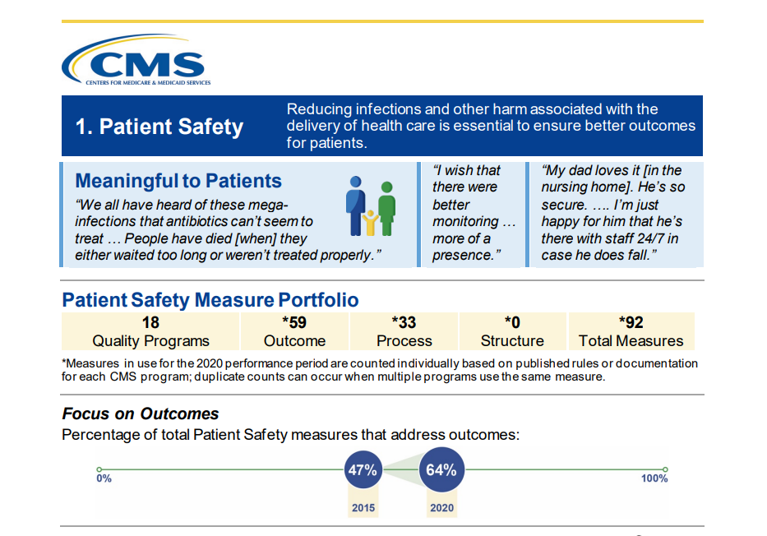
2021 Impact Assessment Report
The Impact Assessment provides a summary of how successfully quality measures have driven improvements in high-priority aspects of care
It also identifies areas where further measure development may be needed
Notes:
Depicted in the illustration above is how CMS implements patient safety measures in 18 quality programs. Since 2016 the number of outcome measures focused on patient safety has increased, along with the inclusion of qualitative feedback that contextualizes these patient safety goals.

Slide 13
Care Compare
Consumer-facing website that contains information to guide patient decision-making about where to seek care
Previously, the information was shared across setting-specific sites (Nursing Home Compare, Hospital Compare, etc.).
As part of a 2020 cross-center initiative to better align quality measure reporting, CMS consolidated the various “compare tools” into Care Compare
Data for the Care Compare measures come from VBPs and QRPs.
Care Compare. Medicare.gov. Accessed August 31, 2022. https://www.medicare.gov/care-compare/.
Notes:
Care Compare is the new paradigm that CMS has been using since 2020 in an effort to better align the types of information presented on the website, as well as providing a central place for users to navigate in search of information, including quality measurement information.

Slide 14
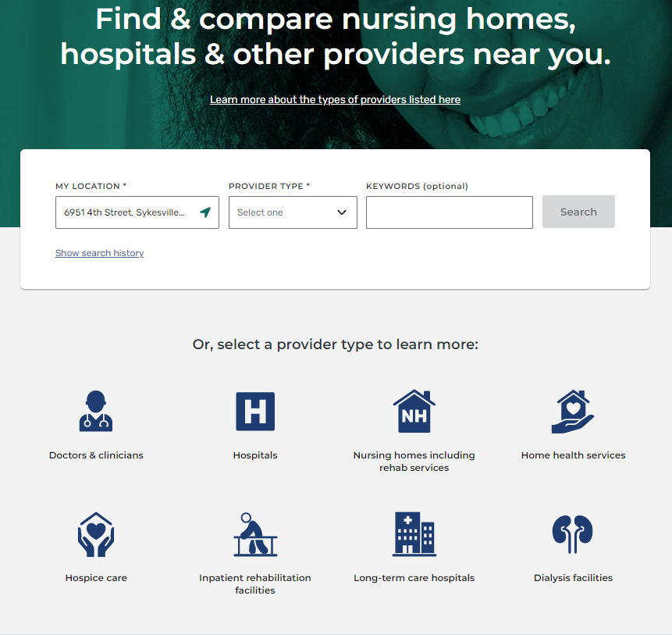
Care Compare
Care Compare is a user-friendly site that allows healthcare consumers to search for providers in their area
Care Compare. Medicare.gov. Accessed August 31, 2022. https://www.medicare.gov/care-compare/.
Notes:
Depicted here is a screenshot of the Care Compare landing page. In the bar in the middle of the graphic is the main functionality for this site specifically for consumers, which enables individuals to search for providers based on their selected geographic locations.
Disclaimer—This information is publicly available. RELI Group is not the business owner of these settings/websites. There are instead dedicated business owners/stakeholders that determine the information that is available and the functionality of the sites.

Slide 15
Provider Data Catalog
Geared toward healthcare providers, researchers, and quality improvement professionals, the Provider Data Catalog contains measure information to be used to drive research and quality improvement
Previously, the information was shared across setting-specific sites
As part of the same 2020 cross-center initiative to better align quality measure reporting, CMS consolidated data reporting sites that were previously shared on data.medicare.gov
As with Care Compare, data come from VBPs and QRPs.
Provider Data Catalog. CMS.gov. Accessed August 31, 2022. https://data.cms.gov/provider-data/.
Notes:
The PDC is the companion site to Care Compare, which contains the same information, but in a more data-heavy format applicable for download, filter and sorting capabilities. The 2020 initiative brought it all under the same umbrella and created the PDC to align, harmonize and streamline this information.

Slide 16
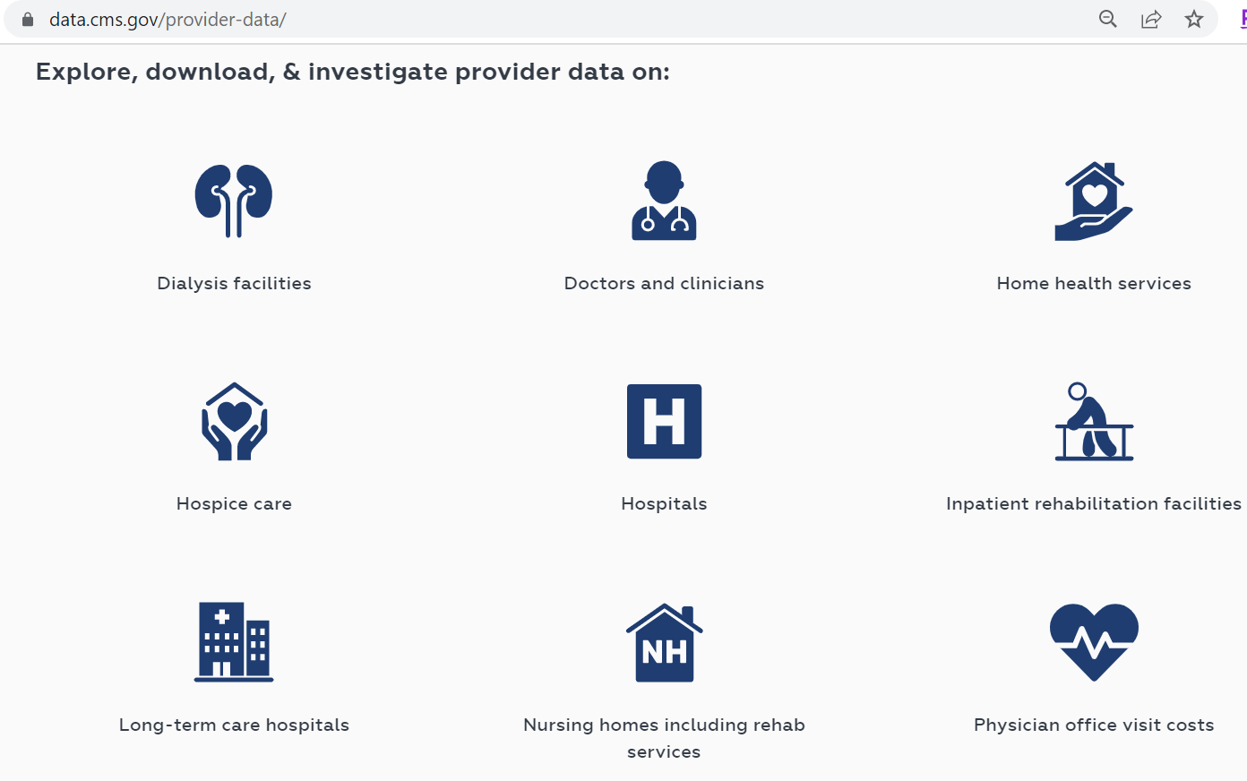
Provider Data Catalog
Users can download and analyze data related to a variety of provider types, all in one place
Supports transparency
Increases the utility of measure data
Provider Data Catalog. CMS.gov. Accessed August 31, 2022. https://data.cms.gov/provider-data/.
Notes:
This again is the landing page for the Provider Data Catalog (PDC) with tabs to “explore, download and investigate provider data.” Here you simply select the provider type to do a deep dive into the data.

Slide 17

Care Compare Overview A powerful tool for consumers

Slide 18
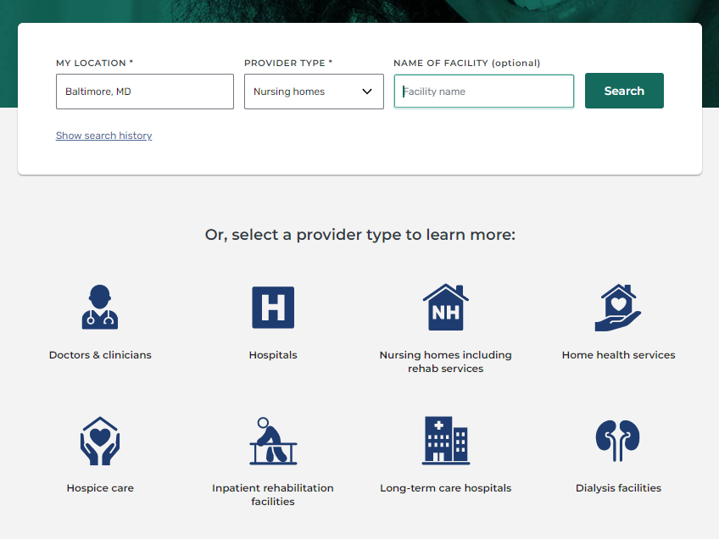
Care Compare Screenshot
Notes:
On this landing page for Care Compare consumers may select a provider based on their geographic area either by zip code, a city/state combination, or state, along with an additional field for provider type. The new site functionality also allows for search histories to be saved for later retrieval.

Slide 19
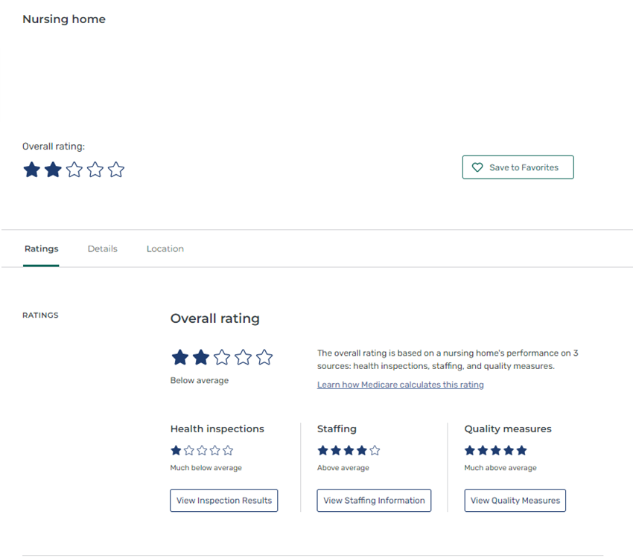
Care Compare Ratings
Notes:
This screenshot illustrates what is typically encountered when selecting an individual nursing home. Normally, where it says “nursing home” it would provide an address and even a phone number and a map. This has been hidden simply for purposes of this presentation. Lastly, CMS provides frequent data updates on these sites, ranging from monthly for nursing homes and quarterly for quality measures.

Slide 20
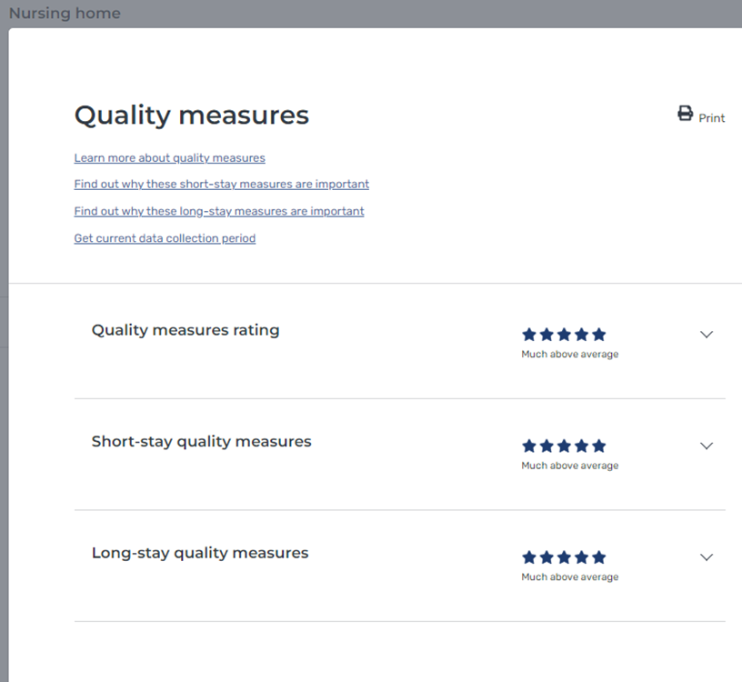
Care Compare Quality Measures
Notes:
If a user clicked on “quality measures” on the previous page, they would reach this screen. In the nursing home space quality measures are categorized by “short stay” and “long stay” measures. They provide an overall quality measure rating, short stay quality measure rating, and long stay quality measure rating. Clicking further would deliver a drop-down of the individual quality measures and how that nursing home fares on these specific measures, as well as a comparison to state or national averages.

Slide 21

Provider Data Catalog Overview Data to drive improvement

Slide 22
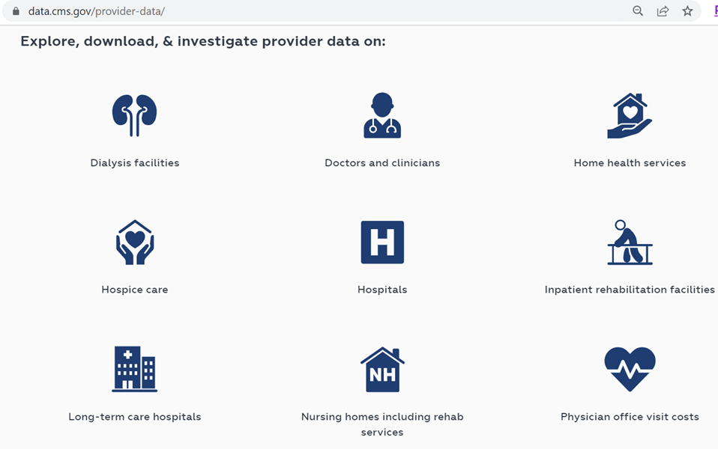
Explore: Provider Data Catalog

Slide 23
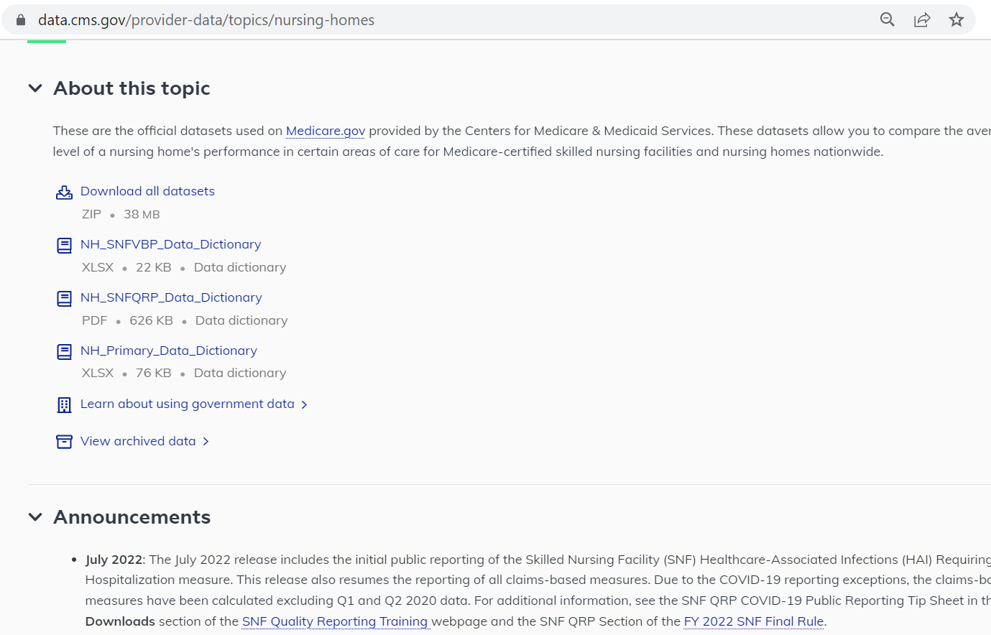
Provider Data Catalog
Notes:
The PDC allows access to all the information required to interpret data on these websites. Users may “download all datasets,” downloaded as a ZIP file. Also included are multiple data dictionaries, along with the SNF VBP and SNF QRP. Also provided is the nursing home primary, which contains information including the star ratings, staffing, and health inspections, etc.
At the bottom CMS makes archived data available whereby a researcher can extract information and manipulate the datasets to generate a longitudinal file, which may prove useful for purposes of quality improvement and research.

Slide 24
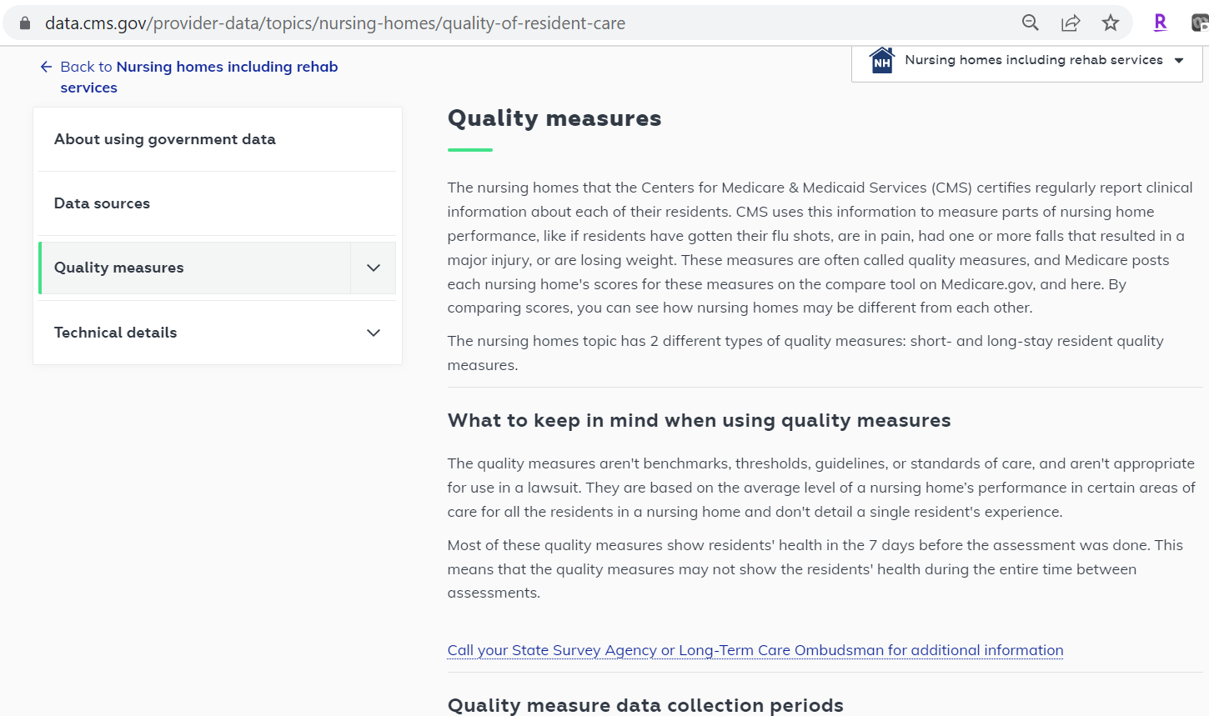
Provider Data Catalog
Notes:
Users here may wish to do a deep dive to learn more about various measures, which includes links to relevant sources of information such as the technical user guide, and quality measures technical guides.
Also on the PDC users can access what’s called the “data explorer.” CMS makes available an interactive dashboard of the data for which users may manipulate the columns by selecting which variables are displayed. Uses may further filter the datasets and export them for download.

Slide 25
Questions

Slide 26
CMS
Gequincia Polk (COR) Contact: gequincia.polk@cms.hhs.gov Melissa Gross (CMS Lead) Contact: Melissa.Gross@cms.hhs.gov
Battelle
Contact: MMSSupport@battelle.org

