Slide 1
Thank you for attending! The presentation will begin soon.

Slide 2
Want to Ask a Question?
Audience questions will be answered during the Q&A session at the end of the presentation.
Instructions on how to submit questions:
Webex Q&A panel
Please feel free to submit questions throughout the presentation

Slide 3
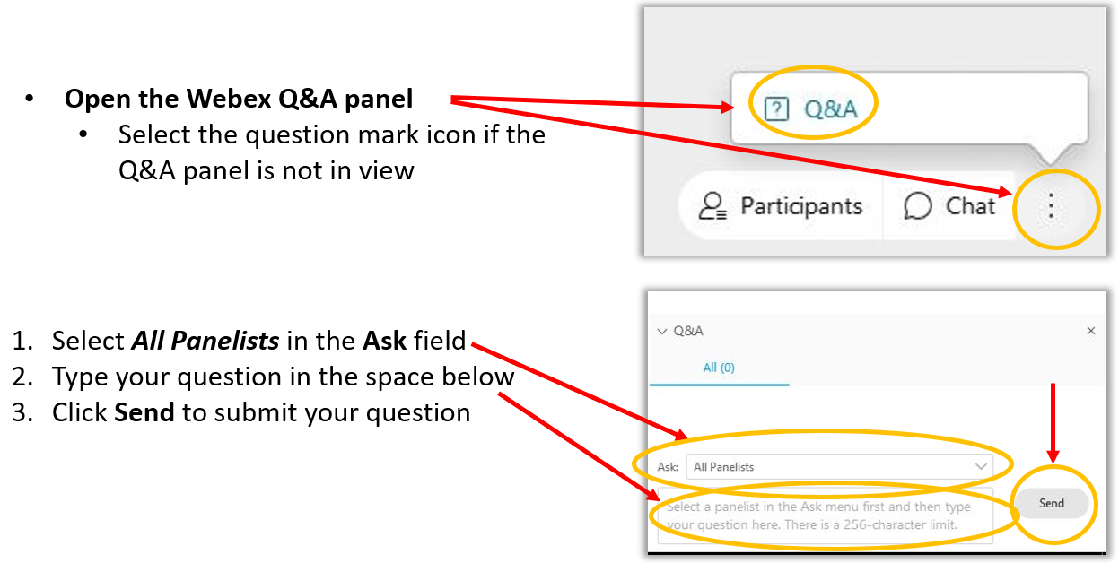
Want to Ask a Question? Webex Q&A Panel

Slide 4
The New CMS Measures Management System Website – The CMS MMS Hub
Speakers
Kathy Lesh, PhD, RN-BC, CPHQ, FAMIA, Battelle
Kim O’Brien, MS, PMP
5/25/2022

Slide 5
Agenda
Modernizing the CMS MMS website
Where to find MMS Blueprint content
Live demonstration
Questions
Wrap-up

Slide 6
Learning Objectives
Become aware of the CMS
MMS Hub
Find Blueprint content on the CMS
MMS Hub
Find public
comment, technical expert panel
opportunities, and updates on the CMS MMS Hub
Know where
to find the CMS
MMS Hub

Slide 7
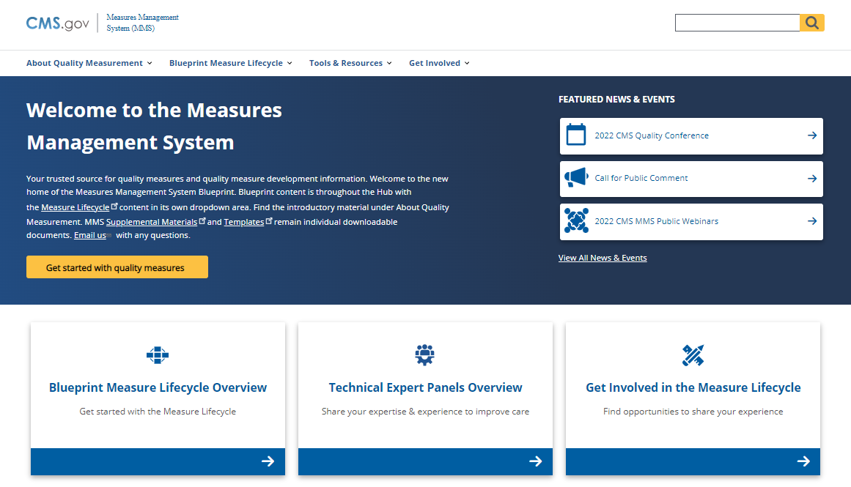
CMS MMS Hub – Now Available!
Launched May 24, 2022
Transforms the MMS Blueprint into a comprehensive, user-friendly website
Integrates the Blueprint content and the previous MMS website for a more streamlined experience
https://mmshub.cms.gov/

Slide 8
Key Features
Rolling Updates
News & Events
CMS MMS Hub
Interactive Blueprint Content
Quickly Access Stakeholder Opportunities

Slide 9
Demonstration
Live Demo

Slide 10
Goals for MMS Hub
Become the primary source for quality measurement education and engagement opportunities
Modernize technical guidance for measure developers so it is easy to search and find meaningful resources
Better connect individuals, families, and others with opportunities to participate in measure development and maintenance
Evolve and be responsive to our stakeholders’ changing needs

Slide 11
Questions
We look forward to your comments and suggestions.
Please email us at MMSsupport@battelle.org
Thank you for your time!

Slide 12
Key Points of Contact
Melissa Gross, CMS Lead
melissa.gross@cms.hhs.gov
Kathy Lesh, Content Lead
lesh@battelle.org, 240-508-3232
Kim O’Brien, CMS MMS Hub lead
obrienk@battelle.org, 410-372-2709

Slide 13
Announcements
In Case You Missed It
April MMS Information Session on “Electronic Clinical Quality Improvement (eCQI) Resource Center Updates”
April CMS MMS Public Webinar: “Rural Health: How CMS Initiatives Improve the Way We Measure and Address Gaps in Care”
Upcoming MMS Information Session
The Cascade of Measures: A Tool for Measure Prioritization
3 - 4 p.m. (ET) June 29

Slide 14
CMS
Melissa Gross (CMS Lead)
Contact: Melissa.Gross@cms.hhs.gov
Battelle
Contact: MMSSupport@battelle.org

