Slide 1
Population Health Measures
What they are and why they matter
Presented by:
Brenna Rabel, Battelle

Slide 2

MMS Info Session Goals
Part of a larger effort to engage stakeholders and the public in quality measure development.
Additional activities the MMS team leads:
  Annual public webinars on high-priority CMS topics
  Outreach via our stakeholder listserv and
  the CMS MMS listserv
  MMS website updates and maintenance
  Development and promotion of emerging
  tools and resources
  MACRA-specific education and outreach
Notes:
CMS is committed to providing Education and Outreach opportunities about the quality measure development process to interested stakeholders to improve understanding of the process. CMS also seeks continual feedback to improve and/or expand its offerings to the healthcare quality measure development community and interested stakeholders.
To date, CMS has implemented an Education and Outreach webinar series and has created resource materials that break down and explain various components and challenges in the measure development process. There are dedicated websites, listservs, and roadmap documents that are available to support those that are working in quality measure development, or are just curious and want to learn more about how it is done.

Slide 3
Presentation Objectives
By the end of this presentation, you will know:
  What population health measures are and why they are important
  2020 population health measure gaps and available tools to assist in identifying population health measure needs
  Important population health specific factors to include in measure creation/implementation

Slide 4
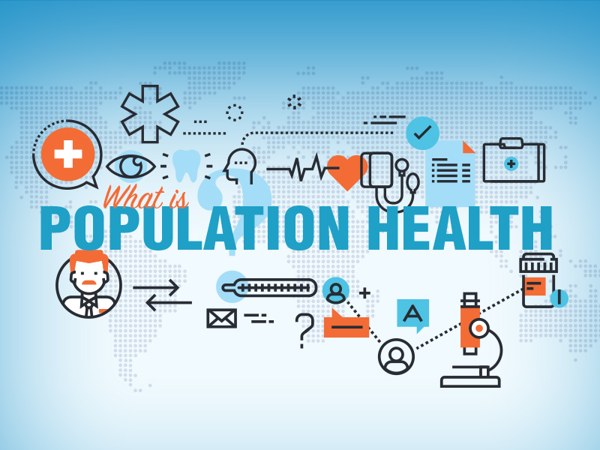
What is Population Health?
Population health refers to health behaviors and outcomes of a broad group of individuals
Population-level outcomes should be measured with characteristics of the population in mind
Note: Per CMS, "population" does not mean "everyone". A population still needs to be clearly specified using the measure denominator.
Image Source: www.umc.edu
Notes:
Population health is not synonymous with public health, but refers to overall health behaviors and outcomes of a broad but clearly defined group of individuals with outcomes measured with those characteristics of that population in mind.
Example—A population may be all Medicare beneficiaries 65 and older, or more narrowly defined as Medicaid and/or Medicare beneficiaries with severe mental illness. When tracking outcomes for either population it’s important to consider their unique characteristics.

Slide 5

What is a Population Health Measure?
Population health measures are a broadly applicable indicator that reflect the quality of a group’s overall health and well-being.
  Examples of measure topics include access to care, clinical outcomes, coordination of care and community services, health behaviors, preventive care and screening, and utilization of health services
Image Source: Healthanalytics.com
Notes:
Population health measures alone or grouped should define the health status of the measured population, for which screening and outcome measures are especially useful — measures that gauge the percent of a population adhering to vaccinations, screening guidance, or a percentage of patients that avoid complications due to diabetes.
Measures that evaluate specific processes limited to clinical settings are not considered population health measures. A measure that looks at average time between arrival to an emergency department and a CT scan is an important measure of clinical quality, but does not offer anything about the health of any population.
Population health measures and CQMs are not mutually exclusive. A measure that assesses population health outcomes can be an indicator of clinical quality and falls into both categories, and the same applies for screenings, wellness visits, vaccinations, etc.

Slide 6
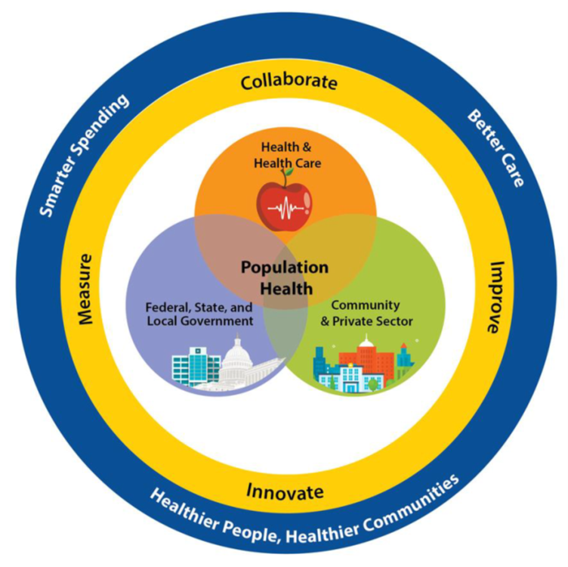
Approach to Population Health
Measurement and Improvement
The population health of a group is dependent upon the interplay of several factors, of which clinical care is only a portion
  Other factors include: economic, social, environmental, cultural, behavioral
Population health improvement requires a multisector approach
Image Source: Blueprint
Notes:
Population health is dependent upon a range of factors, not limited to clinical settings.
Links exist between environmental factors, such as with air quality that impact rates and severity of diseases like asthma.
Economic/social factors such as poverty or homelessness can drastically impact access to care and long-term health outcomes.
Access to reliable transportation can strongly impact how well patients adhere to follow-up care and guidance.
A multisector approach linking the healthcare system with community/private sector partners, as well as federal, state, tribal and local government is ideal.
Most quality measures rely on data from claims/EHRs which do not include information from other entities.
The goal with population health measurement is to think broadly about a population to understand the extent to which there is engagement in good health behaviors that results in an experience of positive health outcomes.

Slide 7
Population Health vs. Public Health
Population Health
Health outcomes of a group of individuals
  Can be broad, e.g., all Medicaid beneficiaries
  Or narrow, e.g., Medicare beneficiaries with osteoarthritis of the knee
Population health outcomes are the product of multiple determinants of health, including:
  Policies,
  Clinical care
  Public health,
  Genetics
  Behaviors (e.g., smoking, diet)
  Social factors (e.g., employment, poverty)
  Environmental factors (e.g., food, water safety)
  Distribution of disparities in the population
Public Health
Focus on protecting the health of entire populations.
Public health activities include population-based disease prevention and health promotion programs/policies that extend beyond medical treatment by targeting underlying risks.
Examples of public health activities include:
  Immunizing and controlling infectious diseases.
  Ensuring motor vehicle safety.
  Ensuring workplace safety.
  Ensuring food safety.
  Sanitizing water.
  Protecting maternal and child health and access to family planning.
  Preventing chronic disease.
https://www.astho.org/Health-Systems-Transformation/Medicaid-and-Public-Health-Partnerships/Learning-Series/Public-Health-and-Population-Health-101/
Notes:
Population Health—Is a more narrow category than public health with a different focus and concerned with the health outcomes of a group of individuals.
Public Health—Focus on protecting the health of entire populations and involves activities that extend beyond the provision of medical care.
While public health practitioners use metrics to evaluate the success of their interventions, they are not metrics that fall under the direct purview of CMS and other payers. The focus here is on the delivery of high quality healthcare and on measures of population health that are based in part on the healthcare data.

Slide 8
Population Health Measure Gaps
In the 2020 Annual Report to Congress, NQF Prevention and Population Health Standing Committee Identified seven population health measure gaps:
Measures that focus on:
Pediatric population and neurological conditions (e.g., stroke performance and care, emergency response, rehabilitation, etc.)
Consideration of physical and occupational therapy as it relates to neurological conditions
Perinatal and woman's health
Provider “burnout”, including those tied to payer-managed care
Care integration between mental health, substance use disorders, and physical health (e.g., primary care)
Disparities and social determinates of health (e.g., adequate housing, employment, and transportation)
Care coordination across the life span
Notes:
Care Integration:
In order to understand how effectively the healthcare system is treating patients with mental illness, we must promote and measure the extent to which healthcare systems are effectively integrating mental and physical healthcare for patients in both areas.
Knowing patients’ conditions at discharge from an inpatient psychiatric facility provides little about the overall health or quality of care for this population. Instead, most informative is the extent to which patients received follow-up care in an ambulatory setting, or are adhering to their prescribed treatment plans.

Slide 9
Approaches to Measuring
Population Health
Three approaches to measuring population health:
  Aggregating health outcome measurements made on people into summary statistics, such as population averages or medians
  Assessing the distribution of individual health outcome measures in a population and among specific population subgroups
  Measuring the function and well-being of the population or society itself, as opposed to individuals

Slide 10
Approaches to Measuring
Population Health
In 2013, the Institute of Medicine, identified criteria for selecting and prioritizing measures of quality for use in population health improvement:
Conditions or outcomes for measurement should be:
Reflective of a high preventable burden
Actionable at the appropriate level for intervention
Measures should be:
Timely
Understandable
Usable for assessing various populations
Accepted and harmonized
Methodologically rigorous
Notes:
Population health measures should be actionable in ways that allow experts to make inferences about how improvements to care may improve outcomes for that population.
Measures should be timely and accepted by the scientific community at large and understandable to relevant stakeholders.
They should be based using strong methodology that assesses the health of a given population.
The measured conditions/outcomes should be reflective of preventable burden and actionable at the appropriate level for intervention.
The actionability should be within the control of the person being measured, as in the case of provider accountability in improving the health of a population.
Any affected population measure should yield information that drives further improvement.

Slide 11
Unique Considerations for Conceptualization
Population health measures should identify opportunities for improvement at the population level, rather than only seeking to identify gaps or variations in clinical care.
Although population health improvement is a priority goal, there are limited incentives tied to improvements or disincentives to worsening of population health. This creates challenges for making a business case.
The focus of population health measures differs from clinical quality measures.
Notes:
Most quality programs are geared towards creating incentives tied to improvements in care within specific care settings. When developing a population measure for use in a CMS program, consider whether changes in clinical care will drive improvements in the population outcome being measured. If that connection can be established, then you’re well on your way to conceptualizing the business case.

Slide 12
Measure Conceptualization Tools
Environmental Scan
Measure developers need to expand their environmental scan search criteria beyond their usual sources for quality measures, e.g., the CMS Measures Inventory Tool and NQF Quality Positioning System.
Organization for Economic Co-operation and Development (OECD) has 80 key indicators for population health and health system performance that could provide insights to population health needs.
Community Health Needs Assessment
The Patient Protection and Affordable Care Act of 2010 requires a community health needs assessment (CHNA) and implementation strategy every three years for all Section 501(c)(3) nonprofit hospitals (charitable hospitals) working with public health agencies and community members
The IRS requires hospitals to submit their needs assessment and implementation strategy with their IRS Form 990 and provide an annual description of how the hospital is addressing the needs identified in their CHNA and implementation strategy.
Notes:
Environmental scan—How do we identify population health gaps and what’s actually reasonably measurable? Begin with an environmental scan to identify similar or related measures, since this is a crucial part of any measure development effort.
Community Health Needs Assessment—Is used to identify the health needs of a community served by a given hospital and helps develop an implementation plan to address those needs. What is required are metrics to determine if the implementation is successful, which developers of population health measures may use as a starting point for development.

Slide 13
Measure Conceptualization Tools Cont.
Research Social Determinants of Health and Social Risk Factors
Research into effects that Social Determinants of Health and Social Risk Factors can also provide measure developers with ideas for population health measures.
Example:
A recent study has shown that when state and local governments increase spending on non-healthcare services (e.g., education, social services, environment, and housing) infant mortality rates in high-risk populations has gone down.
Healthy People
Healthy People 2020/2030 provides a set of broad population level goals and objectives broken down into five categories: health conditions, health behaviors, populations, settings and systems, and social determinants of health
Healthy People 2020 also addresses SDOH and includes a list of examples of social determinants and links to other federal SDOH initiatives with multiple objectives: economic stability, education access and quality, healthcare access and quality, neighborhood and built environment, and social and community context. and resources. Healthy People 2030 identifies five SDOH domains each
Notes:
Conducting a formal literature review may highlight important research related to such things as social determinants of health (SDOH), or other risk factors that can impact the types of measures being investigated.

Slide 14
Measure Specification
The measure developer must distinguish population health measures from clinical quality measures using:
  Target/Initial population
    Geography based – zip code, country, city, state, etc.
    Patient panel-based
  Stratification
  Data Sources
  Level of Analysis
  Time Interval
  Risk Adjustment
Notes:
The overall structure of population health measures is very similar to CQMs; however, there are specific parts of the specification where there are key differences.
Target population—Likely much larger/more broadly defined than many quality measures. In some cases, may even be defined at the geographic level, although not a requirement.
Stratification—Absolutely crucial for a population health measure, the types of data sources used. When relying on clinical/other non-clinical data, this will appear quite different than for a measure based entirely on claims data.
Level of analysis/risk adjustment/time interval—How far back should you look at these populations in order to track improvements over time?

Slide 15
Measure Testing
Measure testing may be challenging due to use of multiple data sources in a single measure and a lack of data, especially SDOH data.
Consider the (in)completeness of data sources and data elements.
Chance the measure developer will have to be creative with their testing plan and should partner with a variety of stakeholders including the data owners.
Notes:
The concept of attribution is who is accountable for the measure—For clinical measures this is clear since hospitals and physicians provide clinical care. Public health/social service agencies do not or in a very limited capacity, but with an increased emphasis on the importance of social risk factors. Healthcare systems are directly involved in addressing social risks concepts through the direct provision of or referral to services like housing or food security, or are formalized in collaboration with entities outside the healthcare system.
For purposes of defining the quality constructs for measure testing, measure developers may expand attribution for traditional measured entities to include the delivery of public health/social services, or both healthcare/non-healthcare providers. The more expansive the population in the numerator, the greater the developer should consider partnering with a variety of stakeholders, including data owners to understand the scope of the testing needs. Flexibility and innovation are going to be crucial to move towards success here.

Slide 16
Considerations when testing measures
Which system owns the
quality construct?
For the purposes of defining the quality construct for measure testing, the measure developer needs to expand attribution for traditional measured entities to include the delivery of public health and social services, and/or to expand the measured entity to include both healthcare and non-healthcare providers.
Once the measure developer defines the quality construct, then measure testing would proceed as with any quality measure with the focus on importance, scientific acceptability (reliability and validity), feasibility, and usability.
Is the quality construct
a public good?
There must be a person-level process/outcome relationship established with rigorous evidence and there must be an entity-level (e.g., ACO) demonstration of validity of the quality construct which shows that there is alignment between the behavioral response of persons and clinicians to the measure with the end user intent.
Nature of the population level outcome
A population level outcome might examine the distribution of outcomes across population subgroups and consider whether increasing access to healthcare or social services for certain subgroups would have the largest impact on outcomes.
Notes:
Which system owns the quality construct?—Who is ultimately responsible for driving improvements on the quality measure?
Is the quality construct a public good?—Here is required a person-level, process-outcome relationship established with rigorous evidence, and an entity-level demonstration of validity showing alignment between the behavioral response of people and clinicians to the measure with the end user intent and demonstrates that changes either to patient behavior or clinical processes are driving improvements in the population’s health.
Nature of the population-level outcome—Are all population subgroups impacted the same way by access to a given intervention? It’s crucial with a population-level measure to stratify in many ways to understand the level of uniformity of the impacts of your measure.

Slide 17
Measure Implementation/Maintenance
Due to population health measures not being setting specific, their adoption would primarily be into CMS programs such as the Medicare Shared Savings Program (MSSP), Marketplace Quality Rating System, and Medicare Advantage program and potentially MIPS.
The ideal plan is to use population health measures broadly, report them at the community level, and share results among participating clinicians, public health, community, and other organizations.
Population health measures are subject to the same three types of measure maintenance reviews as other types of measures – annual, triennial comprehensive, and early maintenance – using the measure evaluation criteria outlined in the CMS MMS Blueprint
Notes:
Population health measures follow a similar overall lifecycle as CQMs. There exist unique considerations, especially during testing that are specific to the broader defined population.

Slide 18

Questions

Slide 19
Announcements
In case you missed it:
  September Info Session “Overcoming Common Challenges in Measure Development Lifecycle” now available on YouTube https://www.youtube.com/watch?v=E0xdBNrgRiI&list=PLaV7m2-zFKphUtJHX-mLzNWCMj630UdeF&index=17
  Upcoming Info Session November 17th from 2:00 – 3:00pm ET “Review what’s New” in v17 of the MMS Blueprint

Slide 20
Final Slide with Battelle & CMS Contact Information
Battelle
Brenna Rabel (Stakeholder Engagement Task Lead)
Contact: rabel@battelle.org
Feedback: MMSSupport@battelle.org
CMS
Laura de Nobel (CMS Project Lead)
Contact: laura.denobel@cms.hhs.gov

