Slide 1

Specifying Your Measure
How to create clear and unambiguous measure specifications
Meridith Eastman, Battelle
August 25, 2021

Slide 2
Want to Ask a Question?
Audience questions will be answered during the Q&A session at the end of the presentation.
Instructions on how to submit questions:
Webex Q&A panel
Please feel free to submit questions throughout the presentation

Slide 3
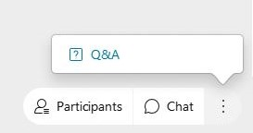

Want to Ask a Question? Webex Q&A Panel
Open the Webex Q&A panel
Select the question mark icon if the Q&A panel is not in view
Select All Panelists in the Ask field
Type your question in the space below
Click Send to submit your question

Slide 4
Agenda
What is measure specification?
Measure specification in the measure lifecycle
Key components and sources of influence
The measure specification process
Special note about eCQM specifications
Additional resources
Questions
Notes:
The focus of this presentation is on a key step in the CQM development lifecycle, which is the measure specification stage.

Slide 5
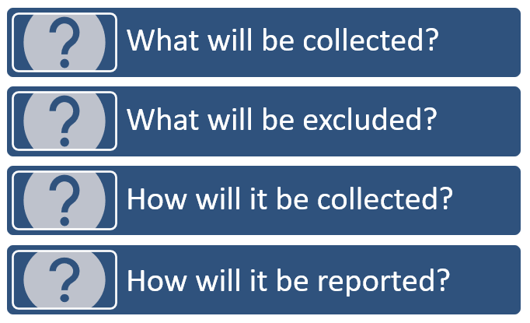
What is measure specification?
Measure specifications are a comprehensive set of technical instructions for how clinical quality measures are collected and implemented consistently, reliably, and effectively.
Notes:
Consistency, reliability and effectiveness are critical to the measure specification process. The instructions should leave very little to the imagination; therefore, two developers with a similar set of specifications will obtain the same results.

Slide 6
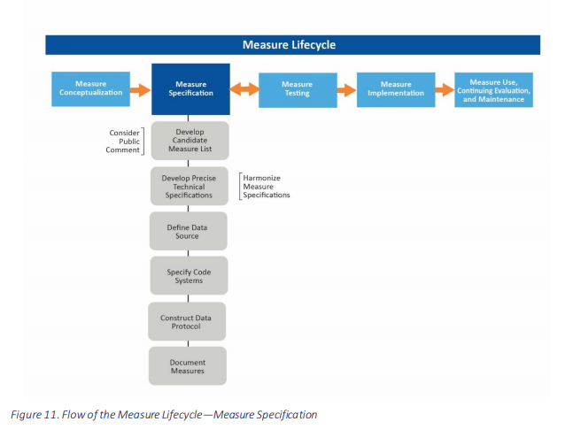
Measure specification in the measure lifecycle
Notes:
Depicted on this slide is a diagram of the measure lifecycle taken from the Measures Management System (MMS) Blueprint:
Measure specification occurs between conceptualization and formal testing
Developers consider available data elements to operationalize the measure concept
Preliminary feasibility is completed to ensure data is easily specified and obtained
The measure’s TEP weigh in on the draft specifications, along with public comment
Alpha and beta testing may also result in refinements to the specifications

Slide 7
Key components of measure specifications
Measure name/title
Measure description
Initial population
Numerator statement and definitions
Numerator exclusions
Denominator statement and definitions
Denominator exclusions
Denominator exceptions
Target population
Time interval
Stratification scheme
Risk adjustment methodology
Calculation algorithm
Sampling methodology
Data source(s)
Key terms, data elements, codes, code systems
Level of analysis
Attribution model
Notes:
Measure specifications include the components listed on this slide; however, not all of these components are necessarily included in each and every measure.

Slide 8
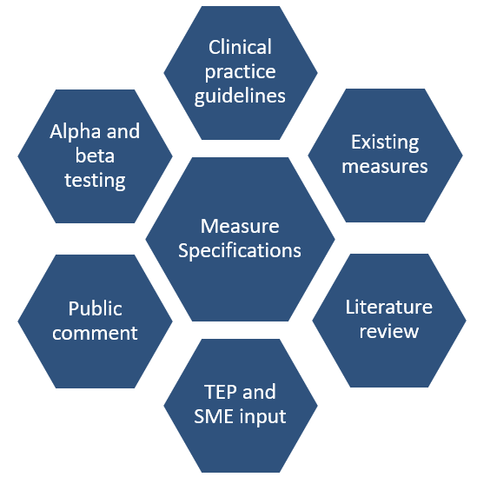
Sources of influence
Notes:
Related to existing measures, ensure your measure is not duplicating existing work, and that any differences from existing measures are sufficiently justified. All of these sources are synthesized to determine the specifications for clinical quality measures (CQMs).

Slide 9
Measure specification process
Define the data source
Develop specifications and definitions
Specify codes and code systems
Construct the data protocol (how data are aggregated or linked to calculate the measure)
Document the measure (occurs throughout!)
Notes:
Define the data source/develop specifications and definitions—This methodology may appear circular to state the development of specifications in order to develop specifications, but in fact it refers to the development of definitions for measure components and data elements.
Document the measure—Although listed last in the list of steps, this occurs throughout the process and is iterative throughout the specification development process.

Slide 10

1. Define the data source

Slide 11
Data source
Potential data sources may include:
Administrative data
Claims data
Patient medical records (both EHR and paper)
Electronic clinical data (e.g., device data)
Registries and QCDRs
Standardized patient assessments
Patient-reported data and surveys
Notes:
Consider strengths, limitations and feasibility of the data collection method carefully, since it determines the reliability, validity, feasibility and usability of the measure.
Multiple data sources can potentially be used for a measure; for example, an EHR and chart-abstracted data. Specifications are developed for each, and the developer must document that results from them are comparable.

Slide 12

2. Develop specifications and definitions

Slide 13
Specifications and definitions
The process of developing specifications is adding increasing amounts of detail to the measure concept in terms of:
Initial population
Denominator
Numerator
Exclusions and exceptions
Stratification scheme

Slide 14
Initial population
All individuals to be evaluated by a specific performance measure who share a common set of characteristics
The cohort from which to select the denominator population
Details may include information based on:
Age groups
Diagnoses
Diagnostic and procedure codes
Enrollment periods

Slide 15

Denominator
The population evaluated by the individual measure
May be the same as the initial population OR a subset that further constrains the measure
Parameters may include:
Age ranges
Settings
Diagnosis
Procedures
Time intervals
Other qualifying events (e.g., a lookback period)

Slide 16

Writing a denominator statement
Format: Patients, age [age or age range], with [condition] in [setting] during [time frame]
Examples:
All patients aged 18 and older with a diagnosis of Chronic Obstructive Pulmonary Disease (CMIT ID 0326)
All patients at least 18 years old as of the first day of the reporting month who are determined to be maintenance hemodialysis (HD) patients (in-center and home HD) for the complete reporting month at the same facility (CMIT ID 5642)
Notes:
Example 1—All patients age 18+ with a diagnosis of COPD. This follows the formula depicted at the top of the slide stating a description of the patient, how old they are, and the diagnosis that they share.
Example 2—This example adds a bit more complexity. There are more parameters in the denominator than in Example 1, but still maintaining the formula while applying the same structure in both cases.

Slide 17
Denominator exclusions and exceptions
Denominator exclusion
Denominator exception
Criteria that result in removal of individuals from the denominator before calculating the numerator
The numerator is not applicable to those who are excluded
Allows provider to get credit when numerator action is performed; no penalty if numerator is action is not performed for an appropriate reason
Allows for clinical judgement; numerator action considered for all denominator patients
Notes:
The next few slides will provide examples that will clarify the differences between the denominator exclusion and exception, and the appropriate use of each type.

Slide 18
Denominator exclusions and exceptions
Denominator exclusion
Denominator exception
Example:
Women who have had bilateral mastectomy are excluded from the denominator for a measure of screening mammography
Numerator action (screening mammography) does not apply
Example:
Asthma in the use of beta blockers for heart failure.
Clinician weighs risk/benefit. If provider does not administer beta blockers, record is reviewed for exception (asthma diagnosis) and removed from the denominator.
Notes:
Denominator exception example—In this case, the score is not negatively impacted because the provider used clinical judgment to determine the appropriateness of the numerator action.

Slide 19
Denominator exclusions and exceptions
Denominator exclusion
Denominator exception
Consider if…
Exclusion condition occurs with a frequency that would otherwise distort results
Evidence that measure validity is improved
Evidence that face validity is improved
Consider if..
Precisely defined and evidence-based medical reason
Patient preferences may determine numerator action
System inadequacies (rare)
Notes:
Circumstances for specifying a denominator exclusion—The goal is to define the measure’s population without overreaching or underreaching. Each consideration for a denominator exclusion is tested during the testing phase of the measure lifecycle. Prior to testing, developers cast a net defining a set of exclusions broadly listing multiple exclusions to improve measure validity, and then testing the exclusions and narrowing the list according to findings.
Circumstances for specifying a denominator exception—Denominator exceptions are only relevant in a proportion measure. For example, we limit uses of exceptions; however, it may be prudent to note the exceptions if there is a potential for a vaccine shortage.

Slide 20
Numerator
The process, condition, event, or outcome that satisfies the measure’s focus of intent
Parameters may include:
Event or events that satisfy the numerator inclusion criteria
Performance period or time interval for the numerator event (if different from that used in the denominator)

Slide 21
Writing a numerator statement
Format: Patients who received/had [measure focus] {during [time frame] if different than for the denominator}
Examples:
Patients with documented spirometry results in the medical record (CMIT ID 0362)
The number of adult patient-months in the denominator who were on maintenance hemodialysis using a catheter continuously for three months or longer as of the last hemodialysis session of the reporting month (CMIT ID 5642)
Notes:
Example 2—This complex example is more detailed, but still follows the distinct formula. The time period and timeframes have been specified here. It’s particularly important if the timeframes are different between your denominator and numerator to state those timeframes explicitly.

Slide 22
Numerator exclusion
Relevant only for ratio measures
Defines elements that should not be included in numerator data
Example:
If the number of central line bloodstream infections per 1,000 catheter days were to exclude infections with a specific bacterium, that bacterium would be listed as a numerator exclusion.

Slide 23
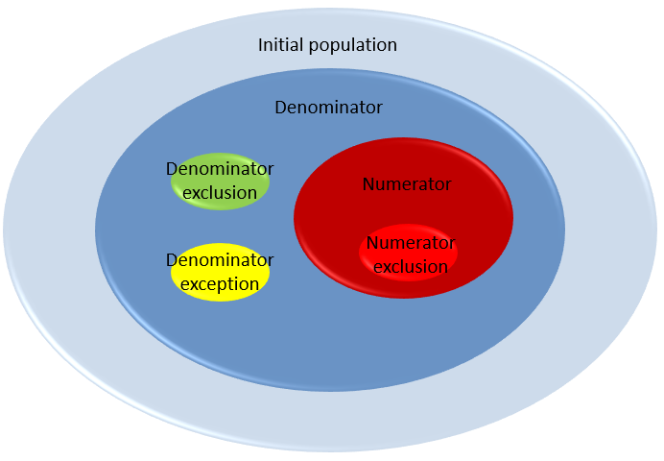
Measure components
Notes:
Shown here is a graphical depiction of the anatomy of a hypothetical measure, hypothetical since it includes all of the components previously discussed. Not all measures will have all of the components, but the broadest category is the initial population. The light blue color is further constrained as the denominator withholds for denominator exclusions and exceptions. In red is the numerator with a hole for that rare numerator exclusion.

Slide 24
Stratification
Consider stratifying population based on risk for an outcome
May detect disparities related to the measure focus
Population stratification variables must be defined
Example:
Measure is to be stratified by a population type (i.e., race, ethnicity, age, social risk factors, income, region, gender, primary language, disability) (CMIT ID 2513)
Notes:
Stratification can quantify disparities related to a measure focus between different racial and ethnic groups. To complete the statistical stratification, you can identify and define the stratification variables in the measure specifications. Since stratification is not always appropriate, there may be statistical reasons not to stratify; for example, cell sizes could become so small that patient identification is feasible.

Slide 25

3. Specify codes and code systems

Slide 26
Codes and code systems
Most measures rely on use of standardized codes or code systems for classifying healthcare
Examples:
International Classification of Diseases (ICD), Current Procedural Terminology (CPT), SNOMED CT, RxNorm
Specifications should include all required codes, and the code system and version from which they come

Slide 27
Codes and code systems
Considerations:
Code system versions must align with the timeframe of testing data, potentially spanning multiple versions of a code system
Specifications may require that codes accompany other codes, occur in specific locations in the record, or occur on claims from specific provider types
Some code sets (e.g., Current Procedural Terminology [CPT] codes) may require copyright statements to accompany use
Notes:
Example —A measure may reference the current version of a code system for a current diagnosis, but reference a prior version to capture the denominator exclusion diagnosis that occurs during a lookback period.

Slide 28

4. Construct the data protocol

Slide 29
Merging data
Potential challenges
Identifying duplicates
Different units of measurement used by different data sources
Different codes sets used by different data sources
Different quality controls used by different data sources
Notes:
If merging multiple datasets and linking patient IDs across multiple sources of data, it may be necessary to identify and resolve duplicates. All of the items listed are important pieces to consider when merging data. It may become necessary to perform data cleaning to ensure that these issues are addressed prior to measure calculation.

Slide 30
Define key terms and data elements
Define key terms used in the numerator, denominator, exclusions, and exceptions using codes and code systems
Example:
Up-to-date vaccination status requires a clear definition of which type of vaccinations need assessment along with the definition of “up-to-date.”

Slide 31
Data source implications
Patient medical record data requires instructions for abstraction
Identify allowable terms used in the record, allowable places within the record, and allowable values
Claims data requires information about type of claim, data fields, code types, and lists of codes
Example:
The AMI mortality measure includes admissions for Medicare FFS beneficiaries aged > 65 years discharged from non-federal acute care hospitals having a principal discharge of AMI and with a complete claims history for the 12 months prior to the date of admission. The codes ICD-10-CM code 121.xx, excluding those with 122.xx (AMI, subsequent episode of care).
Notes:
Instructions must be clear so that each individual collecting data for the measure will interpret the specifications in a similar fashion.
Example:
For “hypertension” in the medical record is the abbreviation “HTN” acceptable?
For high blood pressure is the abbreviation “BP” acceptable?”
Are those acceptable terms for data abstraction?

Slide 32
Unit of analysis
The primary entity upon which to apply the measure
Developer must state and justify the measure attribution
Measures should be specified with the broadest applicability supported by the evidence
Note: Reliability and validity cannot be assumed to hold for different levels of analysis.
Notes:
Reliability and validity must be tested appropriately for the level of analysis, and so measures must be retested for each setting, each population, or each level of analysis to which they’re applied. For example, one cannot take for granted that a measure specified for the facility level will perform reliably and validly at the clinician level.

Slide 33
Sampling
If applicable to the measure
Describe sample size (or provide guidance to do so)
Describe sampling methodology

Slide 34
Risk adjustment
If applicable (e.g., for outcome measures)
Risk factors that exist outside of healthcare encounters may affect outcomes regardless of quality of care received
Risk adjustment can facilitate fair and accurate comparisons of outcomes across healthcare organizations, providers, or other groups
Risk adjustment methodology should be disclosed to ensure transparency and accountability
Notes:
Example—Process measures are typically not risk-adjusted. If used, they explicitly describe the risk adjustment methodology to aid in the transparency and clarity of the measure calculation.

Slide 35


Time intervals
Define time intervals to determine cases for inclusion, indicate index events, indicate how often to report the numerator and include patients in the denominator
Avoid ambiguity
Use exact units
Explicitly state lookback periods

Slide 36
Scoring and reporting
Identify the scoring type (rate, categorical value, count, frequency distribution, ratio, etc.) and how to interpret
Higher score indicates better quality; improvement noted as increase in rate
Lower score indicates better quality; improvement noted as decrease in median value
Score within a defined interval indicates better quality

Slide 37
Calculation algorithm
Ordered sequence of data element retrieval and aggregation
Describes the path of raw data to the result
Can be represented graphically
Basis for computer programming to produce results
Notes:
The data protocols should include the calculation algorithm, which is the ordered sequence of data element retrieval and aggregation, which describes the path of the raw data to the measure score. This can be represented graphically in a flowchart diagram or narratively, or a combination of the two. This algorithm is critical, because it becomes the basis for any subsequent computer programming to calculate the measure results.

Slide 38

5. Document the measure
3/17/2022

Slide 39
Documentation
Measure Information Form (MIF)
Measure Justification Form (MJF)
Measure Authoring Tool (MAT)
Specify QDM or FHIR eCQMs using CQL
Export human and machine-readable formats
Notes:
Documentation is essential for technical specifications and any additional documents required to evaluate and implement a measure. The MIF/MJF are found in the Blueprint.
For eCQMs, the documentation occurs in the MAT where measures are expressed using CQL, an HL7 standard — a clinically focused and author-friendly language — that enables precise measure specifications. It provides the ability to express measure logic in a way that’s human-readable, yet structured enough for processing a query electronically.

Slide 40
Special note for eCQMs
Specification process is essentially the same!
Precise written specifications facilitate “translation” into CQL using the MAT
Value sets for codes will be linked to the Value Set Authority Center (VSAC)
Measure logic (i.e., relationship between data elements) can be tested in Bonnie
Coding in the MAT may occur alongside or following written specification
Notes:
The specification process for eCQMs is largely the same until the documentation step. Precise written specifications in plain English will facilitate the translation into CQL using the MAT. The difference is that specifying a measure in the MAT requires that value sets for relevant codes be linked to the VSAC, and that any measure logic written through your MAT entry can be tested using the linked Bonnie tool.

Slide 41
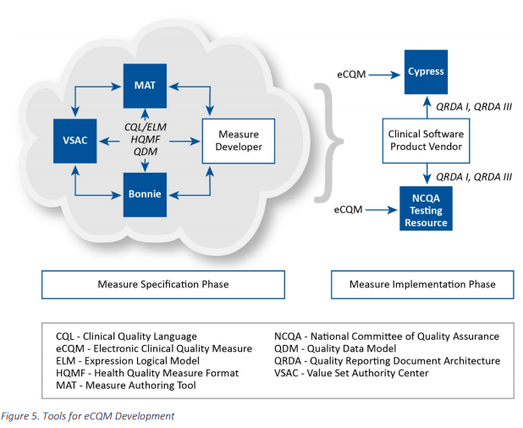
eCQM specification
Notes:
The documentation process for eCQM specification is depicted on the left side of this diagram. It states “measure specification phase” under that cloud and is our area of focus. Here the measure developer uses the linked tools of the MAT, VSAC and Bonnie to express the measure in CQL.

Slide 42
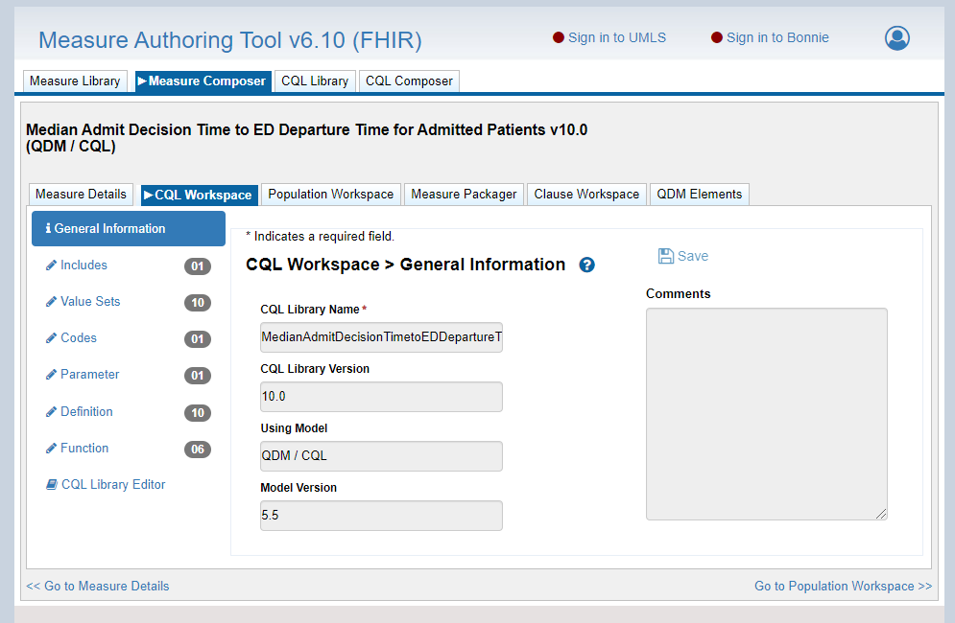
Measure Authoring Tool
Notes:
Depicted is a screenshot of the CQL workspace in MAT 6.04 QDM and FHIR. You can see there are places to record value sets, codes, parameters, definitions and functions.

Slide 43
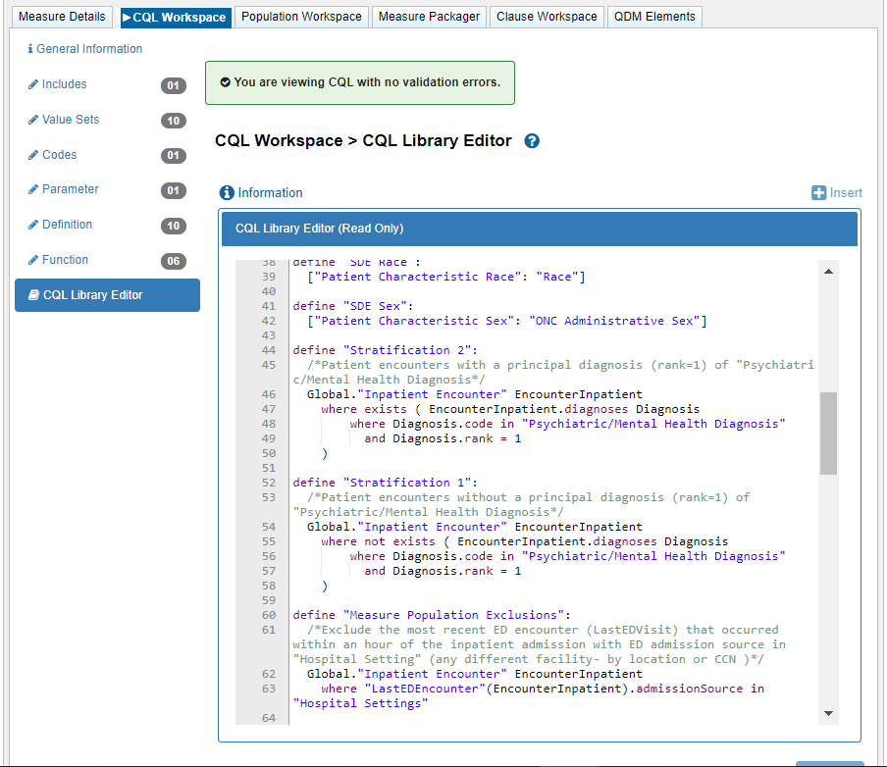
Measure Authoring Tool
Notes:
This slide illustrates what is shown by clicking on “CQL Library Editor” at the bottom of the menu, representing the actual CQL syntax. The color-coding denotes the different types of syntax. There’s green for comments not part of the code, but instead reflect the programmer’s comments about the code.
The green box at the top of the screen shows a built-in validation check to ensure codes are free of errors. One would receive an error message should something in the code be inaccurate. Here however the green box indicates that everything is progressing well.

Slide 44
Additional resources
MMS Blueprint
Templates
Measure Information Form
Measure Justification Form
Guidance
Chapter 5: Specification
Codes, Code Systems, and Value Sets
eCQM Specification, Testing, Standards, Tools, and Community
eCQI Resource Center (for eCQMs)
https://ecqi.healthit.gov/

Slide 45

Discussion questions

Slide 46
Coming September 10: Blueprint Version 17!
On Friday, September 10, 2021, the Centers for Medicare & Medicaid Services (CMS) will publish the updated Blueprint for the CMS Measures Management System on the Measures Management System website.
Highlights of the changes for Version 17 include
A new supplemental material addressing the topic of population health measures
Substantially revised Business Case Form & Instructions and related content
Additional information on special considerations for Medicaid-focused measures
Significantly revised reliability content
Information about the new CMS Measures Under Consideration Entry/Review Information Tool (CMS MERIT)
Notes:
There is additional information on special considerations for Medicaid-focused measures, significantly revised reliability content — very useful for those who plan testing of their measures. Also, information about the new CMS MERIT tool, the submission tool released this year for the pre-rulemaking process. For those seeking submission of their measure onto the MUC List, you may find these changes to be of interest.

Slide 47
Announcements
In case you missed it:
April Info Session “Understanding Qualified Registries and QCDRs and their Role in MIPS” now available on YouTube: https://www.youtube.com/watch?v=ofrd0aFGS74
Upcoming Info Session
“Overcoming Common Challenges in the Measure Development Lifecycle” September 15th from 2 – 3pm ET
Notes:
Additionally, there is a whole series of other Info Sessions posted on YouTube for your review, if your preference is to listen to a presentation instead of reading the slides.

Slide 48
Final Slide with Battelle & CMS Contact Information
Battelle
Brenna Rabel (Stakeholder Engagement Task Lead)
Contact: rabel@battelle.org
Feedback: MMSSupport@battelle.org
CMS
Kim Rawlings (CMS COR)
Contact: kimberly.rawlings@cms.hhs.gov

