Slide 1

PUBLIC WEBINAR CMS Measure Development Education & Outreach
Driving Quality in the US: How CMS Evaluates its Measure Portfolio
Presenters:
Maria Durham (CMS)
Sophia Chan (CMS)
Melissa Castora-Binkley (HSAG)
Kate Buchanan (Battelle)
Meridith Eastman (Battelle)
July 2021

Slide 2
Introduction
Welcome! This is an annual presentation to engage the public in the work CMS is doing around quality measurement
Aim to shed light on the processes and function of quality measurement in CMS programs and initiatives
If you are new to quality measurement, stay tuned for available resources that can help navigate development and use

Slide 3
Learning Objectives
Articulate the role of the Measures Management System in advancing CMS goals and objectives
Identify how CMS ensures the quality of its measures
Standardized measure development processes as described in the MMS Blueprint
Evaluation throughout the measure lifecycle
Triennial Impact Assessment

Slide 4
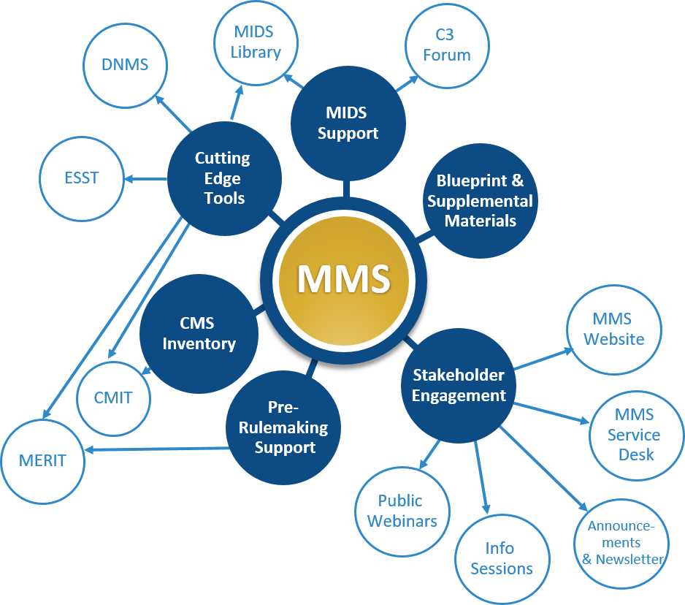
Overview of the Measures Management System
CMS developed the MMS to foster and support standardization, flexibility, and innovation in quality measurement through a series of channels
The MMS conducts stakeholder outreach and education, which includes annual public webinars, monthly information sessions, a newsletter, and other ad hoc outreach activities
MMS Overview Website
Notes:
To lay a foundation we must start with the Measures Management System (MMS). Our team supports CMS in its work to ensure that measures are developed to the highest possible standards. We manage the CMS Measures Inventory Tool (CMIT), conduct stakeholder engagement activities such as webinars like this one, support measure implementation, and we maintain the MMS Blueprint which is the definitive source for information about CMS quality measure development. You’ll hear more about the Blueprint later in the presentation.
For more information you can visit the MMS website. We also maintain a help desk where you can reach us with questions about quality measurement. You can access it by emailing MMSsupport@battelle.org.

Slide 5

Ensuring Quality in Quality Measures

Slide 6
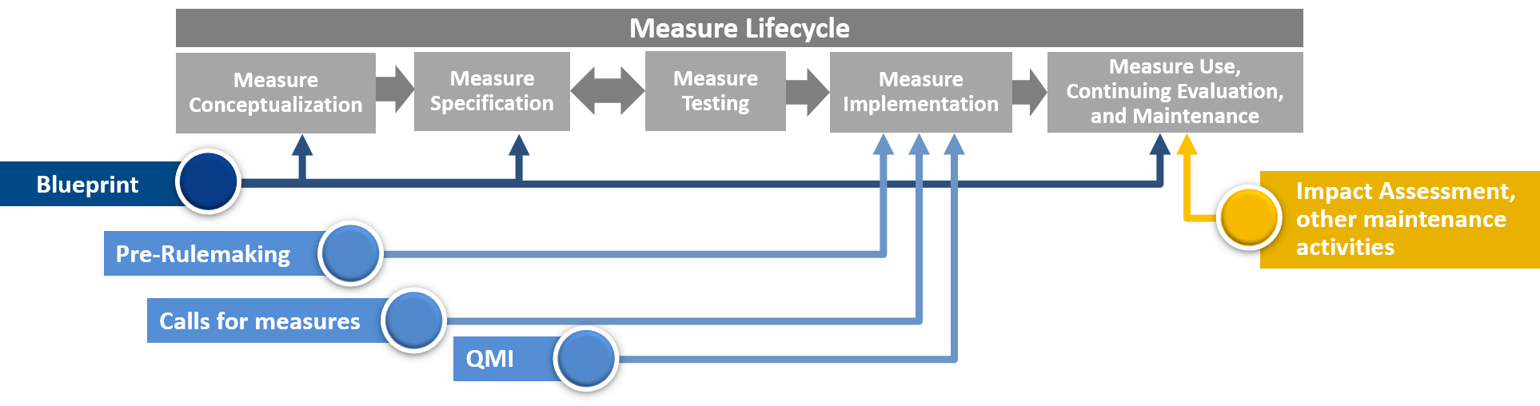
Evaluation throughout the Measure Lifecycle
CMS requires rigor throughout the measure lifecycle to ensure:
Measures indicate quality and drive quality in the healthcare system
Only high-value measures are adopted into national CMS quality, payment, and public reporting programs
Notes:
At every point during the measure lifecycle CMS implements processes to ensure only high-value measures are adopted into CMS quality payment and public reporting programs. The Blueprint is a collection of materials that document all of the processes and decision-making criteria to guide measure development, implementation and maintenance.
The processes described in these documents ensure measure developers have the information required to meet the evaluation criteria CMS requires for use in its programs. The pre-rulemaking and other measure selection processes ensure rigor in measure selection and CMS funds a program-level evaluation of the impact of its active quality measures.

Slide 7

Ensuring Quality during Development

Slide 8

Standardized Processes
Business Case
Environmental Scan
Technical Expert Panel
Public Comment
Specifications
Testing requirements
Notes:
CMS created the MMS Blueprint to document the core set of processes and decision-making criteria for measure development, implementation and maintenance.
The Blueprint:
Is required for CMS developers but is a helpful resource to all.
Creates a standardized process and set of requirements to help developers create Meaningful Measures that CMS can implement.
Provides templates to assist developers, such as the business case template where they can articulate the justification that the benefits of the measure outweigh the cost and burden of the measure development implementation.
Includes information on the specification and testing requirements so that measures accurately capture information related to healthcare quality.
Clearly explains CMS evaluation criteria and provides the information and resources that measure developers need to ensure that measures meet these criteria.

Slide 9
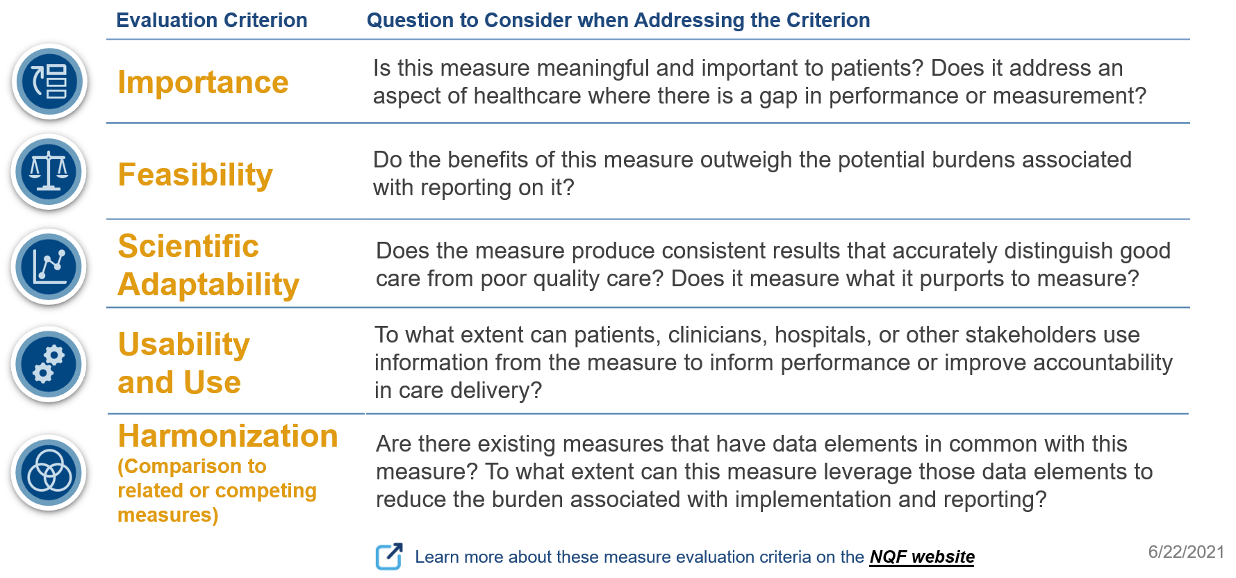
Evaluation Criteria
Notes:
Evaluation criteria listed on this slide represents the essential characteristics of a quality measure. By evaluating measures against these criteria, CMS may identify those most likely to positively impact the quality of healthcare being delivered.
Feasibility—When evaluating a data source, is the information easily available in an electronic health record (EHR) or something that needs to be manually abstracted?
Scientific acceptability—Is evaluated using quantitative data using testing to ensure the measure behaves the way it’s supposed to in the real world, meaning the measure assesses exactly what it proports to measure, and that the measure consistently and correctly captures differences in performance among measured entities such as clinicians or facilities.
Usability and use:
Is the information provided by the measure helpful?
Can the measure be used in quality improvement efforts? In public reporting to facilitate patient decision-making?
Are there plans to use this measure currently, or is the measure currently in use?
Harmonization—This criterion is a resource to the extent to which any new measure is aligned with similar measures currently in use. The goal with this criterion is to help reduce reporting burden by relying on common data elements or measure logic.

Slide 10
Risk Adjustment
Risk adjustment is a method to adjust for factors outside a clinician’s control that may impact an outcome or a measure score
Promotes better measure validity by helping to tie measure performance to the quality of care provided
Risk adjustment models for measures must be supported by evidence and the risk adjustment methodology must be tested during development as part of scientific acceptability testing
Notes:
Measures are risk adjusted to ensure we are holding clinicians accountable for outcomes within their control. Healthcare is provided within the context of the communities and populations it serves; as such, external factors impact how reporting entities perform on quality measures. These factors may be clinical by type number, types of severity of condition, demographic such as age or gender or socioeconomic, ethnicity, income and race.
Example—Doctors whose patients are predominantly elderly and have multiple chronic conditions if not risk adjusted would probably perform worse on measures than doctors who see a wider mix of patients.

Slide 11

Harmonization
Harmonization describes the process of aligning related measures so that their components are uniform or compatible, unless differences can be justified
The extent of harmonization depends on the relationship of the measures, the evidence for the measure focus, and differences in data sources
Contributes to burden reduction for measured entities and ensures that any novel data elements/measure logic are justifiable
Notes:
Reporting on quality measures can be burdensome, especially when programs or payers use different measures to track similar aspects of care. Harmonization is a way CMS tries to mitigate that burden. The idea here is that any way that a measure can use the same components as an existing measure, the better the reporting on these measures.
Example—If you have two different diabetes measures, they should be harmonized to the extent that they define diabetes in exactly the same way and use the same ICD-10 codes for the data element definition. This limits the amount of extra programming that has to be done by measured entities.

Slide 12
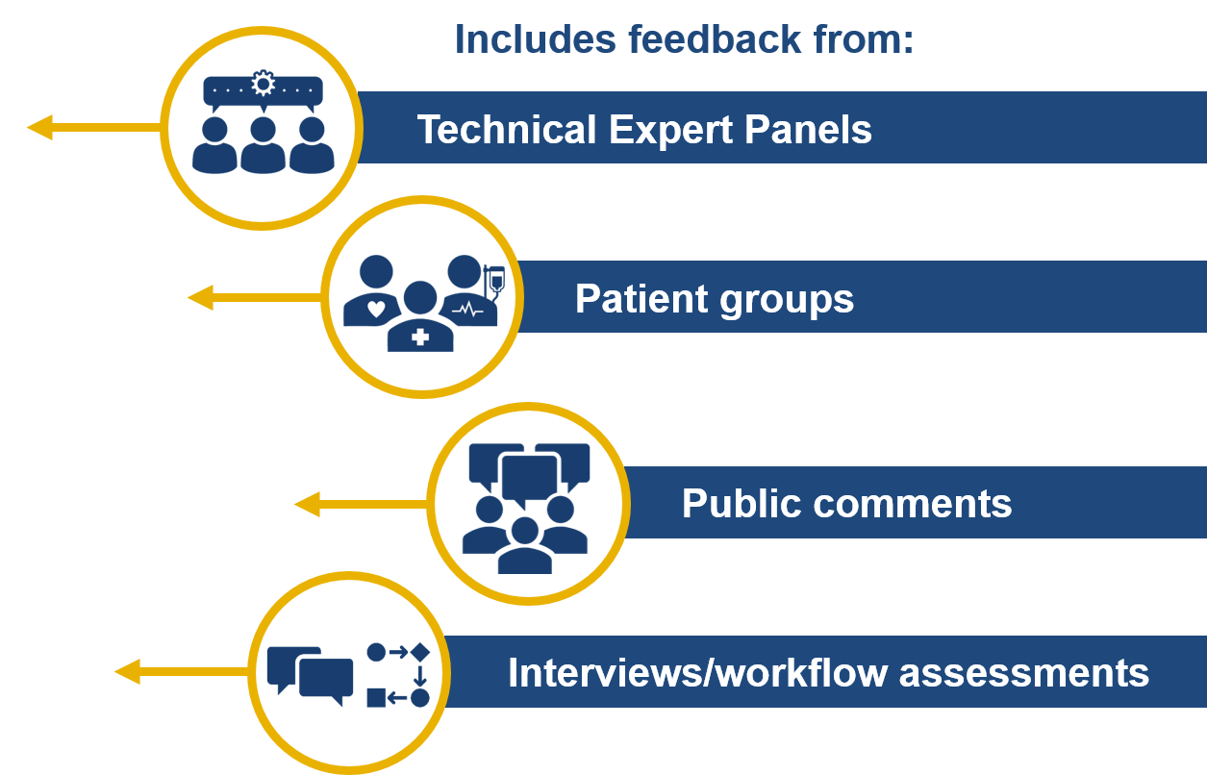
Stakeholder Engagement
Stakeholder input helps ensure that measurement is
transparent
patient-centered
well-informed
Notes:
Stakeholder feedback is essential in that the feedback they offer often informs the criteria of feasibility, importance, face validity and usability.

Slide 13

Measure Evaluation during Implementation

Slide 14
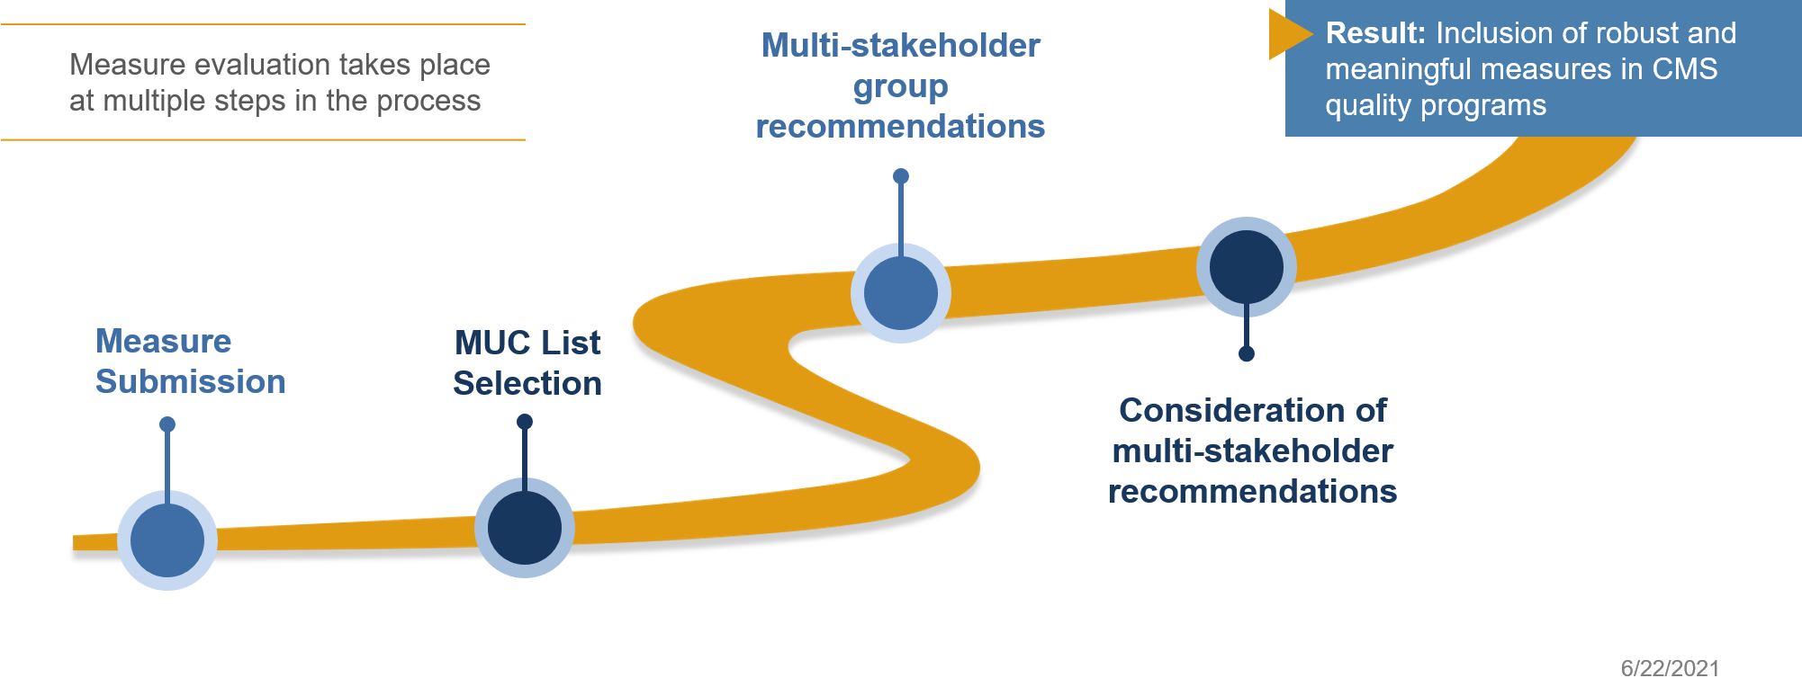
Pre-Rulemaking
Notes:
The process that many, although not all programs use to select quality measures, is called “pre-rulemaking.” It is a statutorily mandated phase for relevant programs that helps determine which measures are proposed for rulemaking in the Federal Register for potential use in programs.

Slide 15

CMS MERIT
CMS MERIT is the web-based tool used to submit measures for the MUC List
Ensures uniformity of information collected about each measure
Facilitates CMS review of submitted measures
Notes:
CMS MERIT was launched January 2021 and offers several features that facilitate measure evaluation. It uses automated validation checks and standardized measure information fields to ensure the uniformity of information collected about each measure, so that there is a set of standardized data elements being evaluated for the measure submitted.
CMS MERIT establishes the workflow for CMS review so that CMS program leadership can evaluate each measure against program and agency needs and priorities, and ensure that measures placed on the MUC List are sufficiently specified and tested. Not all measures submitted in CMS MERIT end up on the MUC List, which gets published annually by December 1st. Those that do, however, undergo a multi-stakeholder group review.

Slide 16
Measure Applications Partnership
Consensus-based partnership that informs the selection of performance measures to achieve the goal of improvement, transparency, and value for all
Provides input to HHS during pre-rulemaking on the selection of performance measures for use in public reporting, performance-based payment, and other federal programs
Identifies gaps for measure development, testing, and endorsement
Encourages measurement alignment across public and private programs, settings, levels of analysis, and populations to:
Promote coordination of care delivery
Reduce data collection burden
Notes:
The multi-stakeholder group that evaluates measures on the MUC List is called the “Measure Applications Partnership” or the MAP. Measures are statutorily mandated to go through pre-rulemaking and have been selected for the MUC List.

Slide 17
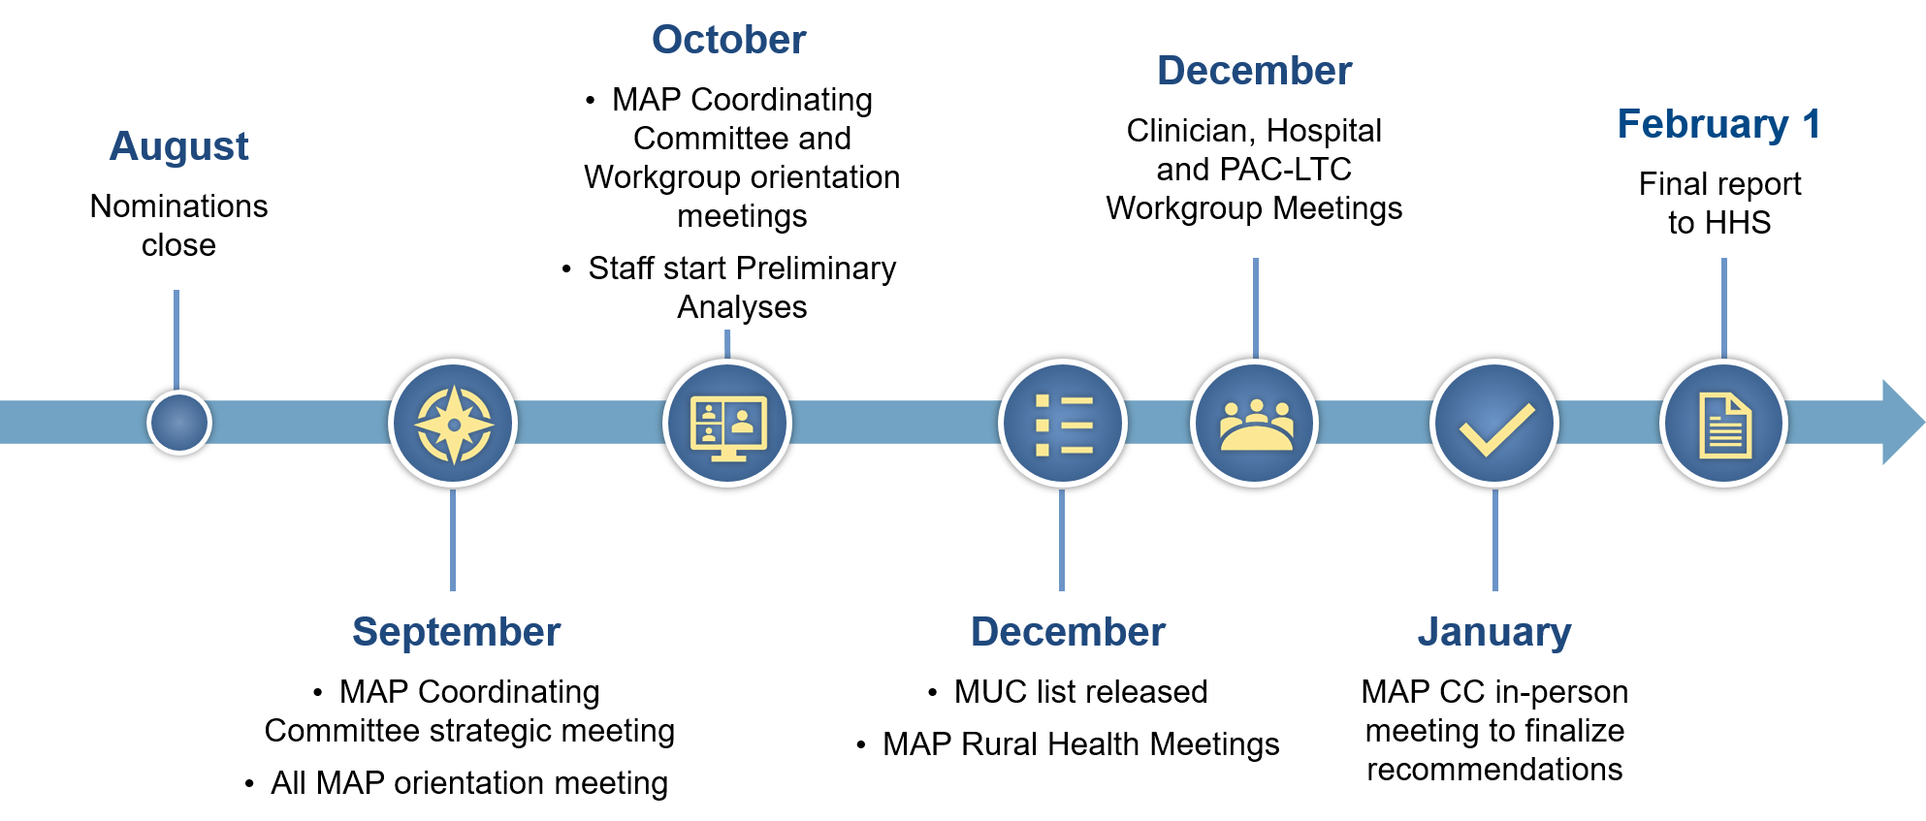
MAP Timeline
Notes:
This slide illustrates the annual timeline for MAP activities:
All MAP meetings are open to the public and meeting summaries are posted online.
Each MAP workgroup evaluates candidate measures using measure selection criteria.
Several conclusions for each candidate measure are reached, including “to support, do not support, conditionally support, or to refine and resubmit the measure.“
MAP recommendations are finalized in January.
A final report with program-specific recommendations is submitted to HHS by February of each year.
CMS reviews recommendations in determining measures to be proposed for rulemaking in the Federal Register.

Slide 18
Calls for Measures
Some measure programs do not use the pre-rulemaking or rulemaking processes, but the same level of rigor is applied
Example: Quality Rating System (QRS)
These programs use Call Letters to communicate changes and request comments on proposed refinements

Slide 19
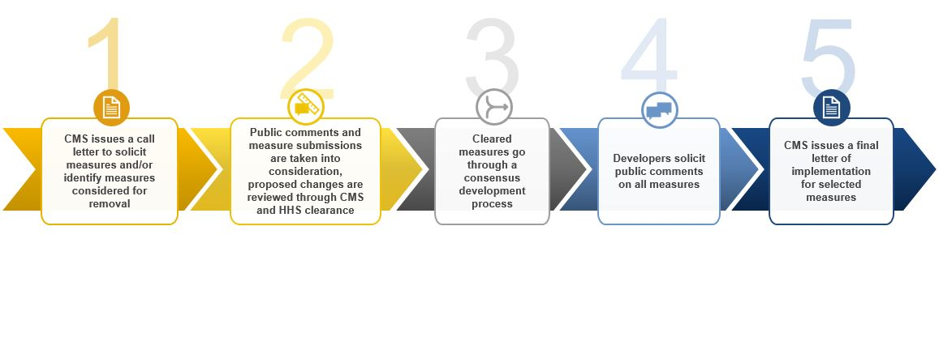
Calls for Measures Process
Notes:
The purpose of this slide is to demonstrate the Calls for Measures process that some programs use in lieu of pre-rulemaking/MAP processes.

Slide 20

Evaluating Measures Currently in Use

Slide 21
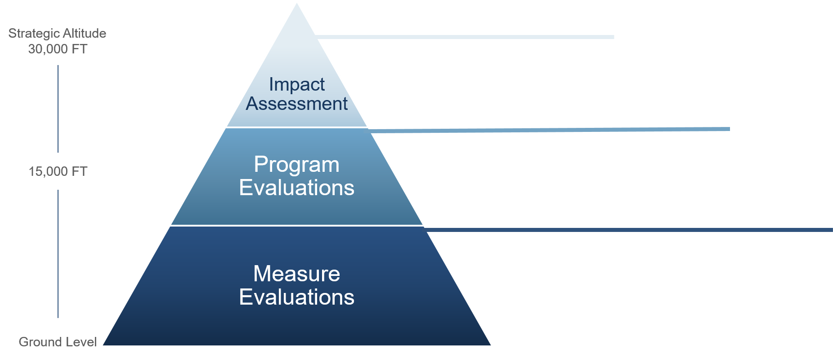
Evaluating Measures Currently in Use
All included CMS quality programs
National aggregate data
Assesses national impact of measures
Individual CMS Programs
Clinician and provider profiling/rates
Assesses the implementation of program design and included measures
Individual measures
Clinical/scientific updates, measure maintenance
Evaluates measures according to criteria importance, scientific acceptability, usability, and feasibility
Notes:
Measures are evaluated at the program level to better understand clinician and provider performance and how measures contribute to program design; for example, as incentives or penalties to encourage quality improvement activities.

Slide 22

Impact Assessment
Required by section 1890A(a)(6) of the Social Security Act
Triennial report
Structured by health care quality priorities (e.g., Patient Safety)
Notes:
This high-level analysis produces the Impact Assessment Report, a statutorily mandated report under the Social Security Act with a primary charge to assess the national impact of quality measures across CMS programs. 2021’s edition is the fourth report in the series and is organized by six healthcare quality priorities—safety, person and family engagement, effective treatment and prevention, communication, care coordination, working with communities and affordable care.

Slide 23
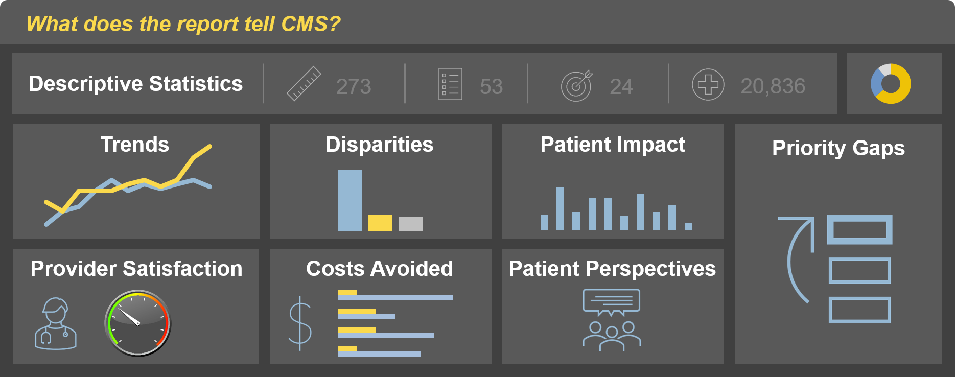
Impact Assessment
Notes:
How well does the portfolio reflects priorities (e.g., digital measures, outcome measures)?
Which measures are improving, stable or declining across care settings?
Which measures are improving, worsening and show persistent disparities?
Which improving measure had the largest impacts on number of patients?
The report contains descriptive statistics which describe the CMS measure portfolio and reflects measure priorities, such as outcome measures and reducing burden. It includes measure performance trends based on 21 CMS programs and 336 measures characterized as improving, stable or declining across care settings. The analysis is retrospective and the focus is on 2013-2018, being prior to the impacts of COVID-19.
Disparities—In our patient impact analysis we use measure evaluation to describe how improving measures had large impacts on patients and patient care.
Costs avoided—Using the patient impact analysis results combined with per-event estimates derived from the published literature to estimate the costs avoided.
Priority gaps—Indicated in the report identified by national stakeholders and published in national reports between 2018-2020 to describe important topics for measure development.
Provider perspectives—Are represented through over a 1,000 home health agencies (HHAs) that responded to a survey, as well as 39 qualitative interviews. The nationally representative survey assessed how providers responded to quality measures and the impact of their use. For example, 91% of HHAs indicated that CMS measures are clinically important.

Slide 24
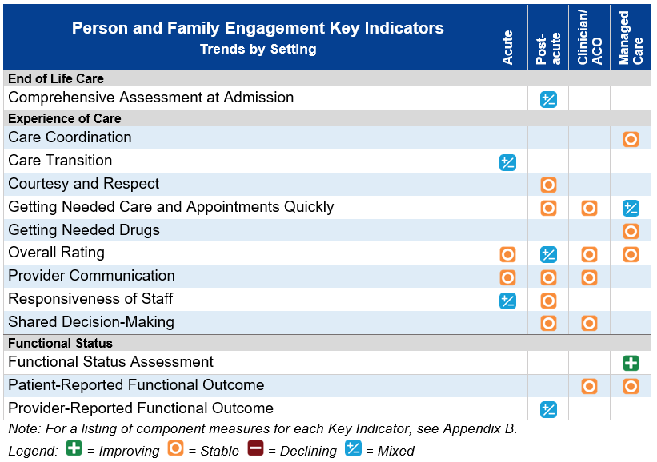
Person and Family Engagement Key Indicators
Notes:
This slide presents a snapshot of the evaluation results in the Impact Assessment Report. In the rows are measurement areas which we call “key indicators” and the columns on the right represent “care settings.” The orange icons indicate that many areas have stable performance between 2013-2018. The blue icons indicate that there was more than one measure in the setting, or one measure in multiple programs and the measure performance was mixed. The single green icon shows that measure performance improved in the managed care setting for functional status assessments.

Slide 25
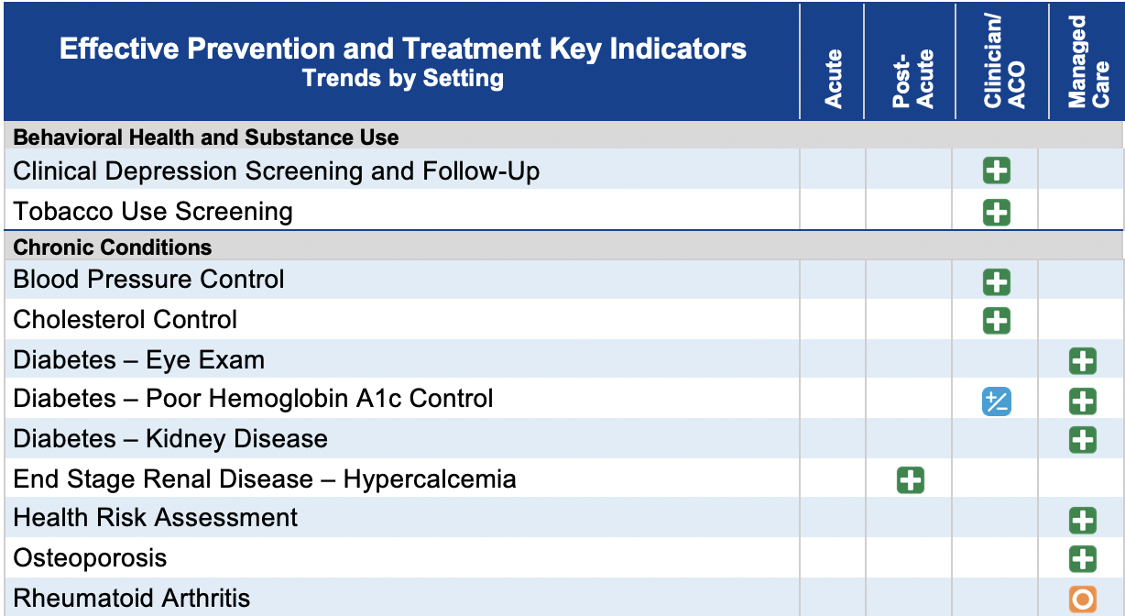
Effective Prevention and Treatment Key Indicators
Notes:
Another example of measure evaluation results from our report is represented here by the effective prevention and treatment key indicators. This shows most of the key indicators as improving, as well as one stable and one mixed.

Slide 26

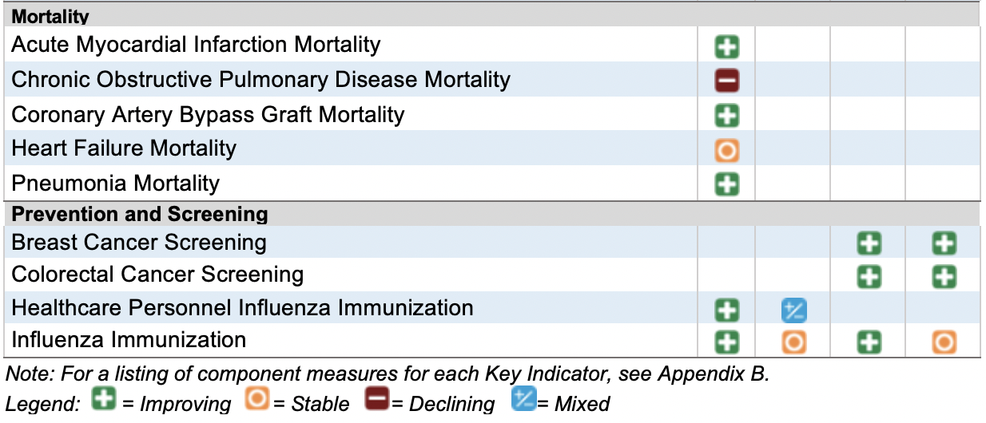
Effective Prevention and Treatment Key Indicators (cont.)
Notes:
Effective prevention and treatment continues onto this slide where we have the singular case in today’s presentation of measure performance worsening in the acute care setting for COPD mortality. Overall, the findings from our report indicated that 91% of measures analyzed had improved or stable performance.

Slide 27
Disparities Methods Overview
Disparities (2013–2018)
19 programs, 228 measures, including 82 Key Indicator measures
Identified disparities and disparity trends for population subgroups based on sex, age, race, ethnicity, region, urban/rural location, income, or dual-eligibility (Medicare and Medicaid) status
Focused on clinically (relative difference >10%) and statistically significant differences (p < 0.05) between comparison and reference groups
Subgroup-specific slopes and annual measure scores were used to evaluate changes in disparities over time (i.e., improving, worsening)
Aligned with AHRQ’s National Healthcare Quality and Disparities Report
Notes:
Supporting the initiatives of the federal government to advance equity for all, here we discuss the disparities analyses in the Impact Assessment Report where not all measures have sufficient data to conduct analyses for all strata.

Slide 28
Overall Disparities Results
Out of 59 Key Indicator measures with a disparity in the first year of the trend series, 34% showed improvement in at least one measure performance comparison.
Notes:
This slide shows six rows of quality priority areas and four key strata of dual eligibility, income, race/ethnicity and urban/rural. Within each cell the coloration represents disparities results where yellow indicates worsening disparities. Dark blue indicates the number of improving disparities and light blue indicates improvement to the point where a previous disparity is no longer evident.
While we have lots of room for improvement, there are a number of measures with disparities among comparison groups improving. Focusing on a subset of measures, out of 59 key indicator measures with a disparity in the first year of the trending series, 34% showed improvement in at least one measure performance comparison.

Slide 29
Disparity Measure Level Result Example
Part D (MA-PD) Medication Adherence for Cholesterol
Notes:
The measure depicted on this slide is from the Medicare Advantage Part D prescription drug program that monitors quality showing improving disparity for the race/ethnicity strata. Here it’s monitoring medication adherence for cholesterol where higher rates indicate better performance. The measure rates are improving for all strata. For the datapoint all the way to the left representing 2013, the rates were more spread apart from the reference group, represented by the top thicker blue line.
By 2018, the rates furthest to the right, the rates are still different from the reference group but the magnitude is less drastic where specifically trends and disparities were improving slightly for black or African-American patients indicated through the dark gray line, and for Hispanic and Latino patients with the light blue line.
Disparities were still detected for both groups in 2018. American Indian and Alaska Natives represented by the orange line showed persistent disparities over time. For overall improvement in all groups, the improvement was not equally shared among groups.

Slide 30
Impact Assessment
Strengths of 2021 Impact Assessment Report
Accessible: Designed for a wide group of stakeholders, including patients
Comprehensive: Includes 686 measures from 26 reporting programs
Data-driven: Leverages data from multiple internal/external data sources
Rigorous: Adopts methods recommended by experts, aligned with AHRQ
Strategic: Assesses CMS health care quality priorities
Notes:
This report may prove useful in comparing how a practice is doing compared to national measure performance.
The 2021 report is streamlined for ease of navigation and readability, gaining an at-a-glance understanding of measure performance.
As a researcher or a policy expect, the comprehensive appendices provide lots of information. The counts are based on published program documentation, as well as rules published through the Federal Register, each listed in the appendix of the report.
A helpful resource for measure developers in understanding the breadth of measures used in CMS quality programs.
The report is data driven and informed and influenced by a technical expert panel (TEP) and adopts rigorous methodology aligned with other methodologies used across HHS.
The report is strategic to ensure that it informs key CMS priorities.
Example—The 2021 Impact Assessment Report found that CMS supported burden reduction by reducing the overall number of measures from over 900 in 2015 to 686 in 2020.

Slide 31

Impact Assessment
Limitations
Attribution: Results cannot be attributed directly to measures
Plausible that measurement contributed to impacts
Missing data: Data for analyses may be incomplete
Number of measures analyzed by analysis indicated
Comparability: Results are not directly comparable to prior reports
Methods have been modified to enhance scientific rigor
Appendices contain period-of-record analysis
Notes:
The Impact Assessment Report does not investigate causality; therefore, the results cannot be attributed directly to measures and not all measures have data for all disparities strata. The report results should not be compared across publication years as we continually update our methodology and enhance our methodological scope. However, the report appendices use all of the available data to provide results for the period of record for each measure.

Slide 32


Impact Assessment
Results supplement other CMS efforts to understand impact
Fosters comparisons across settings/programs relative to key clinical topics and CMS health care quality priorities
Quantifies national impact of measures on improving care to inform measure selection
Identifies disparities that may require further investigation to determine underlying causes and target quality improvement initiatives
Highlights actions taken by providers and barriers encountered in seeking to improve quality

Slide 33

Conclusion
Results suggest that:
Use of CMS quality measures likely contributed to improving quality and reducing health care costs in key health care quality priorities
Opportunities for improvement remain
Reducing disparities and improving health equity
Increasing performance on declining measures
Improving EHR interoperability
CMS has taken steps to reduce burden, increase outcome measures, and better understand patient and provider perspectives

Slide 34

Future Plans

Slide 35
Evolving Priorities
Streamline quality measurement
Leverage measures to drive improvement in health outcomes more effectively
Transition to digital measures and use of advanced analytics
Increase patient-centeredness through patient-reported quality measures and increase transparency
Promote health equity and close gaps in care via quality measures
1
2
3
4
5
Notes:
At the end of 2020 CMS began outlining an internal action plan to guide the next 5-10 years of quality measurement. The five overarching goals on this slide will aim to address the challenges of quality measurement and work towards the goals of improved health outcomes by supporting the delivery of value through impactful quality measurement.
Priority 1—To have more efficient, high-value measures with the least amount of burden to ensure that they address priority aspects of healthcare with a good distribution across priorities whilst limiting any gaps in measurement.
Priority 2—To leverage measures within value-based programs to drive both value and improved outcomes. This second goal is about modernizing and streamlining the programs.
Priority 3—To transform quality measures through efficiency moving to the future through digital measurement, meaning prioritizing the development and implementation of digital measures and identifying opportunities to phase out super labor-intensive manually abstracted measures where possible.
Priority 4— To use measures to empower patients and caregivers to make the best choices by emphasizing the importance of the voice of patients, consumers and caregivers; that they are heard through the measure development process, and that PROMs and measures on shared decision-making are front and center. Lastly, stressing the importance of transparency and accessibility.
Priority 5—This goal is important enough to stand alone; however, it is baked into the other four goals, since we cannot achieve the first four priorities without equity.

Slide 36

What Is the QMI?
Tool that provides an objective and standard methodology to rapidly assess the relative value of quality measures in achieving CMS strategic objectives
Notes:
In 2017 with the initial identification of desired measurable characteristics, we began this work to align with the launch of the Meaningful Measures. We have conducted testing with clinician-level measures and revised and refined all of the variables based on results of testing with input from our external stakeholders.
In 2019 the GAO study found that CMS used multiple approaches to assess measures and lacked a systematic method to ensure that they met CMS strategic objectives. This is a systematic measure assessment tool aligned with CMS quality objectives. Currently, the QMI is undergoing end-to-end testing using measure information submitted in a 2021 pre-rulemaking process, and will go out for comment the entire QMI early next year.

Slide 37
Incentives to Develop the QMI
Measure information currently provided by stakeholders to CMS is heterogenous and imprecise
Key information on the scientific acceptability and impact of quality measures is often missing or not standardized
These factors limit fair comparisons of the relative value of quality measures in achieving CMS strategic objectives and selecting measures for programs *
*A 2019 Government Accountability Office (GAO) study found CMS used multiple approaches to assess measures for inclusion, continued use, and removal, and lacked a systematic method to ensure measures met CMS strategic objectives.¹
Notes:
QMI Benefits:
Addresses the GAO recommendations.
Systematic, repeatable, streamlined and standardized.
Assists CMS in prioritizing measures for development.
Provides an objective method to assess all measures.
Not intended to replace any existing endorsement or measure selection process, but rather to enhance this process and make it more repeatable.
Can be adapted to assess measures across the lifecycle and setting so that it can be used at multiple points.
Lastly, it is the support tool for CMS’ evaluation efforts.

Slide 38
Ongoing Evaluation: Alignment Efforts
Increased emphasis at CMS on evaluating the measure portfolio to identify opportunities for improved alignment across programs
High value measures identified for use across programs
Low value measures identified for potential removal pending stakeholder input
Alignment opportunities exist at multiple levels:
Agency-wide (Internal Alignment Workgroup)
Cross-agency (CMS/VA/DoD Workgroup)
Public/private (Core Quality Measures Collaborative [CQMC])
Notes:
There is an increased emphasis on a more global evaluation of measures with the goal of identifying high-value measures that are used across programs. Alignment efforts exist on multiple efforts — within CMS, across different agencies, and between public and private payers. CMS internally convenes a workgroup with the express goal of aligning measures across various CMS programs. Alignment is a key priority to make the most parsimonious and strongest measure sets.
The goal is to use the most important, valid, reliable and usable measures available, and to ensure a focus on meaningful and high impact aspects of healthcare. This is orchestrated through careful development processes outlined in the Blueprint, rigorous measure selection processes like pre-rulemaking, our triennial Impact Assessments and ongoing internal reviews for alignment and more.

Slide 39
Questions

Slide 40
Battelle
Measures Manager
Contact: MMSsupport@Battelle.org
CMS
Kimberly Rawlings (CMS COR)
Contact: Kimberly.Rawlings@cms.hhs.gov

