Slide 1
PUBLIC WEBINAR
CMS Quality Measurement
Where it's headed and how we will get there
Presenters:
Kim Rawlings (CMS)
Joel Andress (CMS)
Brenna Rabel (Battelle)

Slide 2
Learning Objectives
Understand how CMS plans to build on successes of Meaningful Measures
Meaningful Measures 2.0
Burden reduction
Alignment initiatives
Identify key themes from the CMS Digital Quality Measurement Blueprint
Notes:
By the end of this presentation, you will better understand how CMS plans to build off of its successful Meaningful Measures Initiative launched in 2017 and see how the latest iteration of Meaningful Measures 2.0 will support CMS’ long-term goals to streamline quality measurement. Dr. Joel Andress of CMS will present on the digital quality measurement Blueprint, not to be confused with the MMS Blueprint, serving as a roadmap for CMS’ work to modernize its approach to quality measurement.

Slide 3
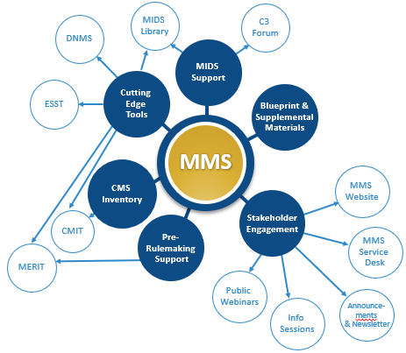
Overview of the Measures Management System
CMS developed the MMS to foster and support standardization, flexibility, and innovation in quality measurement through a series of channels
The MMS conducts stakeholder outreach and education, which includes annual public webinars, monthly information sessions, a newsletter, and other ad hoc outreach activities
https://www.cms.gov/Medicare/Quality-Initiatives-Patient-Assessment-Instruments/MMS/Index.html
Notes:
The graphic on this slide shows the complexity of this project. Our team supports CMS in its work to ensure measures are developed to the highest possible standards. We also manage CMIT and support measure implementation by managing MUC List submissions and maintain the MMS Blueprint. For more information about any of these offerings, visit the MMS website help desk where you can reach us with questions about quality measurement. Alternatively email MMSsupport@battelle.org.

Slide 4

MMS Blueprint
Documents processes and decision-making criteria for measure development, implementation, and maintenance
The processes outlined in the document ensure measure developers meet the evaluation criteria CMS requires
While required for CMS developers, it is useful for anyone developing measures, especially those submitting measures for consideration into CMS programs.
Notes:
In 2020 the Blueprint was distilled down to100 pages of high-priority measure information with an extensive series of supplemental materials with more in-depth information on key topics. This collection of materials documents all of the processes and decision-making criteria to guide measure development, implementation and maintenance. Although the Blueprint is required reading for CMS measure developers, the information in the document is useful for anyone that has an interest in applying best practices to measure development. The MMS Blueprint is the definitive source for information about CMS quality measure development, and the digital Blueprint serves as a roadmap for guiding CMS’ modernization efforts with regard to healthcare quality measures.

Slide 5
Quality Measurement at CMS

Slide 6

Impacts and Next Steps
Meaningful Measures 1.0
Future State
Since 2017, CMS has made progress in streamlining measurement and reducing burden by:
Eliminating measures that are redundant, not clinically relevant, and/or low impact from our programs
Removing 15% of measures from CMS programs (IQR 60% reduction in inpatient quality reporting and 22% reduction in MIPS)
Identifying gap areas across programs
Prioritizing outcome (including patient reported) over process measures.
Build on MM 1.0 to:
Continue efforts to streamline quality measurement
More effectively leverage measures to drive outcome improvement
Transition to digital measures and use of advanced analytics
Increase patient-centeredness through patient-direct quality measures and increased transparency
Promote equity and close gaps in care via quality measures

Slide 7



Vision for the Next 5-10 Years
Use impactful quality measures to improve health outcomes and deliver value by
Empowering persons to make informed care decisions
While reducing burden to measured entities
Notes:
Value is derived through empowering persons or patients to make their informed care decisions through increased transparency accessible to the average American. Value also comes from reducing burden to measured entities such as clinicians, hospitals, states, health plans, nursing homes, etc.

Slide 8

Known Challenges in Quality Measurement
Burden on measured entities
Large number of measures
Perceived gap between quality measurement and quality improvement
Challenges associated with EHR data for quality measurement
Ensuring measures are meaningful and useful to patients
Measuring disparities in social determinants of health to inform equity improvement
Notes:
CMS has worked hard to reduce the number of chart-extracted measures, but eCQMs are not without challenges. While we have decreased the number of measures, there are approximately 600 measures used across the agency, not counting all of our CMMI models, QCDR measures, etc. It can be burdensome to realize the connection between quality measurement and quality improvement and ensure that connection is easily deciphered and understood.

Slide 9
Major Goals
Streamline quality measurement
Leverage measures to drive improvement in health outcomes more effectively
Transition to digital measures and use of advanced analytics
Increase patient-centeredness through patient-reported quality measures and increase transparency
Promote health equity and close gaps in care via quality measures
1
2
3
4
5
Notes:
Step 1:
Use the Meaningful Measures Framework to streamline quality measurement, meaning having more efficient, high-value measures with the least amount of burden possible.
Step 2:
Where the first goal is about the measures themselves, the second goal is about the modernization and streamlining of the programs themselves, and so thinking about some of the modernization coming with the MIPS value pathways as an example.
Step 3:
Transforming quality measures to make them more efficient and to move to the future through quality measurement.
Step 4:
Using measures to empower patients and caregivers to make the best healthcare choices by ensuring voices of patients, consumers and caregivers not only throughout the measure development process, but in measures themselves by ensuring CMS is using more PROMs and measures in shared decision-making in programs and the importance of accessible transparency in our programs.
Step 5:
Promote equity and ensure we are doing everything we can to leverage quality measures to close gaps. This goal perhaps stands on its own, but also is one that can be baked into the other four goals.

Slide 10
Streamline Quality Measurement
Meaningful Measures 2.0 will serve as the basis for streamlining measurement by:
Utilizing only quality measures of highest value and impact focused on key quality domains.
Aligning measures across value-based programs and across partners, including CMS, federal, and private entities.
Prioritizing outcome and patient reported measures.
Transforming measures to fully digital by 2025 and incorporate all-payer data.
Developing and implementing measures that reflect social determinants of health
Notes:
CMS is prioritizing existing measures as well as the development of measures that directly address disparities, or those that reflect SDOH.
CMS is working very closely with the VA and DOD to review measures particularly in the hospital setting and with Hospital Compare.
CMS is working with CQMC to align measures across all payers, and by aligning measures across CMS, federal programs and private payers, CMS will prioritize and ultimately reduce the number of measures in their portfolio.

Slide 11

Meaningful Measures Framework 2.0
Meaningful Measures 2.0 will:
Address priorities and measure gaps
Promote digital quality measurement
Promote better collection and integration of consumer and caregiver voices
Promote better alignment across CMS programs

Slide 12
Steps Toward Streamlining
Engage a CMS Agency-wide Work Group to identify measure alignment/reduction opportunities among CMS programs
Focus on measure standards: are we measuring the right aspects of care?
Prioritize outcome and digital measures through measure development, measure selection/implementation, and alignment activities
Retiring manually abstracted measures and low-value process measures
Notes:
Outlined as quality topic areas are diabetes and hypertension to ensure that measures are meaningful to audiences and programs we aim to reach to make improvements while ensuring the measure captures a standard of care critical to improving a health outcome, or when possible capturing the health outcome itself. Focusing on high-priority topic areas will help to streamline this work, but we must measure outcomes where possible and pay attention to the burden associated with capturing the data and reporting the measures to CMS and other payers.

Slide 13
Prioritizing High Impact Measures
Notes:
High-prevalence example:
Diabetes impacts over 30 million people in the U.S. and controlling blood glucose or HbA1c is a critical part of diabetes care. By evaluating clinicians/facilities on the percentage of patients with well/poorly controlled blood sugar, CMS may incentivize active ongoing care for those most vulnerable patients.
Low-prevalence example:
A disease/condition/treatment limited to a very small group of patients.
Adherence to frameworks like this one in conjunction with Meaningful Measures 2.0 helps CMS to carefully evaluate its portfolio and streamline measures to only high-impact, high-likelihood conditions and identify any gaps.

Slide 14
Characterizing Burden
What drives burden in quality measurement?
Large numbers of measures, especially redundant or minimally harmonized measures
Different measure requirements across payors/programs
Measures that require special data collection (i.e., data not collected during the normal course of care)
EHR requirements (e.g., the creation of new data fields)
Notes:
The enterprise of quality measurement can be a costly one.
Measure reporting is time and resource-intensive to measured entities like hospitals or clinicians.
Measures can add burden in terms of workflow. Anytime a measure relies on a questionnaire, test or practice that isn’t incorporated into the normal course of care, hospitals and practices must invest time and shift workflows to accommodate them. This translates into increased wait times for patients, etc. Lastly, the costs and feasibility associated with creating new fields in EHR systems vary significantly from system to system.

Slide 15



Characterizing Burden: Whose Burden Is it?
Measured entities (clinicians, hospitals, health plans, etc.)
Patients
Administrative costs associated with staff time
Costs associated with EHR modifications
Training costs
Time spent entering data vs. time spent with patients
Increased paperwork before, during, and after visits
Repetitive/formulaic questions from providers
Reliance on disparate patient portals

Slide 16
Reducing Burden
Reduce the total number of measures
Align measures across programs to minimize the number of measures a given entity must report
Identify only the most important aspects of care to measure
Leverage emerging technologies (like FHIR) to simplify data collection
Engage patients to ensure that only measures that patients find to be meaningful are used in programs
Notes:
CMS staff review measures across their programs to identify opportunities to remove redundant measures and leverage high-value measures across multiple programs to reduce reporting burden on entities that report across all programs.
CMS is taking a measure standards approach to ensure that only the most important aspects of care are being prioritized.
CMS aims to engage persons and caregivers to ensure that the patient voice is at the center of defining what is important and meaningful.
CMS is working hard to take advantage of emerging technologies with FHIR, NLP and machine learning to simplify data collection and reporting.

Slide 17
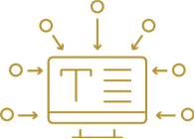
The Journey from Paper to Digital
Traditional
eCQMs
dQMs
Paper Quality Measures
Data from claims, manual chart extractions and patient experience surveys.
Electronic Clinical Quality Measures (eCQMs)
Data primarily from electronic health records (EHRs).
Digital Quality Measures (dQMs)
Data from EHRs, registries, HIEs, claims, patient experience surveys, etc.
Notes:
Traditional measures:
Reliance on manual chart extraction of clinical information from data sources.
Incredibly time/resource-intensive and susceptible to human error.
eCQMs:
Reliance on structured data captured in EHRs enabling electronic data extraction with automated extraction.
Downsides, including challenges associated with getting required data fields added to EHRs.
Challenges associated with collecting information stored in unstructured fields.
dQMs:
Refers to a broader group of electronically derived measures of which eCQMs are one type.

Slide 18
Digital Quality Measurement Blueprint

Slide 19
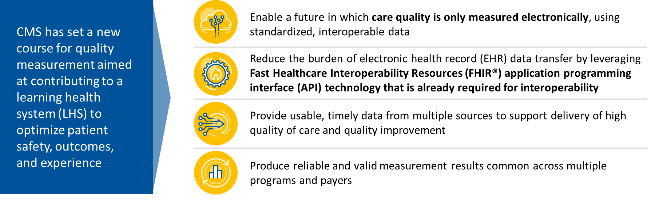
CMS has set the ambitious and critical goal of transitioning to digital quality measurement by 2025

Slide 20
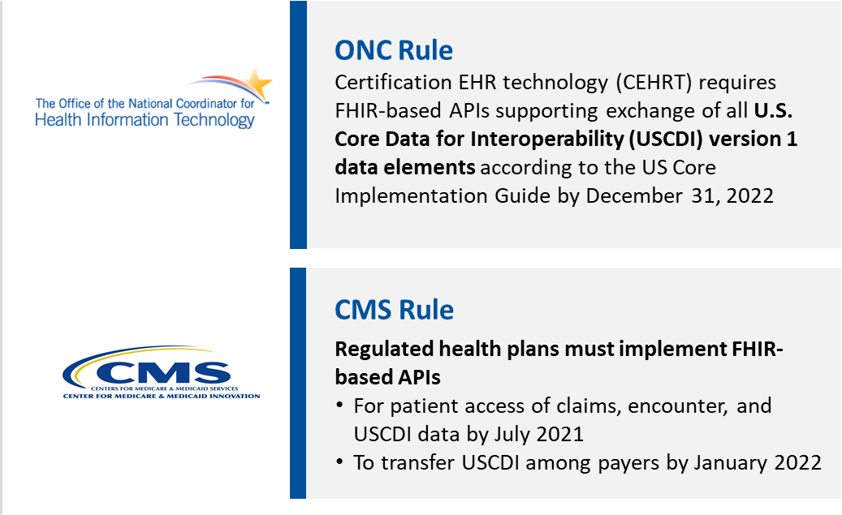
To achieve this vision, CMS needs a coordinated strategy that builds on recent and current activities
Recent rules require provider and health plan FHIR APIs that will make data more accessible for interoperability
Meaningful Measures 2.0 identifies priority areas and focuses on digital quality measures
CCSQ QMVIG Strategy Project is building tools for specifying and testing electronic clinical quality measures (eCQMs) in FHIR, and ISG is building a FHIR server for data storage
Health Level Seven (HL7®) FHIR Accelerator multi-stakeholder private and public-private groups are advancing FHIR standards for use cases
Sources:
https://www.cms.gov/meaningful-measures-20-moving-measure-reduction-modernization
https://www.federalregister.gov/documents/2020/05/01/2020-07419/21st-century-cures-act-interoperability-information-blocking-and-the-onc-health-it-certification
https://www.federalregister.gov/documents/2020/05/01/2020-05050/medicare-and-medicaid-programs-patient-protection-and-affordable-care-act-interoperability-and
Notes:
Essentially, what is described on this slide is that our current environment is ripe to take advantage of a new set of technology; therefore, it is reasonable for us to begin thinking about how technology can serve the overarching policy goal of better quality for patients.

Slide 21
Goals
Quality measurement system that is fully based on digital measures, which reduces burden of reporting, are able to provider many dimensions of data in a timely fashion, enable rapid feedback and transparent reporting
Digital measures leveraged for advanced analytics to define, measure and predict key quality issues
Quality measures are a secondary product from routine data generation of normal workflow (less burden)
This new quality measurement paradigm can only be accomplished through digital measures combined with interoperability, ideally through FHIR API technology

Slide 22
What is FHIR®?
FHIR® – Fast Healthcare Interoperability Resources (http://hl7.org/fhir)
FHIR is a next-generation standards framework created by Health Level Seven International (HL7)
Provides an Interoperable Platform for Healthcare data
Defines a common way to structure health data known as ‘Resources’
Enables automated data exchange through Application Programming Interfaces (APIs)
FHIR uses latest technologies to be developer-friendly
Gaining widespread adoption in both commercial and government settings
Notes:
FHIR provides a common structure for data for use across multiple data sources and platforms and allows for automated data exchange for the use of APIs. This presents an opportunity to make data more accessible between providers and data systems. This is imperative since many issues are derived from fragmented data sources which limit their usability for specific use cases.

Slide 23
Digital quality measures (dQMs) defined
dQMs are quality measures that use one or more sources of health information that are captured and can be transmitted electronically via interoperable systems
Potential data sources for dQMs include, but are not limited to:
EHRs
Administrative systems
Case management systems
Instruments (e.g., medical devices, wearable devices)
Patient portals or applications (e.g., for collection of patient-generated health data)
Data from health information exchanges (HIEs) or registries
Data from post-acute assessments
dQMs will leverage advances in technology (e.g., FHIR APIs ) to access and electronically transmit interoperable data for dQMs will reinforce the aggregation of data across multiple data sources, rapid-cycle feedback, and alignment of programmatic requirements

Slide 24
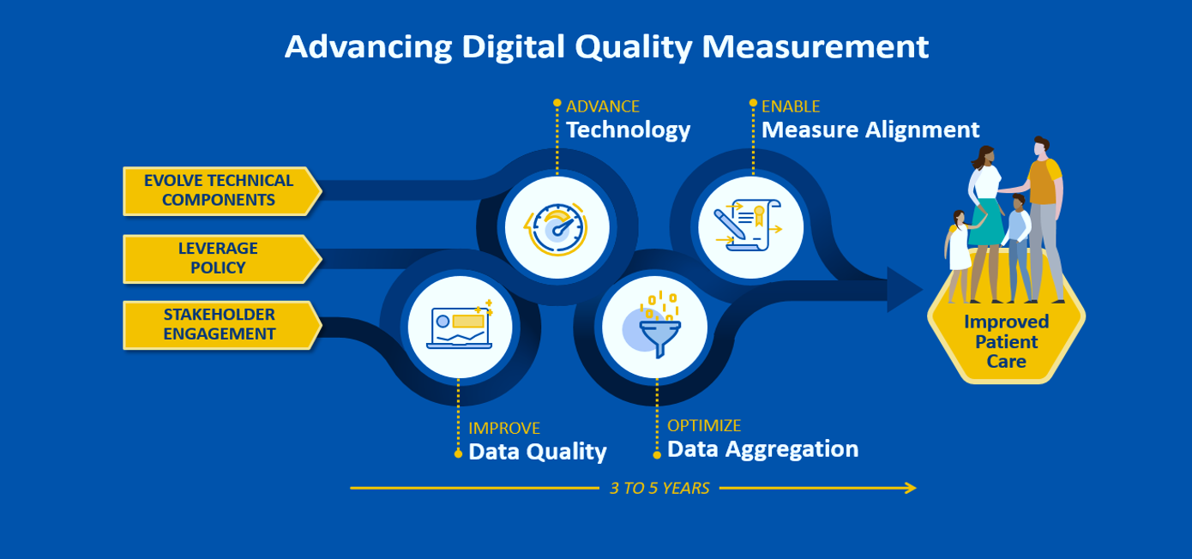
CMS is developing a strategy for advancing dQM centered around four key domains
Notes:
Improve data quality— This means standardizing both the format of the data, but also standardizing the data requirements available for use within the healthcare ecosystem while pushing for the advancing of technology, including FHIR API reporting, but also in the approach to measure calculations.
Measure alignment—This means trying to align a vast ecosystem of programs, payers and data systems in order to reduce the burden of data being required by providers and their systems today.

Slide 25

Reduce collection burden with structured, standard data
CURRENT STATE
FUTURE STATE
Providers’ struggle to implement current eCQMs
Limitations and slow adoption of current standards
Lack of provider data mapping and quality assurance (QA) of required data
Required changes to clinical workflows
dQM implementation is seamless and at the push of a button
Focus on standardized data – FHIR, USCDI, and supplemental standards that enable automated extraction
Standardized and automated data collection facilitates valid and reliable data mapping and streamlined auditing processes
Eliminate workflow changes required only for measurement and focus on measures that also align with quality improvement priorities

Slide 26
Leverage FHIR APIs to implement a low-burden measurement approach that facilitates learning
CURRENT STATE
FUTURE STATE
Data sharing supports sharing of whole patient record not individual data elements
Electronic data extraction for eCQMs is burdensome or impossible due to differences in EHR set-ups and requirement to map to the Quality Data Model
Hospitals' and other providers' work to implement measures has no collateral benefit
Measures are defined in FHIR, a versatile model used across multiple applications that supports access to “atomic” data
FHIR-based measure applications are components of a service-oriented architecture
Quality measures query data from FHIR APIs mandated for interoperability
Work done to implement measures advances quality improvement and research, and measures are developed as modules within the larger healthcare ecosystem

Slide 27
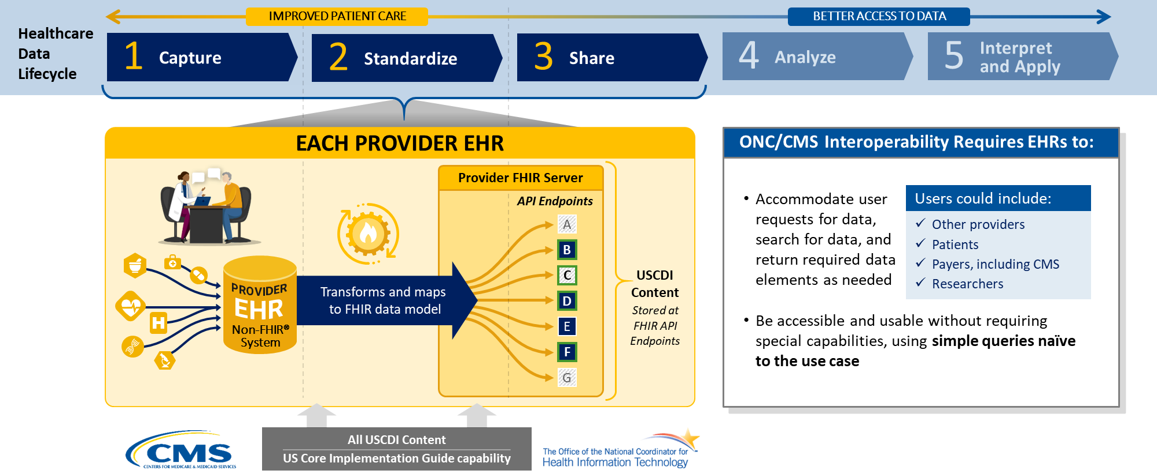
Providers have to implement FHIR APIs that perform transformation functions for data interoperability
Notes:
This slide depicts an eCQM data lifecycle whereby we seek to limit the involvement of the EHR to making data available via FHIR API. So the system is required to capture the data, standardize the data using the FHIR data model, and then to make those data available as endpoints. In turn the need to analyze the data and interpret or apply it necessarily rests with the later data users. In the case of CMS quality programs that would be CMS, and so CMS then takes on the responsibility for analyzing the data and making use of it for its programs. The EHRs no longer have to undertake that responsibility.

Slide 28
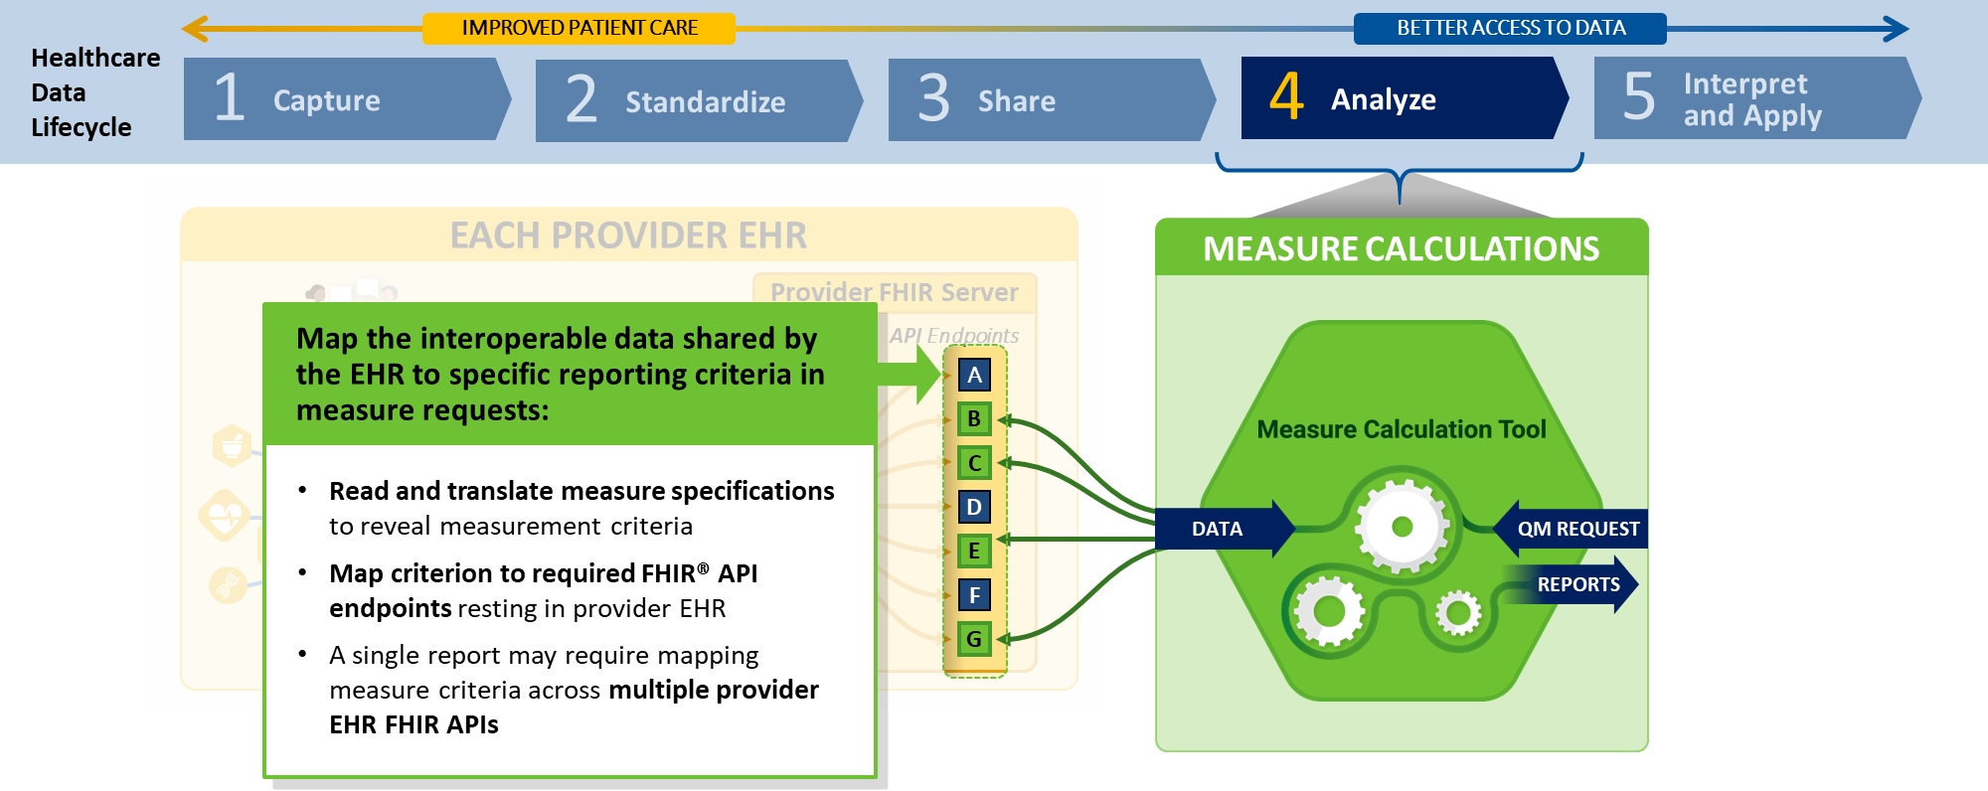
Modular Measure Calculation Tools can bridge the gap between interoperable EHR data and dQM requests
Notes:
The concept of a measure calculation tool which isn’t a specific tool that anyone owns but instead is agnostic to ownership. The purpose of this is to exist as an independent module that contains the logic instructions necessary to take advantage of FHIR API endpoints and then to produce quality measurement reports, feedback and potential needs for the endpoints.
The tool is developed by measure developers and encapsulated with measure specifications and then consumed — whether by CMS, a third party, or by EHR vendor themselves — and is able to take those FHIR API endpoints and apply the measure logic.
The key point here is that it’s not something that has to be developed by the EHR and as such, it places the responsibility for embedding the instructions for analysis and data calculation elsewhere — specifically with the measure developers and the users of the data. The advantage here is that these API endpoints can then be used for other purposes. The calculation tool, while it ensures they can be used for a specific requirement like a quality program, it does not bar them from use for other purposes. We created an environment where those data, while we now need to capture more data endpoints for transmission, those endpoints may now be used across multiple cases in the system.

Slide 29
Progress on other lanes facilitates alignment
CURRENT STATE
FUTURE STATE
Program-, payer-, and setting-specific
Strides toward interoperability
Providers must support many measures
Measures create burden for the provider
Data are fragmented across capture systems, thereby limiting the feasibility of measures that capture the full patient course
Common dQM portfolio across payers and agencies
Aligned measures
Consistent data
Data resources, standards, measures, and tools are shared across the healthcare ecosystem
Reporting across payers is low burden
Health system learning is coordinated and shared, and promotes rapid-cycle feedback
Notes:
One main issue with program alignment is that current program requirements particularly with respect to quality tend to be specific to program payer and setting. Where there is a lack of alignment there is the need for additional burden of data collection in order to meet the requirements for those programs.
The last piece is an effort to standardize data resources and measures and tools incorporated within the healthcare ecosystem. Addressed earlier in the slide deck is that USCDI is one potential vehicle. The goal is to get various parties including state, federal and private payers to agree upon standards for not only how data are formatted, but also what data need to be available in order to serve the purpose of interoperability.

Slide 30
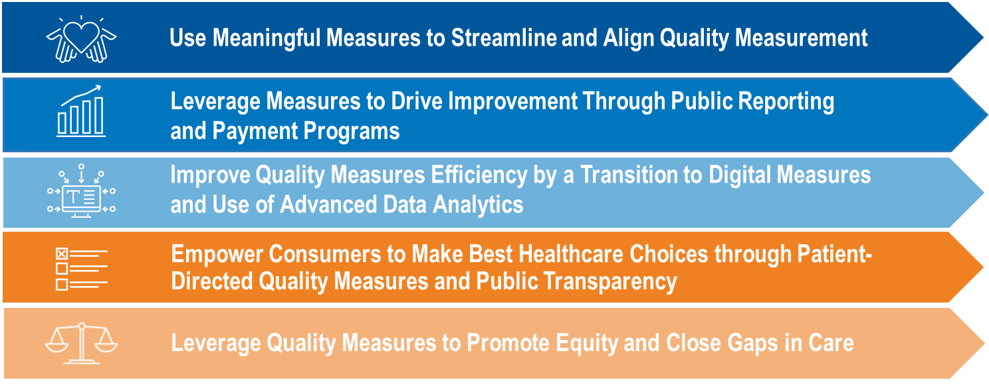
Goals of the CMS Quality Measurement Action Plan
Notes:
Having the ability to cross platforms for data sources gives us the capacity to incorporate data sources to break through the fragmentation of the system as it currently exists, and to potentially pursue other gaps because of the difficulty in accessing data on a reliable basis towards use for quality improvement purposes. This is ideal to breaking down those barriers and ensuring that we’re not limited to just conveniently available data.

Slide 31
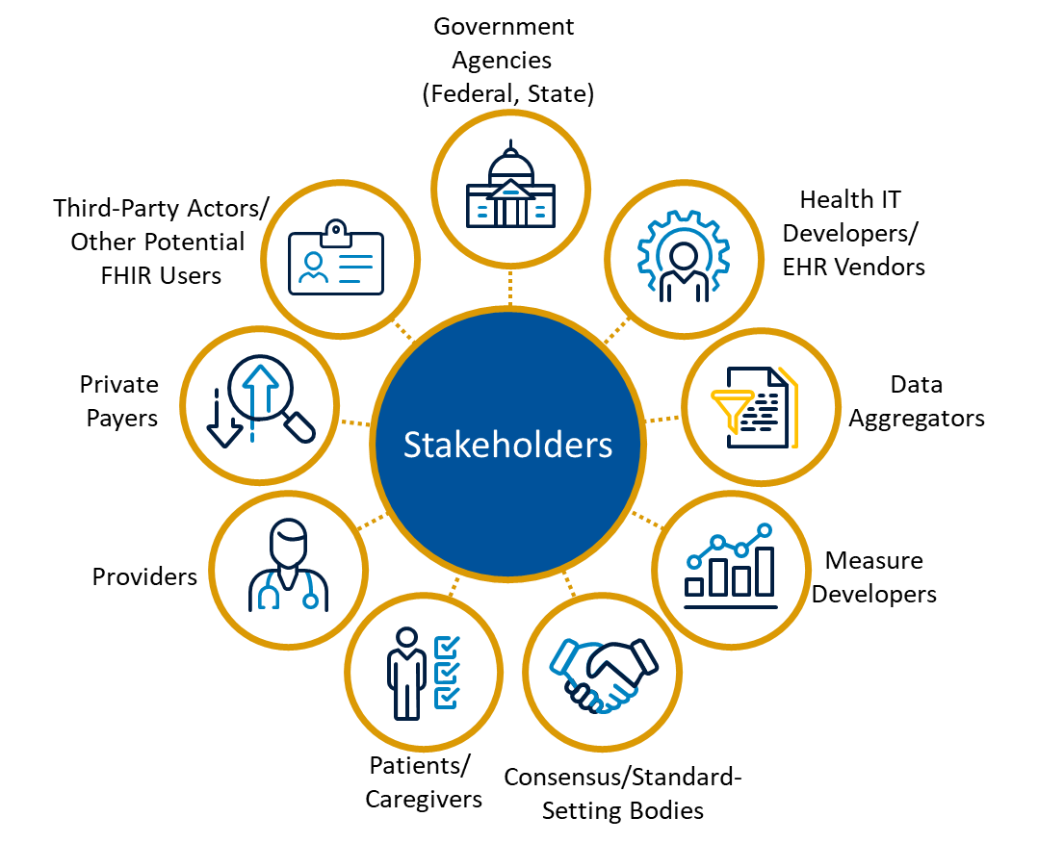
CMS’s active engagement with a broad set of stakeholders is critical to the success of forming, operationalizing, and maintaining the dQM Blueprint
Both the federal government and the private sector play key roles in accessing health data to improve care
For example, private sector develops technologies and measures
Alignment opportunities
Cross-agency
Federal/states
Federal/private sector
Notes:
The effort to engage with stakeholders in outreach has begun and has been initiated with our federal partners. This concept is being presented here in an effort to build awareness of our considerations. There is tremendous work ahead and therefore CMS always seeks input from interested parties in how we can best approach this transitional work.

Slide 32
CMS is currently requesting comments on plans to modernize its quality measurement enterprise
Fiscal Year (FY) 2022 Medicare Hospital Inpatient Prospective Payment System (IPPS) and Long Term Care Hospital (LTCH) Rates Proposed Rule (CMS-1752-P)
Areas for comment
Definition of digital quality measures
Using the Fast Healthcare Interoperability Resources (FHIR®) standard for eCQMs
Standardizing data required for quality measures for collection via Application Programming Interfaces (APIs)
Leveraging technological opportunities to facilitate digital quality measurement
Supporting data aggregation
Developing a common portfolio of measures for potential alignment
To learn more about this request, review the
Proposed rule: https://www.federalregister.gov/public-inspection/2021-08888/medicare-program-hospital-inpatient-prospective-payment-systems-for-acute-care-hospitals-and-the
Rule fact sheet: https://www.cms.gov/newsroom/fact-sheets/fiscal-year-fy-2022-medicare-hospital-inpatient-prospective-payment-system-ipps-and-long-term-care
Notes:
In the spring CMS published the IPPS Proposed Rule which lays out in writing much of what was addressed during this presentation here in greater detail and specifically requests comment for a number of areas. For more information and to those interested in providing us with feedback through the comment period, please reference the link to the factsheet.

Slide 33
Challenges
Systems, vendors and users need to adapt to new digital healthcare environment (Digital transition – Improves American Healthcare Infrastructure)
Need for public/private partnerships to accelerate improvement
Adequacy of workforce
Standardization of data elements; improvement of quality measurement
Notes:
The changes addressed require significant adaptation by systems, vendors and users in order to meet the shifting data requirements and is hardly a cost-free enterprise. We anticipate the need for public and private partnerships to accelerate these improvements in data systems and anticipate workforce changes as necessary to support the system implementation.

Slide 34
Announcements
Round 2!
Driving Quality in the US: How CMS Evaluates its Measure Portfolio
Tuesday, July 13, 2021, from 1:00 – 2:00 pm ET (Register here)
Wednesday, July 14, 2021, from 3:00 – 4:00 pm ET (Register here)
Additional webinars
June MMS Info Session, June 23, from 2:00 – 3:00 pm ET
July MMS Info Session, July 28, from 2:00 – 3:00 pm ET

Slide 35
Battelle
Measures Manager
Contact: MMSsupport@Battelle.org
CMS
Kimberly Rawlings (CMS COR)
Contact: Kimberly.Rawlings@cms.hhs.gov

Slide 36
Contact Information
Measures Manager: mmssupport@battelle.org
eCQI Resource Center: ecqi-resource-center@hhs.gov or ecqi.healthit.gov
QualityNet: qnetsupport@hcqis.org
This is also where the Hospital IQR program information can be found
ONC Project Tracking System (Jira): https://oncprojectracking.healthit.gov/
Meaningful Measures Hub: MeaningfulMeasuresQA@cms.hhs.gov

