Slide 1
A New Method to Improve Measurement of Race-and-Ethnicity in CMS Data and Applications to Inequities in Quality of Care
Marc N. Elliott, PhD | RAND Corporation
Sarah Gaillot, PhD (COR); also for this Task Meagan Khau, MA, Jess Maksut, PhD, Loida Tamayo, PhD (CMS COR)
June 2021

Slide 2

MMS Info Session Goals
Part of a larger effort to engage stakeholders and the public in quality measure development.
Additional activities the MMS team leads:
  Annual public webinars on high-priority CMS topics
  Outreach via our stakeholder listserv and
  the CMS MMS listserv
  MMS website updates and maintenance
  Development and promotion of emerging
  tools and resources
  MACRA-specific education and outreach
Notes:
CMS is committed to providing Education and Outreach opportunities about the quality measure development process to interested stakeholders to improve understanding of the process. CMS also seeks continual feedback to improve and/or expand its offerings to the healthcare quality measure development community and interested stakeholders. To date, CMS has implemented an Education and Outreach webinar series and has created resource materials that break down and explain various components and challenges in the measure development process. There are dedicated websites, listservs, and roadmap documents that are available to support those that are working in quality measure development, or are just curious and want to learn more about how it is done.

Slide 3

Setting the Stage
Increased emphasis on understanding differences in measure performance by race/ethnicity
  Missing data impede efforts to do this
Today’s presentation describes a promising approach for addressing this challenge
  This is for informational purposes
  CMS has not formally adopted this methodology
Notes:
This topic is especially timely and important given an increased emphasis at CMS in understanding the differences in measure performance by race and ethnicity. One barrier to doing this is the prevalence of missing data in the race and ethnicity fields in the medical record.

Slide 4
Presentation Objectives
By the end of this presentation, you will:
  Understand a novel methodology to address missing race-and-ethnicity data or improve existing administrative data in Medicare contexts to compare HEDIS clinical quality of care measures by race-and-ethnicity
  Applications of this methodology:
    Measuring Racial-and-Ethnic Differences in Voluntary Disenrollment from Medicare Plans
    Imputing Race-and-Ethnicity for Survey Respondents who did not report Race-and-Ethnicity
    Developing a Health Equity Summary Score to Incentivize Excellent Care to At-Risk Groups
    National and Contract-Specific Stratified Reporting by Race-and-Ethnicity
    Racial-and-Ethnic Inequities in Behavioral Health Quality Measures in Medicare Health Plans

Slide 5
Race-and-Ethnicity Data Are Essential for Monitoring Quality, Coverage, Cost, and Access
The Affordable Care Act requires all federal data collection efforts to obtain information on race, ethnicity, sex, primary language, and disability status
The gold standard for race-and-ethnicity measurement is self-report
  Sometimes only imperfect administrative information is available for Medicare and other data
Missing or poorly-measured race-and-ethnicity data create barriers to monitoring and improving quality, coverage, cost, and access
We describe two related methods RAND has developed to address missing race-and-ethnicity data or improve existing administrative data in general and Medicare contexts

Slide 6
The BISG and MBISG Methods
Surnames and residential addresses are widely available and can help impute race/ethnicity in a cost-effective, validated approach
The Bayesian Improved Surname and Geocoding (BISG) approach can be used in any dataset with name and address data to measure and compare racial-and-ethnic groups
The Medicare BISG (MBISG) is a specialized version developed for CMS that takes advantage of additional Medicare data to improve administrative measures of race-and-ethnicity for Medicare beneficiaries
  MBISG data are regularly computed for all Medicare beneficiaries
  These data are not yet available via the CCW; this process is ongoing
  These data may be available in the interim via a DUA with CMS

Slide 7
Context for this Work:
CMS Administrative Race-and-Ethnicity Data
CMS’s Office of Minority Health wanted to compare HEDIS clinical quality of care measures by race-and-ethnicity
CMS administrative race-and-ethnicity is based on the Social Security Administration form that only allowed Black/White/Other response options before 1980
  Measures Black vs. not Black well
  Often misses Asian/Pacific Islander (API), Hispanic and misclassifies as White or Other
RAND developed a Medicare-specific algorithm (MBISG) to use surname and address to make HEDIS comparison by race-and-ethnicity possible
  Incorporated a prior, more general RAND algorithm (BISG)
Notes:
The context of the current work is to better understand CMS administrative race and ethnicity data. RAND developed a Medicare-specific approach to use name, address and other information to try to make this variable match what people say and self-report as closely as possible so that we could take other things like HEDIS measures of quality of care and compare them as accurately as possible using race and ethnicity. Part of this approach involved taking this preexisting name and address approach called the BISG and adapting it for the Medicare context.

Slide 8
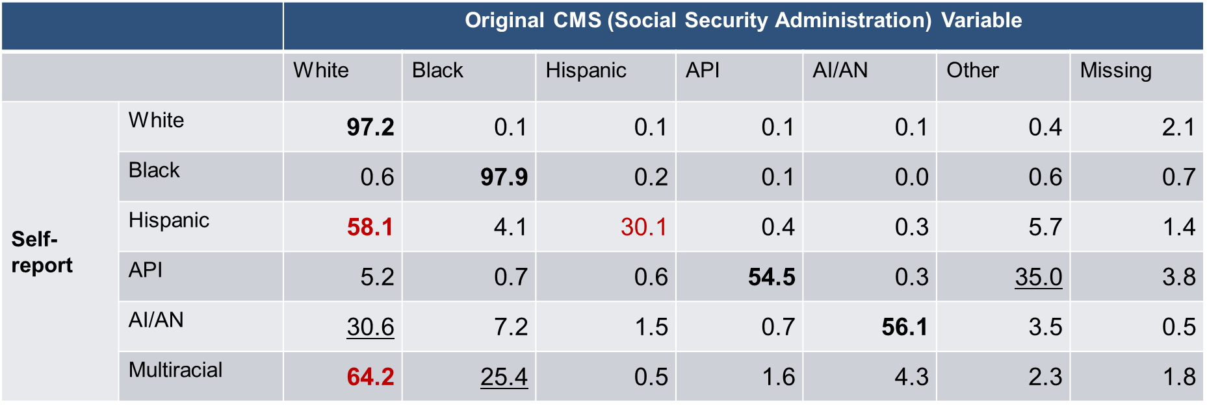
Original CMS Variable Misclassifies
Many Medicare Beneficiaries
Weighted Distribution of 2019 MA/FFS Survey Respondents
Notes:
Example—For somebody who self-reports as Hispanic, in the third row there is only a 30% chance that the SSA variable will record that person as Hispanic. There is a 58% chance they are misclassified as non-Hispanic white; therefore, this presents a number of challenges and paves the way as the motivation for undertaking this work.

Slide 9
RAND Developed the Bayesian Improved Surname Geocoding (BISG) for General Purposes
Incorporates census surname list and residential address probabilities, along with fixes for unlisted names and suppressed counts
Produces a vector of six probabilities of being Hispanic, non-Hispanic White, Black, API, American Indian/Alaskan Native (AI/AN), Multiracial
Concordance of 92-98% for API, Black, Hispanic, White (BISG 1.0; higher for BISG 1.1 in development)
  Limit use for AI/AN, Multiracial
  This general approach does not require Medicare data
MBISG 2.1 (described later) requires Medicare data and has concordance of 96-99% for API, Black, Hispanic, White
  Promising for AI/AN as well
Notes:
BISG—Uses census information about linkages between people’s last names and race/ethnicity reported on the census forms, and linkages with a residential address. It calculates the probability that a given person identifies as one of six different racial and ethnic groups based on those two bits of information.
Medicare BISG—Requires Medicare administrative data, not just name and address. It does better by utilizing additional information for the four largest groups and has shown promise for American Indian and Alaska Native (AI/AN) beneficiaries.

Slide 10
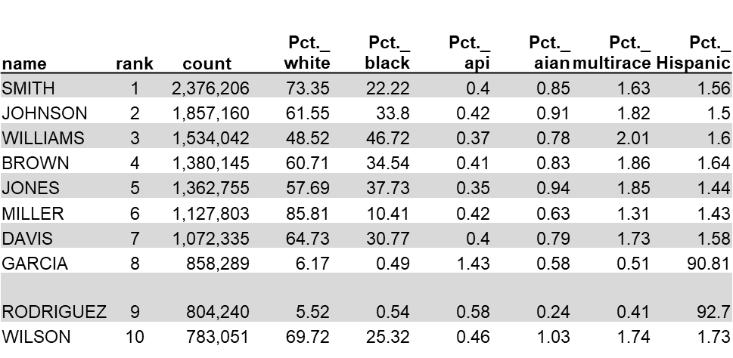
Surnames Can Be Linked to Race-and-Ethnicity Probabilities
2010 US Census surname database contains all surnames applicable to 100 or more Americans, along with race-and-ethnicity percentages
These 151,671 unique surnames cover 89.8% of U.S. population
  Special approach for rare names
Notes:
The Census Bureau puts together a list of surnames and cross-tabulates it with people’s self-reported race and ethnicity. There is not currently a release for the Census 2020; therefore, this is reflective of the 2010 data.
Example 1—If your surname is “Williams” which is the third most common surname in the U.S., there is roughly a 49% chance you self-report as white and roughly a 47% chance you self-report as black.
Example 2—If your surname is “Miller” in which case it’s much less likely that you’d identify as being black, or if your surname was “Garcia,” in which case there’s more than a 90% probability you would identify as Hispanic.

Slide 11
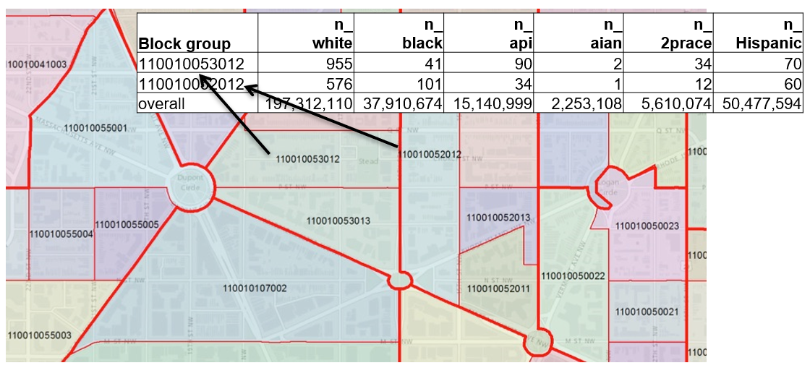
Enrollee Residential Addresses Can Also Be Linked to Race-and-Ethnicity Information
Enrollee addresses are “geocoded” to identify each enrollee’s census block group
Notes:
This figure overlays the race/ethnicity tabulations for two census block groups and overall on a map displaying multiple census block groups. A block group is a relatively small geographic area and is smaller than a census tract. This is based on geocoded information corresponding to the residential address using FIPS codes.

Slide 12
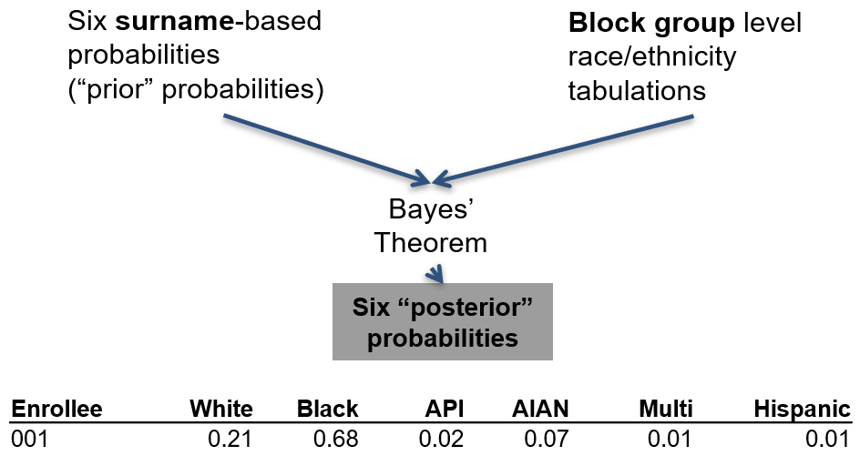
We Combine Both Sources of Information
Initial probabilities based on surname are “updated” using information on block group race-and-ethnicity.
Notes:
What are the different probabilities of race and ethnicity based on your last name?
What are the different probabilities based on where you live?
Example—A given person may have a 21% predicted probability of being white; a 68% predicted probability of being black and so on with those six probabilities summing to 100%.

Slide 13
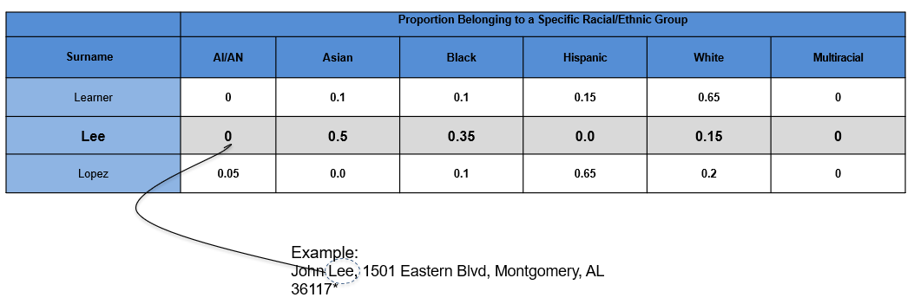
Census Surname List Provides Probabilities that a Person with that Last Name Belongs to Each of 6 Racial-and-Ethnic Groups
Notes:
This table displays the hypothetical proportion of people with one of each of three surnames that belong to a specific racial/ethnic group. Nationally of people with the surname Lee, 50% are Asian, 35% are black and 15% are white.

Slide 14
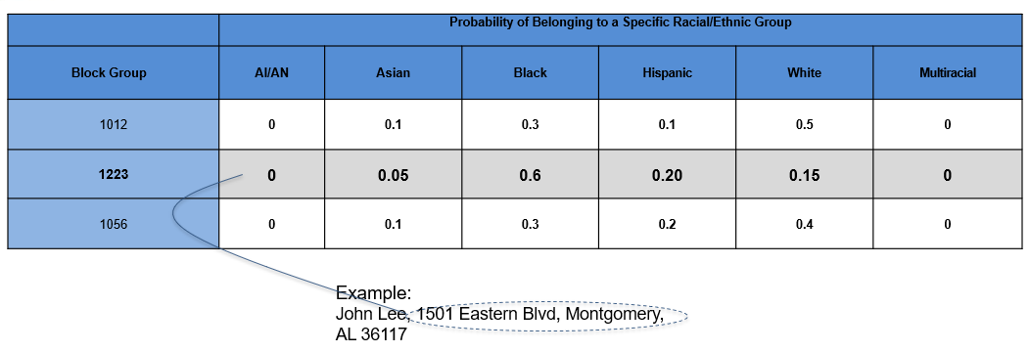
Census Block Group Files Provide Proportions of Residents Belonging to Each Racial-and-Ethnic Group in a Neighborhood
Notes:
This table describes the proportion of people belonging to a special racial/ethnic group in each of three block groups.
The racial/ethnic composition of people living in block group 1223 is 5% Asian, 60% black, 20% Hispanic and 15% white.

Slide 15
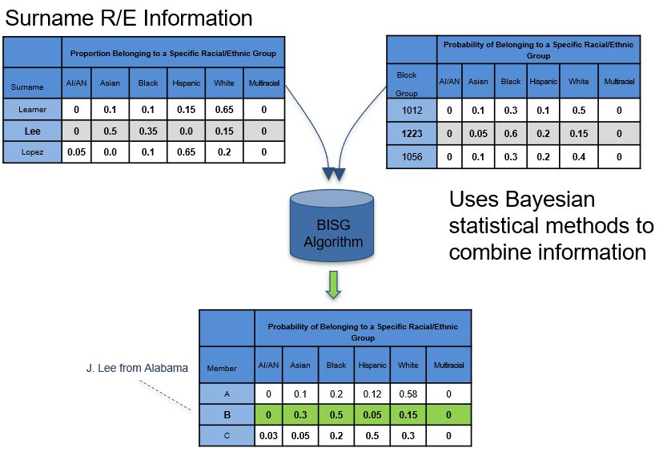
BISG Combines Surname and Block Group Data to Estimate Racial-and-Ethnic Probabilities
Notes:
This figure illustrates how the information about the proportion of people with the surname Lee belong to a specific racial/ethnic group is combined with the probability that a person in block group 1223 belongs to a specific racial/ethnic group is combined using Bayesian statistical methods to produce the predicted probabilities of each racial/ethnic group.

Slide 16
A Further Modification of BISG Updates CMS’s Administrative Race-and-Ethnicity Field (MBISG; Haas et al. 2018)
Turns CMS administrative classification into a vector of racial/ethnic probabilities using previous self-reported data from a national survey of Medicare beneficiaries, post-stratified to CMS enrollment files
Independently calculates a set of 6 BISG racial-and-ethnic probabilities from name and address
Uses similar Bayesian approach to integrate these two estimates, three information sources
Incorporates additional data elements and more flexible modeling
Substantially improves the original CMS variable

Slide 17
Data and Methods
Analyses employ Medicare CAHPS data (n=284,627)
  Permits linking self-reported race-and-ethnicity data to CMS administrative data
Predicted probabilities are checked by:
  Correlating with self-reported data
  Comparing mean predicted probabilities for each racial-and-ethnic group to the corresponding prevalence in self-reported data (calibration)
Evaluation of models uses 10-fold cross-validation:
  Randomly divided the observations into 10 equal parts
  Fit each model on 90% of the sample, and used that model to estimate racial-and-ethnic probabilities for the remaining 10%
  Correlated these out-of-sample predictions with self-reported race-and-ethnicity
  Averaged the 10 sets of correlations
Notes:
One way to validate this work is through a national series of surveys called Medicare CAHPS surveys which survey Medicare beneficiaries of all coverage types involving experiences with care. Beneficiaries are asked to self-report their race/ethnicity on this survey. We then can link it to the predictions made in order to gauge accuracy via a method called cross-validation; however, data being used to run the model isn’t the same data being used to check the predictions.

Slide 18
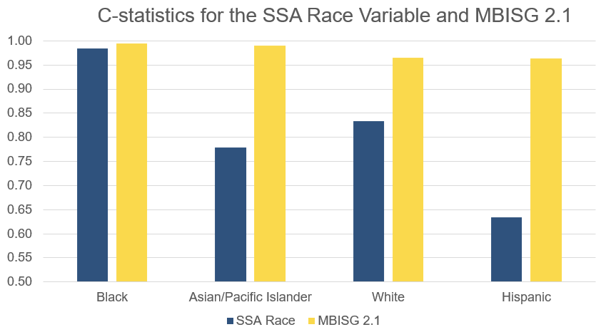
MBISG 2.1 Substantially Improves the Original CMS Variable
Notes:
Depicted here is an illustration of the accuracy you get using the MBISG which is the yellow bars and the original Social Security variable which is the blue bars. This is called a “concordance statistic” where .5 at the bottom means chance, and 1.00 at the top means it’s perfect.
Generally speaking, .7 is considered acceptable, .8 is considered good and .9 is considered excellent. By itself the original variable is excellent for black vs. not black. It’s good for white vs. not white. It’s acceptable for API vs. not, and it’s not even that for Hispanic vs. not, but proves the performance for each category only a little bit for the black race and ethnicity category, since being close to perfect, but substantially for the other categories.

Slide 19
Applications

Slide 20
Race-and-Ethnicity Probabilities
Can Be Used Directly
Descriptive statistics of how many in each racial-and-ethnic group
  % enrollment by race-and-ethnicity by plan, state, overall
Weighting to compare something by race-and-ethnicity
  % who were screened for colorectal cancer for each group
Regression Analysis
  Include race-and-ethnicity in a statistical model that looks at the association of race-and-ethnicity with costs
  Multiple imputation or “plug in” approaches
Best performance using probabilities
  RAND also provides classifications
Notes:
Example:
What’s the racial and ethnic distribution of enrollment in a given plan, or in a given state, or overall?
What proportion were screened for colorectal cancer?
What are differences in costs or spending associated with race and ethnicity after controlling for other variables?

Slide 21
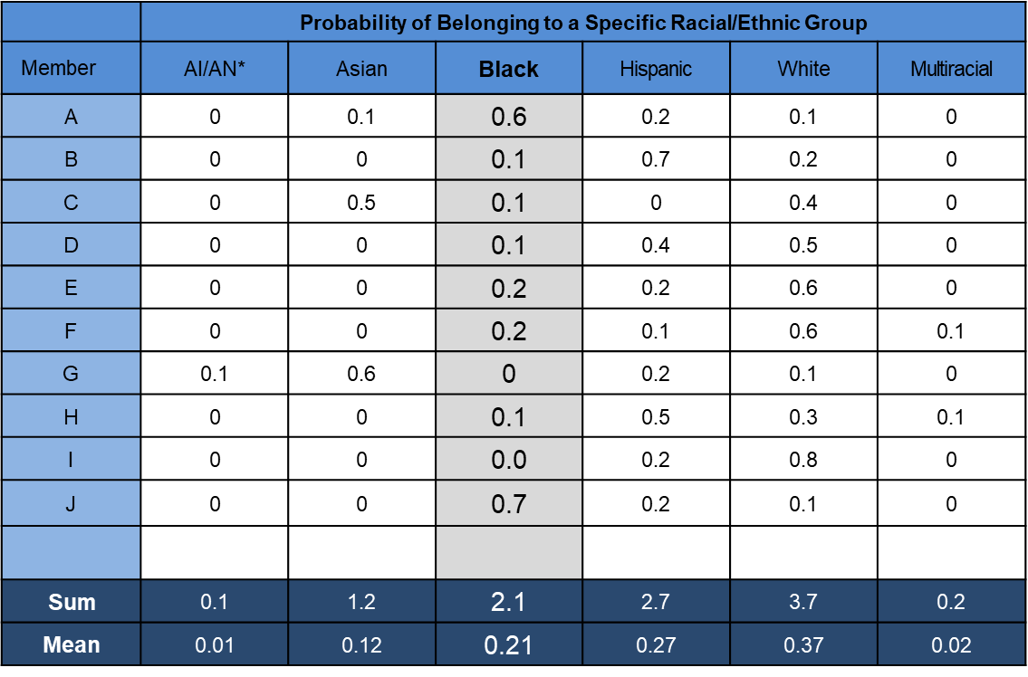
Individual Probabilities can be Converted into Group Counts and Proportions (or Percentages)
Sum = Count Mean = Proportion or Percent if Multiplied by 100
Notes:
For purposes of visualization, if you wanted to estimate how many members of a group are in a given plan, you may add up the probabilities to get an estimated count, or average the probabilities to get a proportion.

Slide 22
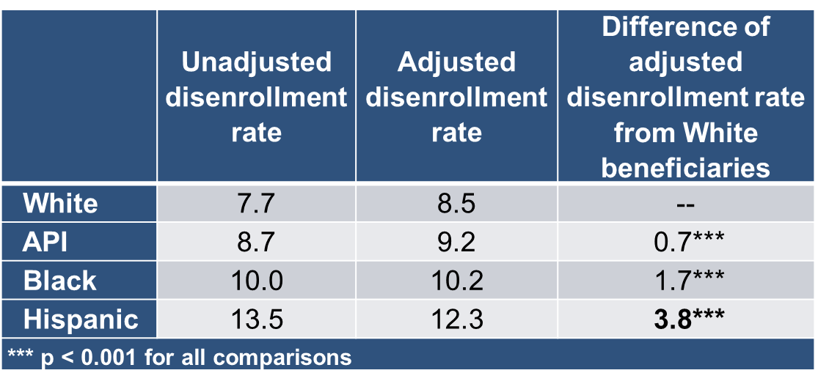
Application 1: Measuring Racial-and-Ethnic Differences in Voluntary Disenrollment from Medicare Plans
We linked voluntary disenrollment information to MBISG 2.0.
Notes:
This slide shows data from a research study about voluntary disenrollment from Medicare plans.
First column—The different rates of voluntary disenrollment by race and ethnicity which were much higher for Hispanic than non-Hispanic white beneficiaries.
Second column—Contains other variables in the model; for example, when you can voluntarily disenroll depends on a lot of factors such as with dually eligible for Medicaid and so in accounting for those factors there are adjusted differences by race and ethnicity.

Slide 23
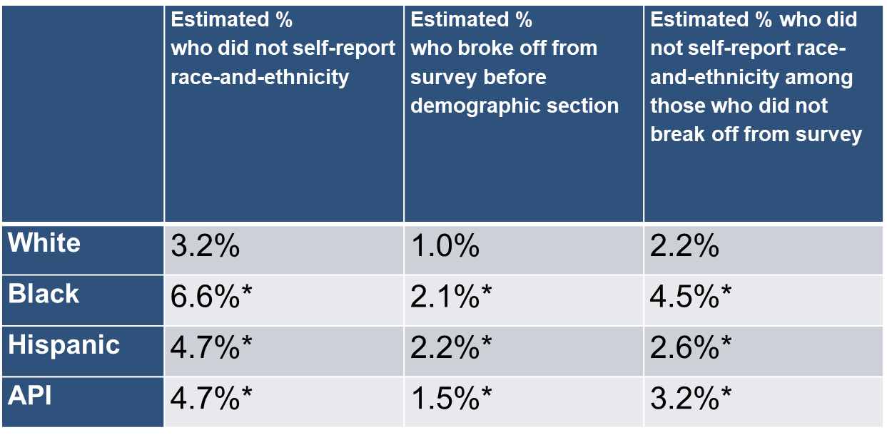
Application 2: Imputing Race-and-Ethnicity for Survey Respondents who did not report Race-and-Ethnicity (Dembosky et al. 2018)
Notes:
This slide addresses those individuals who did not answer the item at the end of the CAHPS survey about race and ethnicity. We then linked them to the racial and ethnic probabilities.
First column—Here we estimate the percent of different beneficiaries by race and ethnicity who chose not to answer. There was evidence that black beneficiaries were more likely to not answer that item, 6.6% of the time than white beneficiaries, 3.2% of the time, with Hispanic and API beneficiaries in between. We discovered that was due to ending the survey prematurely vs. specifically skipping around that item.

Slide 24
Application 3: Developing a Health Equity Summary Score to Incentivize Excellent Care to At-Risk Groups (Agniel et al. 2019)
We created an equity summary score for Medicare Advantage health plans based on HEDIS and CAHPS scores for beneficiary groups associated with dually eligible for Medicare and Medicaid/low income supplement (DE/LIS), race-and-ethnicity
We considered:
  Current levels of care
  Within-plan improvement
  Nationally-benchmarked improvement for API, Black, Hispanic, and DE/LIS beneficiaries
Notes:
Application 3—RAND developed the health equity summary score for CMS to measure and incentivize better care for underserved beneficiaries using HEDIS and CAHPS data that targets care for dually eligible Medicare/Medicaid, or who are LIS as well as beneficiaries who are API, black or Hispanic. It displays each Medicare plan at the current level of care, the extent to which the plan has improved over time, and in terms of closing gaps with its lagging groups.

Slide 25
Application 4: National and Contract-Specific Stratified Reporting by Race-and-Ethnicity
Public reporting of HEDIS measure scores and inequities at the national level
  Inform CMS, plans, and providers about needs for quality improvement
  Inform patients in communicating with their providers/plans about types of care where disparities exist
Public reporting of HEDIS measure scores and inequities at the contract level
  Inform CMS, plans, and providers to focus plan-specific quality improvement efforts
  Inform patients in communicating with their providers/plans about types of care where disparities exist
  May inform choice of contract
National and plan-level data appear on CMS’s Website https://www.cms.gov/About-CMS/Agency-Information/OMH/research-and-data/statistics-and-data/stratified-reporting.html
Notes:
Application 4—The HEDIS data is reported by race and ethnicity at the national level and also for MA contracts. For a number of years this data has been available on the Office of Minority Health’s section of CMS’ website.
Example—Assess how well a given contract performs overall, for say colorectal cancer screening. You can locate which plans perform better, for example, for black beneficiaries or Hispanic beneficiaries for colorectal cancer screening.

Slide 26
Application 5: Racial-and-Ethnic Inequities in Behavioral Health Quality Measures in Medicare Health Plans (Breslau et al. 2018)
Quality of behavioral health care data for older adults may be lower for API, Black, and Hispanic than for non-Hispanic White adults
Unlike other types of medical care, within-plan inequities may be prominent in behavioral health
  Variation within providers tend to be larger for processes involving patient counseling
  Differences by race-and-ethnicity in views of behavioral health care
We describe variation in care by beneficiary race-and-ethnicity
  Within Medicare Advantage contracts
  Variation across contracts
Notes:
Application 5—Described in a Breslau et al. 2018 journal article with a focus on whether quality of care differed for API, black, Hispanic and non-Hispanic white Medicare beneficiaries. In addition, we hoped to understand the extent to which inequities reflected concentration in higher and lower-performing contracts vs. different experiences in the same contracts.

Slide 27
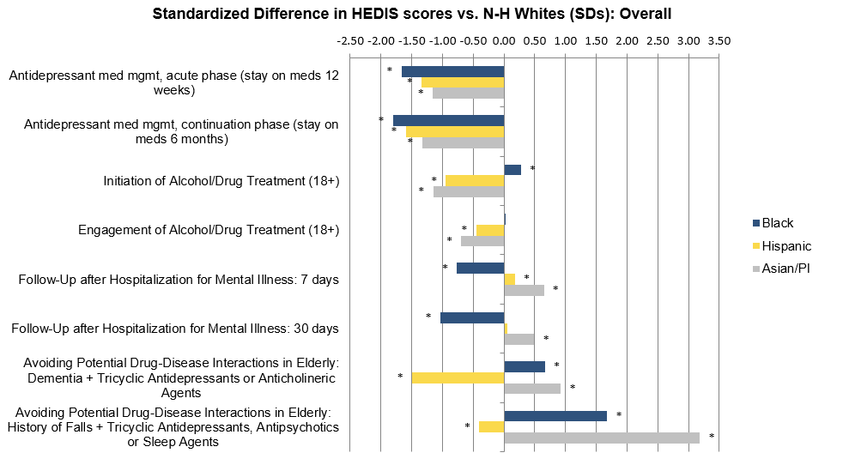
Overall Antidepressant Medication Management Worse for Black, Hispanic, and API Beneficiaries
Notes:
Depicted in this chart are differences between black, Hispanic and API beneficiaries and white beneficiaries.
When the bar goes to the left the group corresponding to the bar is receiving worse care.
When the bar goes to the right, that group is receiving better care.
Our findings highlight in particular antidepressant medication management, which are those first two bars being considerably worse for black, Hispanic and API beneficiaries relative to non-Hispanic and white beneficiaries where patterns differed for other behavioral health measures.

Slide 28
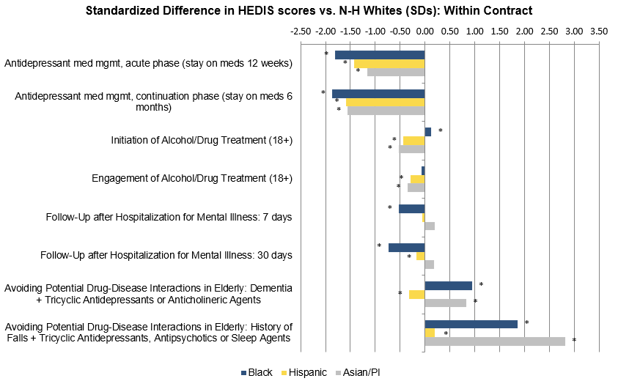
Measures with Larger Overall Disparities Tend to Have Disparities Concentrated with Contracts
Notes:
This chart displays within-contract differences from non-Hispanic whites for black, Hispanic, and API beneficiaries by HEDIS score.
Example—It does not mean Asian, black and Hispanic beneficiaries are primarily enrolled in contracts that do a poor job on antidepressant medication management. Rather, they received worse care by those measures in the same contracts than non-Hispanic white beneficiaries.

Slide 29
Using The MBISG
MBISG by HICN may be obtainable via DUA from CMS
To some extent, Dr. Marc Elliott and RAND colleagues can advise on how to use MBISG probabilities and classifications

Slide 30
References
Agniel D, Martino SC, Burkhart Q, Hambarsoomian K, Orr N, Beckett MK, James C, Hudson Scholle S, Wilson-Frederick S, Ng J, Elliott MN. (2019) “Incentivizing Excellent Care to At-Risk Groups with a Health Equity Summary Score” JGIM doi: 10.1007/s11606-019-05473-x
Haas A, Elliott MN, Dembosky JW, Adams JL, Wilson-Frederick S, Mallett JS, Gaillot S, Haffer SC, Haviland AM. (2018) “Imputation of Race/Ethnicity to Enable Measurement of HEDIS Performance by Race/Ethnicity” Health Services Research 54(1): 13-23. DOI: 10.1111/1475-6773.13099
Breslau J, Elliott MN, Haviland AM, Klein DJ, Dembosky JW, Adams JL, Gaillot S, Horvitz-Lennon M, Schneider EC. (2018) “Racial/Ethnic Disparities in Attainment of Behavioral Health Quality Measures in Medicare Advantage Plans” Health Affairs 37(10): 1685-1692.
Dembosky JW, Haviland AM, Haas A, Hambarsoomian K, Weech-Maldonado R, Wilson-Frederick SM, Gaillot S, Elliott MN. (2018) “Indirect Estimation of Race/Ethnicity for Survey Respondents who do not Report Race/Ethnicity” Medical Care 57(5): e28-e33. doi: 10.1097/MLR.0000000000001011

Slide 31
Key Points of Contact
Marc N. Elliott, PhD
  elliott@rand.org
Sarah Gaillot, PhD (COR)
  sarah.gaillot@cms.hhs.gov
Meagan Khau, MA
  Meagan.Khau@cms.hhs.gov
Loida Tamayo, PhD
  Loida.Tamayo@cms.hhs.gov
Jess Maksut, PhD
  Jessica.Maksut@cms.hhs.gov

Slide 32

Questions

Slide 33
Announcements
MMS Public Webinar
  Driving Quality in the US: How CMS Evaluates its Measure Portfolio
    Tuesday, July 13, 2021, from 1:00 – 2:00 pm ET (Register here)
    Wednesday, July 14, 2021, from 3:00 – 4:00 pm ET (Register here)
Upcoming Info Session
  July MMS Info Session “CMS Impact Assessment” July 28, from 2:00 – 3:00 pm ET

Slide 34
CMS
Kim Rawlings (CMS COR)
Contact: kimberly.rawlings@cms.hhs.gov
Battelle
Brenna Rabel (Stakeholder Engagement Task Lead)
Contact: rabel@battelle.org
Feedback: MMSSupport@battelle.org

