Slide 1
Respecifying Measures to Electronic Clinical Quality Measures (eCQMs)
August 2020
Presenter:
-Brenna Rabel (Battelle)

Slide 2

Vision and Goals​
An ongoing process to engage the public in quality measure development.
Elicit feedback that will help CMS design resources that can help all of those interested in healthcare quality improvement better understand the goals of quality measurement.
Education
Outreach
Dedicated Websites
Measure Development Roadmaps
Listserv opportunities
2/12/2020

Slide 3
Overview​
Define Measure Respecification​
Discuss Rationale for Respecification​
Determine Measure Suitability for Respecification​
Understand Feasibility Testing Considerations
Review Requirements for eCQM Specifications ​
Identify Appropriate eCQM Data Elements​
Development and Use of a Checklist ​

Slide 4
What is Respecifying¹?​
An existing measure is changed to fit the current purpose or use. This may mean changing a measure to meet the needs of a different care setting, data source, or population. Or, it may mean changes to the numerator, denominator, or adding specifications to fit the current use.​ For example, transition existing paper-based, claims, or registry measure to an eCQM. ​
1 Source: CMS Blueprint for the CMS Measures Management System
Notes:
Respecification is also described as reengineering or retooling.
Examples:
A hospital measure related to bed sores respecified for use in a nursing home
Respecified for use in a visual acuity measure in a Medicaid/Medicaid program, or
Respecified for use in the pediatric population

Slide 5
Why Respecify to an eCQM?​
Program requirement for EHR data and eCQM specification ​
Reduce burden of manual abstraction
Use measure in a different setting​
Use measure in a different population
Have a different attribution level
Notes:
CMS’ approach towards the reliance upon EHR data is part of a burden reduction and modernization strategy which is considered less burdensome to report on eCQMs, once successfully integrated into an EHR.
A different setting:
A measure for a nursing home may apply to an HHA, an inpatient hospital or ambulatory surgical setting, or a measure of a different population.
A different attribution level:
A hospital previously measured at the provider level may be respecified at the hospital or group level depending on how a TEP interprets the specification. The reasons for respecifying a measure are greatly impacted by how that measure is being used, and how the use case will change.

Slide 6
To Respecify or Not To Respecify to an eCQM​
Does it meet the importance criterion?
Is the proposed eCQM applicable to the new setting or population?​
Does it meet a quality goal of the new setting or population?​
Does it meet the feasibility criterion?
Are there any anticipated attribution-related challenges?​
What is the EHR adoption rate for the proposed care setting?​
Is there any undue burden or significant clinical workflow impact?
Can all data elements be mapped to EHR data?
​Can the measure be re-specified using current standards​?
Can the measure be reported to CMS using current standard​s?
Notes:
Quality goals:
Does it meet a gap?
Does it promote alignment between multiple programs?
Are the data elements that I need available in this data source?
Can it be integrated into an existing workflow?
Would a new workflow need to be built around this measure?
Attribution-related challenges & feasibility:
Chart-based measures are more straightforward for manual abstractors to glean provider-ordered medications, or referrals; however, for eCQMs this information isn’t readily available in a structured data field. You may wish to reconsider your approach to attribution balancing feasibility against the usability and scientific acceptability.

Slide 7
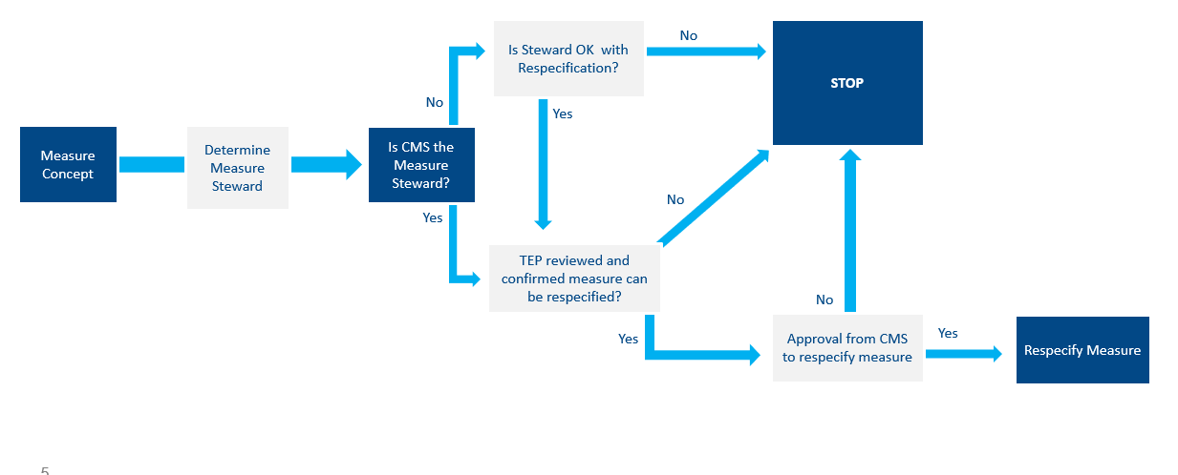
Determine if the Measure can be Respecified
Notes:
Process flow:
Contact original measure steward to gauge their acceptance towards respecifying their measure
TEP evaluation to confirm based on their technical knowledge whether that measure can/should be respecified into an eCQM

Slide 8
Measure Lifecycle ​
After the COR approves respecification, follow measure specification and testing guidelines in the Blueprint
For additional eCQM-specific information, refer to the eCQM sections in the Blueprint
Notes:
There’s a ton of eCQM-specific information in the Blueprint and the supplemental materials available to support your work. Please note that just because the measure your eCQM is based on has been fully specified and tested—it doesn't mean that your respecified eCQM retains that same validity and reliability. All of that will need to be retested with the respecified measure for the new data source and the new population, and whatever other changes you’ve made to that measure.

Slide 9
Considerations when Respecifying to an eCQM
Data elements from one data source e.g., claims, do not always translate 1:1 to an eCQM
Recommend using the NQF Feasibility Scorecard as early as possible
Do not make assumptions that all required data elements for the measure are collected and stored in an EHR in a structured data field
Notes:
Example:
Evidence of a diabetes diagnosis may be available in one or two fields within claims. Check the medications list. If a patient is on insulin or metformin, it may serve as a proxy to determine a diabetic patient. Alternatively, look in the working diagnosis field or problem list.
Is the information collected through normal clinical workflows?
Do they need to be changed to accommodate the measure?
Data accuracy:
Is the information available current, accurate and complete?
Does the data element map to standard terminologies?
Are the data elements matched to an accepted data standard? Such as ICD-10 code or a SNOMED or CPT code?
Feasibility considerations:
Consult with clinical experts and representatives from EHR vendors
Consult representatives from measured entities themselves, i.e., hospitals or clinical practices such as health IT experts or informaticists, the individuals who input the data themselves to glean how data are stored.
Due to an extreme variance from hospital-to-hospital or from practice-to-practice, it’s vital and crucial to get input from people across different practices or EHR systems.

Slide 10
eCQM Standards
To address disparate EHRs, health information technology (IT) standards and tools are used in authoring eCQMs
The standards are managed by the health IT community via a consensus-based development process and adopted for use in CMS programs
Current eCQM standards – Quality Data Model (QDM), Clinical Quality Language (CQL), Health Quality Measure Format (HQMF), and Quality Reporting Document Architecture (QRDA)
Current tools – Measure Authoring Tool (MAT), Bonnie, CQL-to-Expression Logical Model (ELM) Translator, Value Set Authority Center (VSAC), Cypress
Notes:
Please visit the eCQI Resource Center, a comprehensive resource on eCQM-related tools and resources. You can find information and links to other tools, including Bonnie, the CQL-to-ELM Translator, VSAC, and Cypress.

Slide 11
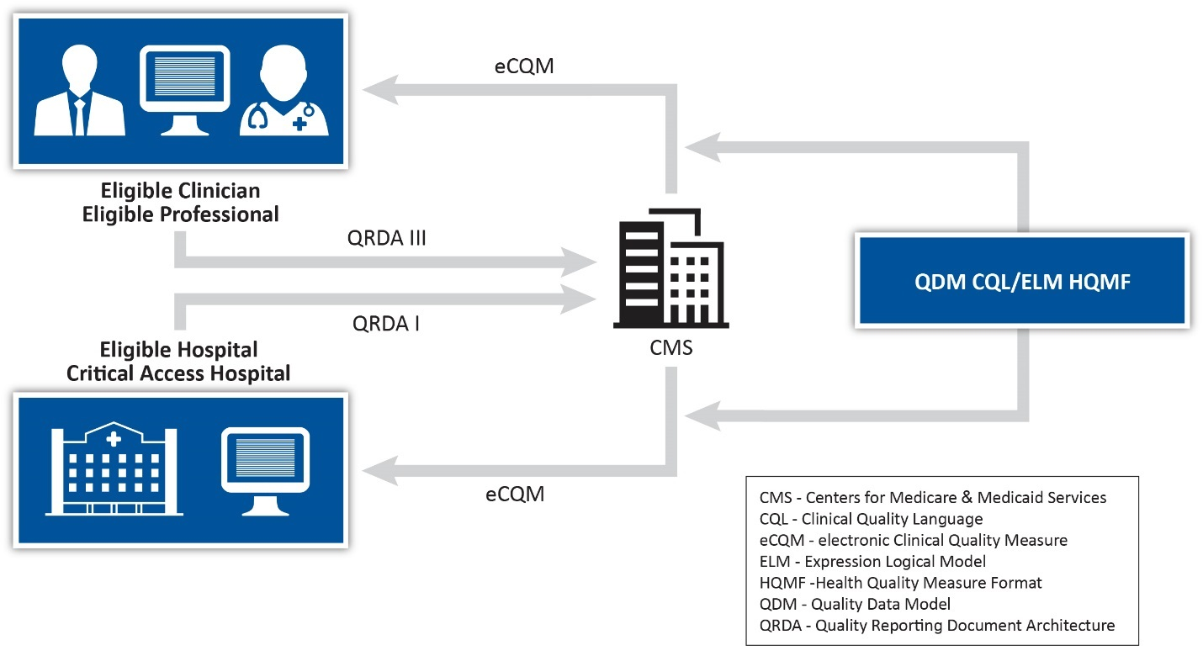
Review of eCQM Standards
2 Source: https://ecqi.healthit.gov/qrda
Notes:
HQMF is the format in which eCQMs are written
HQMF is what the MAT produces once a measure is specified
HQMF is developed by HL7, an accredited standards development organization
HQMF defines the information necessary to compute a quality measure, and resulting value
HQMF is in an XML data file format which is machine-readable
An HQMF document provides the measure details that identify and classify the measure, and provide important metadata about the measure
(i.e., measure populations, stratifications, information about the measure steward, the measure type, the rationale, measure scoring, and value sets.)
HQMF is used with CQL to define the eCQM
The CQL defines the measure logic
QDM is used to present the information
HQMF defines the metadata and the population structure
Healthcare organizations receive measure specifications which are expressed in HQMF using the QDM and CQL. From there, healthcare organizations report the results to CMS using a format known as the QRDA. The QRDA is a standard method to report quality measure results in a structured and consistent format used to exchange the eCQM data between systems and to CMS.

Slide 12
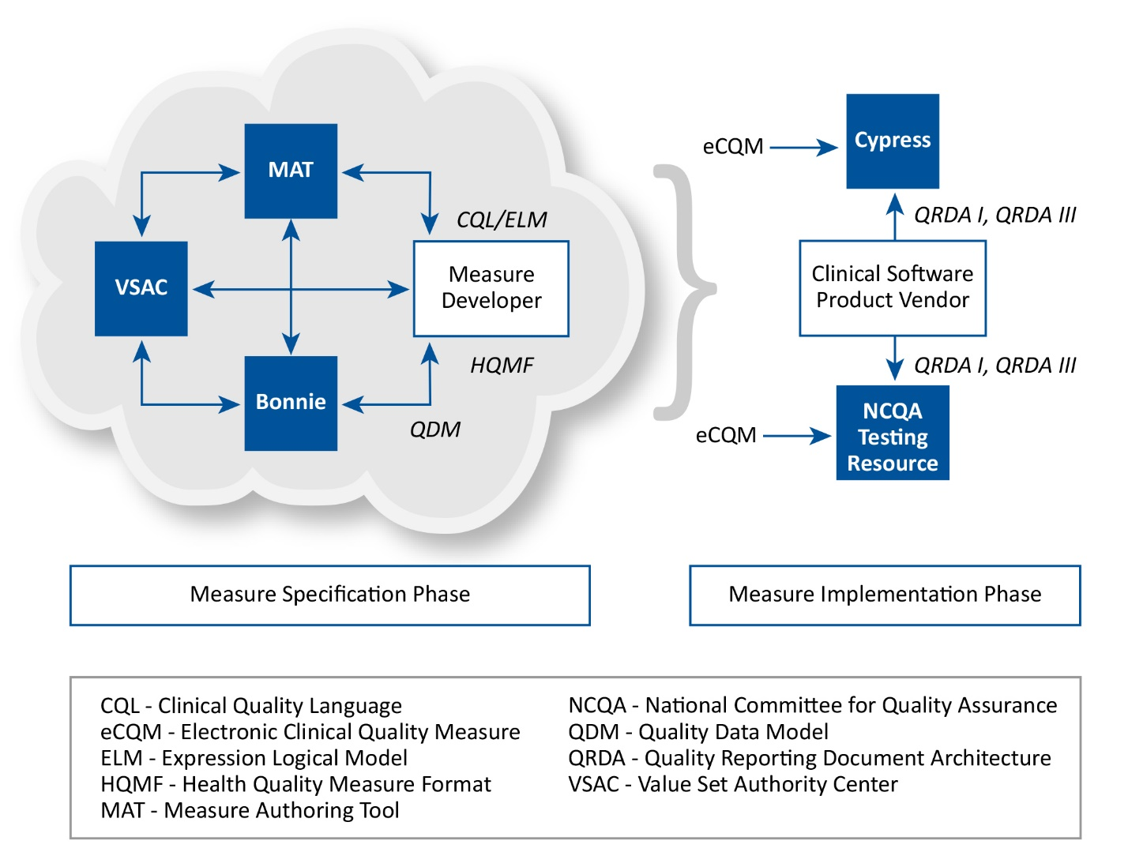
Relationship of eCQM Tools with Standards
Notes:
The MAT is the tool measure developers use to generate their eCQM specifications.
The VSAC is a repository of official versions of value sets that support eCQM development. The VSAC provides measure developers with tools to search existing value sets, offer new ones, and maintain value set content consistent with current versions of the terminologies they use. Value sets in the VSAC can be referenced using the MAT to define the measure data elements.
Bonnie is a software tool. Bonnie allows measure developers to evaluate the behavior of their draft measure’s logic. Measure developers can load their eCQM specifications from the MAT into the Bonnie tool and compare the performance of the measure logic against the patient’s test data to determine whether the measure logic aligns with the intent of the measure.
Cypress is an open source software available to vendors to certify their EHRs and their HIT modules for calculating eCQMs. It’s an official testing tool that works by generating synthetic patient records for the subset of published eCQMs that are selected for certification and testing.

Slide 13
eCQM Feasibility Testing
Feasibility Testing must be done to assess feasibility and determine the extent to which the required data are available and retrievable without undue burden, and the extent to which they can be implemented for performance measurement.⁴
Test early and often; engage stakeholders early and often
Fail early to inform respecification
Do not expect the same performance results of eCQM testing as with the original measure
4 Source: CMS Blueprint for the CMS Measures Management System
Notes:
Measure developers should engage stakeholders, HIT professionals, EHR vendor representatives, health informaticists and clinicians. This is crucial to knowing early in the respecification process whether you’re likely to encounter any deal-breakers so as to mitigate the investment of resources. You should not expect the same performance results with eCQM testing as you might have seen from the original measure. The respecified measure is essentially treated as a de novo measure for the purposes of testing.

Slide 14
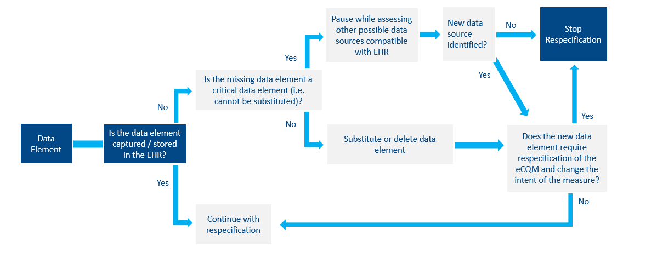
Determine Data Elements
Notes:
The lean and fail-fast approaches are based on the idea that information should be collected early and often to determine a measure’s viability at many steps in the development process.
It’s worth doing that early work to identify the data elements or clinical concepts that you need before giving up on respecifying. It’s also prudent to note that if the critical data elements for your measure just frankly aren't stored routinely in an unstructured way in the EHR, then your measure is likely unsuitable to being an eCQM.

Slide 15
eCQM Feasibility Testing: Points to Consider
Will there be workflow or technology changes required for the eCQM?
Will testing the eCQM show it will be limited to an integrated healthcare delivery system with a shared IT system or interoperable EHR system?
Will the eCQM require data from another setting e.g., facility-based data for an eligible clinician eCQM?
Notes:
Important Considerations:
Who in your practice, or who in a practice or in the hospital is inputting this information?
Is additional training required to know where to store this information? How to best collect it?
Is this information verified?
Is this information in a different place?
How many clicks does it take to get to the information that I need?
How does it impact patient care?
Will this work at any healthcare system?
Does it have to be a uniform EHR system?
Will it require data from more than one site to calculate?

Slide 16
Additional References
For eCQM Standards:
Electronic Clinical Quality Improvement (eCQI) Resource Center (QDM)
HL7 Standards (CQL, HQMF, QRDA)
For eCQM Tools
MAT
National Library of Medicine VSAC
Bonnie
CQL-to-ELM Translator
Cypress
For eCQM Testing:
Introduction to eCQM Testing
National Quality Forum Feasibility Scorecard

Slide 17
Upcoming Webinars
Understanding Clinical Quality Measures: How CMS is modernizing its approach to digital measurement
Presented by Kim Rawlings (CMS), Nicole Brennan (Battelle), and Brenna Rabel (Battelle)
September 15th, 2-3pm ET
September 17th, 3-4pm ET

Slide 18

Questions

