Slide 1

Making Measures More Person-Centered
Applying Human Centric Design Principles
to the Development Process
February 12, 2020
Presenters:
Jayanti Bandyopadhyay (Mathematica)
Jennifer Simkins (Battelle)

Slide 2



Vision and Goals
An ongoing process to engage the public in quality measure development.
Elicit feedback that will help CMS design resources that can help all of those interested in healthcare quality improvement better understand the goals of quality measurement.
Education
Outreach
Dedicated Websites
Measure Development Roadmaps
Listserv opportunities
1
2/12/2020

Slide 3
Agenda
HCD Introduction
Benefits of incorporating Human-centered Design (HCD) in the CMS measure development process
Pitfalls
Blueprint for the CMS Measures Management System
The Measure Lifecycle
Use of HCD Methods in Measure Lifecycle Process
HCD Takeaways
2
2/12/2020

Slide 4

Human-Centered Design in Practice for Measure Development Generating measure concepts for pain management using the patient experience
Presentation for CMS MMS Information Session
Presenter: Jayanti Bandyopadhyay
February 12, 2020

Slide 5

Outline
What is human-centered design (HCD)?
When can we use it?
Why is it important?
How did we use it?
What happened during the phases of work?
What did we learn and why is HCD important to measure development?
4

Slide 6
What is HCD?
HCD is a highly collaborative method to collect deep user insights
It helps the developer identify their unmet and unarticulated needs and develop solutions to meet those needs
“I’d assess things myself and say, it’s been a couple of days, how is it feeling, is it getting any better or is it worse? Does this seem to be a longer-term thing? Is ice helping? Is heat helping? Are anti-inflammatories helping? Is this a sharp pain? Is it a dull pain? How often is this occurring? How much function have I lost? Are things getting better over a little time?”
—Interview participant with
chronic pain
Surface
Explicit need: say and think
Tacit need: do and use
Latent/emerging need: know and feel
Deep
5
Notes:
In measure development, high quality measures of healthcare must be evidence-based and rigorously tested to confirm that they’re conveying appropriate conclusions about the quality of care. However, patients are the ultimate consumers of healthcare and as such, their experience and needs and priorities should really drive those opportunities for improving healthcare delivery.

Slide 7
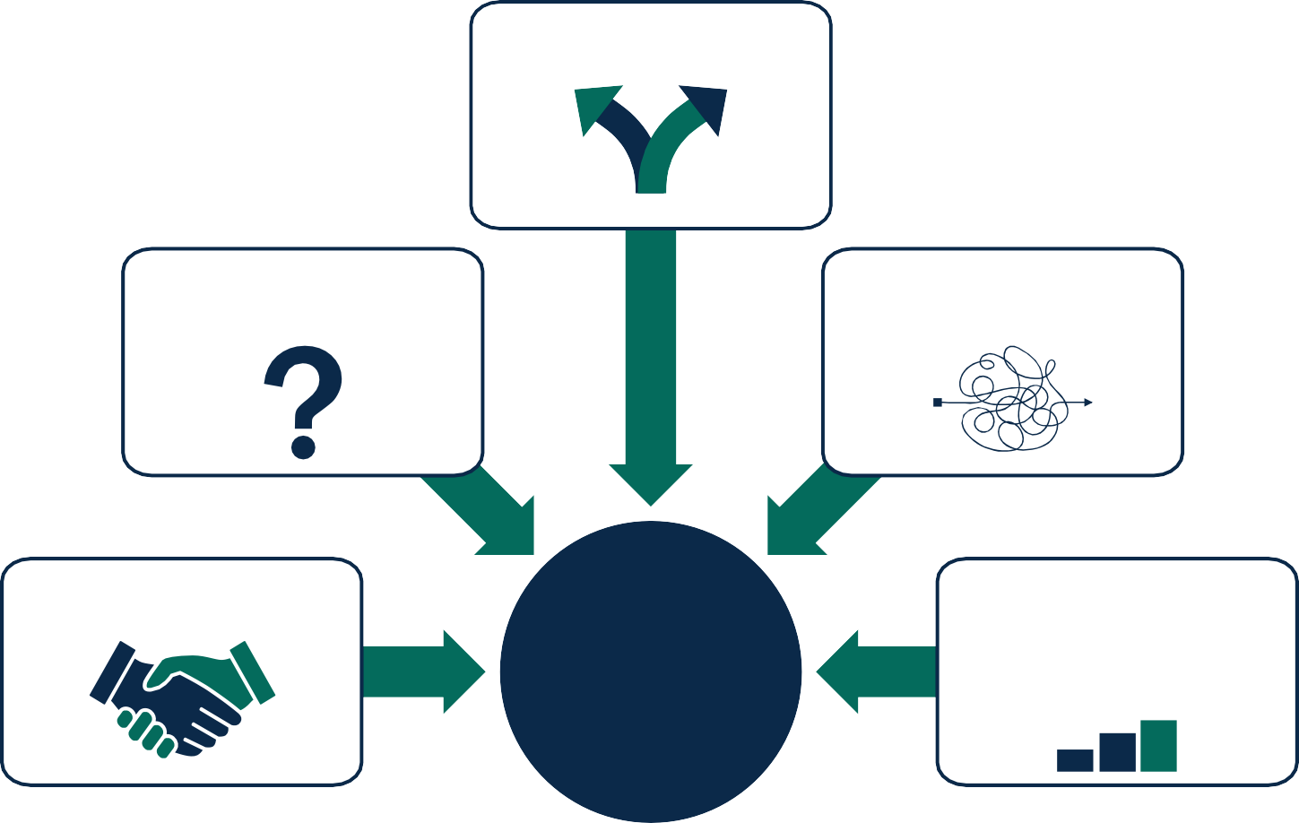
When can we use HCD?
Lack of a clear road map
Uncertainty, complexity, risk
Problem not well- defined or understood
Need to obtain buy-in
Use cases for HCD
Data, expert opinion, or experience not enough, alone or in combination, to ensure success
6
Notes:
This slide shows when it’s helpful to use human-centered design (HCD).
Example: Reducing the number of unintentional opioid overdoses while continuing to assess the quality of care around acute and chronic pain — in light of the ongoing opioid crisis — has become a priority for agencies like CMS.
In this example, data from literature reviews and expert opinion alone may not be enough to fully comprehend the scope and spectrum of a problem — especially because the experience and definition of pain management may vary by user.

Slide 8
Why is HCD important?
diverge on needs
converge on opportunities
diverge on ideas
converge on solutions
DISCOVER
SYNTHESIZE
GENERATE
FOCUS
Inspiration
Observe and document what is important to patients
Ideation
Create design guidelines to inform concept generation
Implementation
Keep gathering feedback and iterating
Ideation
Brainstorm solutions and prototypes; “yes and” thinking
EVALUATE
Notes:
There are 3 phases of HCD: Inspiration, ideation, and implementation.
Note that there’s no one way to apply HCD, but this diagram represents the general flow of the phases.
The diverging and converging pattern of thinking allows you to start with a broad collection of data from patient experience to understand and define the problem.
Example: Working collaboratively with patients and other stakeholders like clinicians to refine that data into action items that can help with the development of solutions in the later phases. By using this approach and starting with the patient voice, you can keep their perspective at the forefront of the work as you continue through each of those measure development phases.

Slide 9
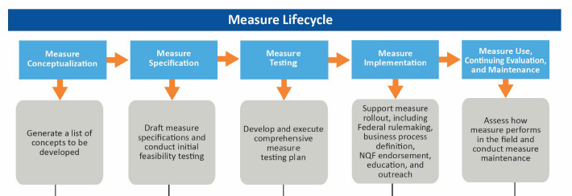
What was the goal of our work?
Objective: Develop a clinical quality measure that identifies unmet needs of patients experiencing pain
Approach: Use HCD to explore patients’ needs
New eCQM
Phases we needed to complete

Slide 10
Integrating HCD into the measure lifecycle
Measure conceptualization
Measure specification
Inspiration
Empathy interviews and design workshops
Literature reviews
Ideate a candidate measure list
Ideation
Clinical expert review
Prioritized list of candidate concepts
Business case
Technical specifications
Implementation
Stakeholder reviews (e.g., TEP and patients)
Draft MER/MJF
First draft of all measure materials

Slide 11
Use Case: Developing a measure concept for pain management

Slide 12
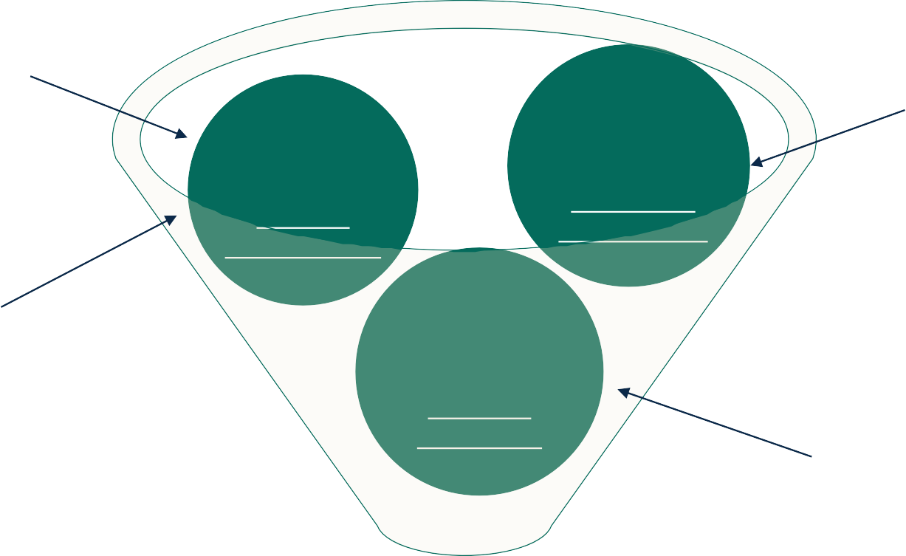
Case study roadmap: What did we do?
Ideation (part 1):
Validate themes from empathy interviews and ideate solutions and concepts with patients and clinicians
Inspiration: Gather
information on what is important to patients
Convert themes to concepts via design workshops
Generate th d
emes base on data from
empathy
i
nterviews
Ideation (part 2): Create design guidelines that will inform generation of measure concepts
Validate list of generated concepts using clinical evidence
Implementation Keep gathering feedback to refine the list of concepts
Initial list of prioritized measure concepts
Notes:
There are three main phases of the work:
Gathering information using empathy interviews. This provides patterns and themes.
Convene design workshops with a group of patients and clinicians and convert those themes from the empathy interview phase into the potential measure concepts.
Validate the list of concepts generated using evidence in the literature and stakeholder input in order to prioritize them before we delivered those to CMS while identifying the top concepts for CMS consideration.
Note: The team was aware that a gap may arise between the concepts identified by patients that are important and the existing clinical evidence — that was a risk.

Slide 13
Phase 1: Empathy interviews
What: Because pain is a complex biopsychosocial issue, we need to better understand the target population (patients with acute or chronic pain) and empathize with their experience, including their mindsets, behaviors, lifestyles, desires, fears, and opinions
Measure lifecycle phase: conceptualization
Human-centered design phase: inspiration
Notes:
This represents the initial divergence step where broad information broad information is collected on the issue at hand.

Slide 14
Phase 1: Empathy interviews—Input
Why (informed by research questions):
Understand the health outcomes most important to patients
Identify patients’ unmet or unarticulated needs regarding opioids
Explore how patients define “quality of care”
Assess the face validity of consensus guideline recommendations against the patient perspective
How:
Conducted one-hour, semistructured, one-on-one interviews with patient participants

Slide 15
Phase 1: Empathy interviews—Output
“I think, because of the pain, my muscles tightened up. . . . So that’s where the massage came in, and I tried to swim. Just certain things for the muscle part, because I learned that they were interconnected. . . . So I think those alternative therapies, I guess, sort of offset the way my body reacted to the pain.”
—Interview participant with chronic pain
Participants used alternative therapies as their primary source of pain treatment, resorting to opioids only when necessary
The concept/measure should consider whether the provider has already recommended alternative therapies and/or the patient has already tried them
Interview data: what?
Design guidelines: so what?
Notes:
The interview data represents the what and the design guidelines represent the so what.
Patient perspective was kept at the forefront of the work. Use the iterative process to these design guidelines to generate concepts to understand how to incorporate the patient perspective.

Slide 16
Phase 1: Empathy interviews—Output
Provide a comprehensive evaluation of the psychological and social impacts of pain
Encourage appropriate, periodic pain assessment and careful consideration of the benefits and risks of options
Educate patient about the known risks and benefits of opioid therapy to address perceptions, expectations, and fears
Educate, counsel, and follow-up about pain level and management pre- and post-surgery
Assessments
Education
Capture data from interactions with other health care professionals
Establish treatment goals for patients with chronic pain and follow up on those goals
Identify and take into account patient preference for treatment in pain management therapy
Provide clinically comprehensiveness pain management—including alternative pain treatments
Care coordination and follow- up
Collaboration and trust
Notes:
Diverging and converging provided diversity around the potential measure concepts and design guidelines generated.

Slide 17
Phase 2: Design workshops—Input
What: Create a draft list of concepts via design workshops
Measure lifecycle phase: specification
Human-centered design phase: ideation
Why (informed by research questions):
Assess validity of the themes from empathy interviews
Draft list of initial measure concepts
How:
Conducted two three-hour design workshops with eight new patient participants and two clinician participants
During data analysis, fleshed out the list of measure concepts drafted and prioritized by patients and clinicians
Notes:
The goal of the workshops is to assess the validity of the themes from the empathy interviews and then draft and prioritize a list of initial measure concepts.

Slide 18
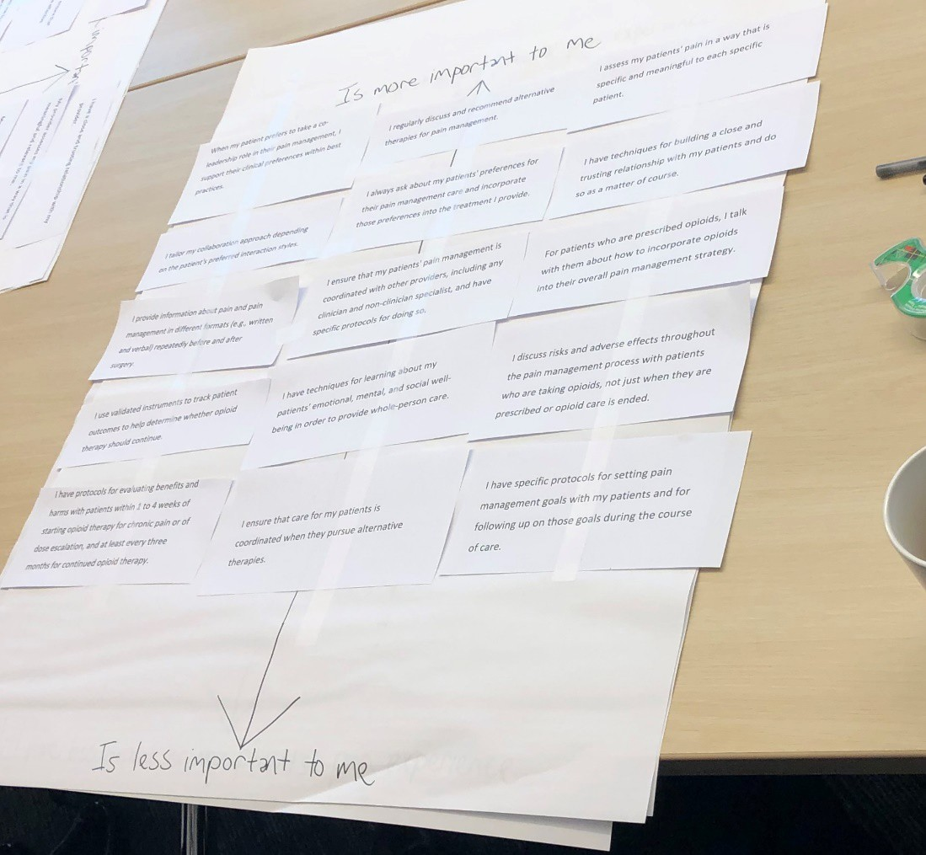
Phase 2: Output—Prioritization
Conducting a prioritization activity with the patient and clinician participants allowed us to understand the most important aspects of pain management from the themes and insights we gained from the empathy interviews.
Notes:
This picture shows the list of the design guidelines. These were then prioritized on different scales to understand where participants would categorize certain things that were generated from the empathy interview phase.

Slide 19
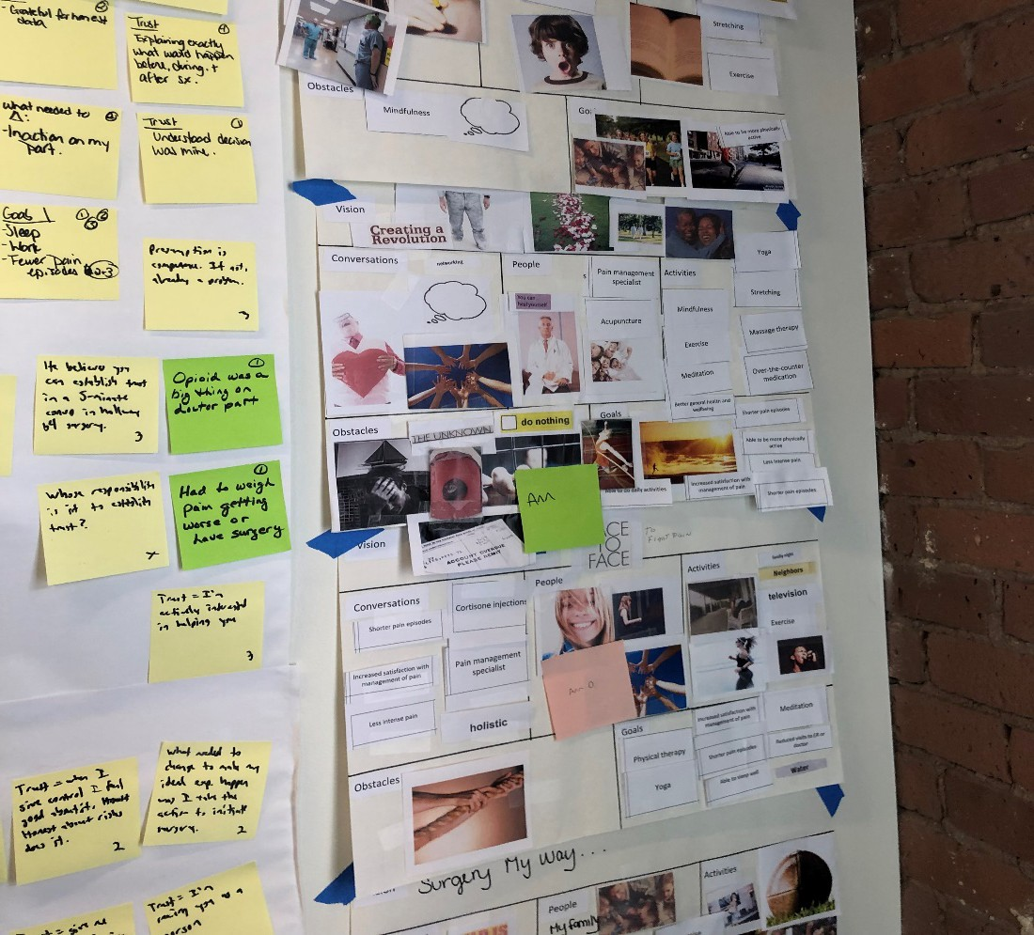
Phase 2: Output—Vision board collage
We asked patients and clinicians to collage their ideal pain management experience.
Using this method allows participants to suggest possible solutions, engaging them directly in problem-solving, and is particularly helpful when we’re ideating concepts.
Notes:
This step encouraged conversations across the clinician and patient and in discussions which were tremendously valuable.

Slide 20
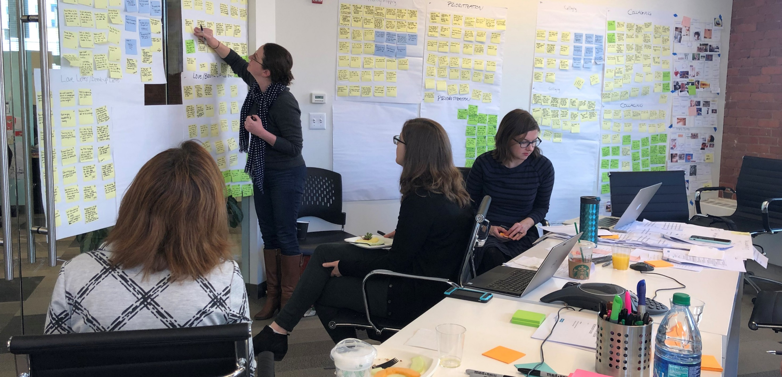
Notes:
This photo shows the team’s data analysis workshop day.
Affinity mapping was used here, which helps to gather large amounts of data and organize them into groups. Dot-voting was also used to understand and gain input from the team on the most usable and feasible concepts, and to really initiate that prioritization of the concepts coming out of the design workshops.
Note: HCD allowed the team to separate desirability of the concepts from feasibility and consider new approaches that led to a range of richer concepts to explore.

Slide 21
Phase 2: Output—Initial list of measure concepts
We ideated over 40 new potential measure concepts, categorized into 8 high-level domains based on the underlying topics (intervention, process, or outcome) of the concepts.
Use of multimodal or alternative pain management therapies
Referral to pain management
Behavioral health integration
Risk and functional status assessments
Care coordination and trust
Follow-up after initiation of pain management
Follow-up after surgery
Patient-reported outcomes

Slide 22
Phase 3: Literature review and clinician input
What: Validate list of generated concepts using evidence from literature review and stakeholder input
Measure lifecycle phase: conceptualization
Why:
Determine which concepts have a strong evidence base
Gain input on the face validity, feasibility (Expert Workgroup only), and usability of the concepts to prioritize them
How:
Convene opioid EWG
Conduct literature review

Slide 23
Phase 3: Output—Top concept
Domain: Use of multimodal or alternative pain management therapies
Patient input: Most patients we interviewed identified pain management therapies other than opioid therapy to be their preference for first-line therapy
Expert input: Clinicians who participated in the design workshops noted that they also drew on nonopioid approaches to pain management

Slide 24
What did we learn by using HCD in practice for measure development?

Slide 25
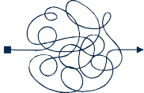
Benefits and outcomes of innovative HCD approach
Why now?
HCD is an excellent fit for data collection in the measure conceptualization phase
We were able to identify hidden insights or unknowns to patients and measure developers
HCD is also an excellent fit for analyzing all the qualitative data in a very short turnaround
Potential unintended consequences or implementation challenges are brought to the forefront
Notes:
Potential unintended consequences or implementation challenges were brought to the forefront right away in using human-centered design (HCD).
Example: Patient and clinician participants in the human-centered design activities noted that cost or access to multidisciplinary and nonpharmacologic pain treatments can be a barrier. Before the client invests in resources in a certain area — or even if the measure development team were to pursue a certain topic — the team was immediately able to recognize some of the risks and issues with the concept in moving it forward.

Slide 26
Benefits and outcomes of innovative HCD approach
Findings specific to our case:
Most concepts identified as important from the patient perspective aligned with clinician consensus statements and national guidelines
For example, patients did not like to use opioids as first-line therapy, which the CDC guidelines also recommend
Patients and clinicians felt very engaged; brought them together to ideate on concepts
Notes:
The team noticed almost all the concepts identified as important from the patient perspective aligned with the clinician consensus statements and national guidelines. This will be helpful going forward and something that will likely help to get more buy-in and refinement later in development.

Slide 27
Questions?

Slide 28
For more information
Jayanti Bandyopadhyay
JBandyopadhyay@mathematica-mpr.com
Cindy Cullen
CCullen@mathematica-mpr.com
Sam Simon
SSimon@mathematica-mpr.com
27

Slide 29
Section 1: HCD Overview
Overview the Human Centric Design (HCD) Process

Slide 30

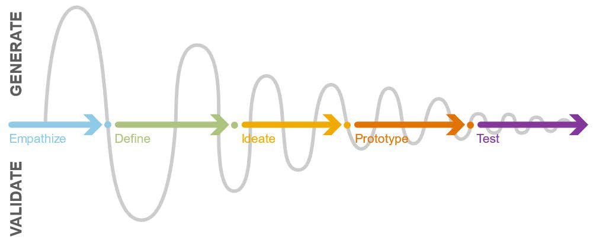
Human Centric Design (HCD)
Human Centric Design is engaging the user(s) through out the development process.
29
2/12/2020
Notes:
This diagram represents another way to show how insights, user information and ideation of solutions are ultimately going through this pendulum effect of understanding user needs.

Slide 31


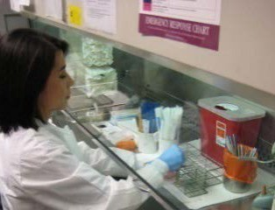
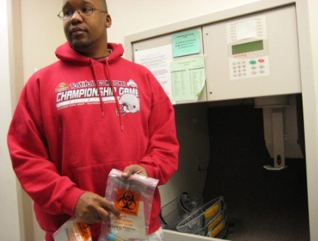
HCD Benefits
Identify ALL users and Inputs
Collect inputs and insights from the appropriate stakeholders.
Identify the appropriate audience who will interact with the process and products
Identify the right problems that need solved.
Collect needed inputs result in quality outputs.
30
2/12/2020
Notes:
It is important that the appropriate users are identified so that inputs and insights are collected from the appropriate stakeholders.
A primary goal of human-centered design is to focus on the people, so it is of upmost importance that the proper audience is identified in order to target the right groups of people who will interact with the process and products.
Identify the right people in order to solve the right problem.
Engaging all the users will aid in the subsequent identification in working with stakeholders to identify the right problems that need solved and will guide the design process.
Identifying all the users who can aid in framing and solving the important problems and issues will provide the needed inputs to the design process and result in quality outputs.

Slide 32
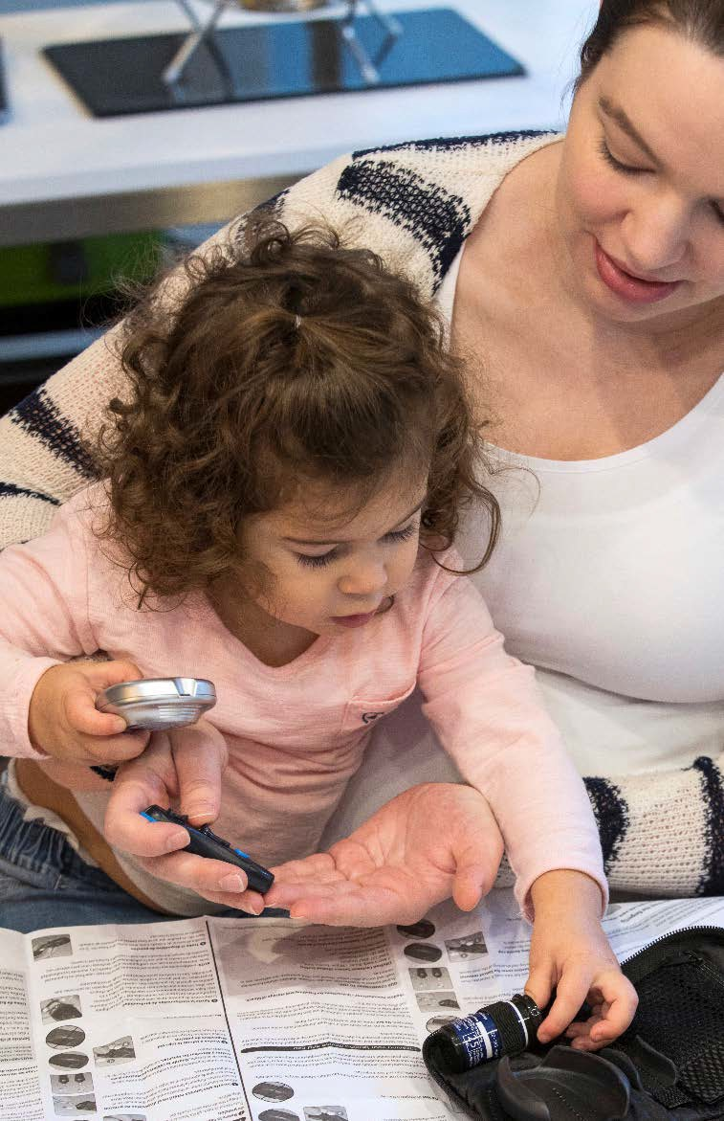
HCD Benefits
Empathy
“Deep understanding of the problems and realities of the people you are designing for.”
Provides deeper appreciation and understanding of user's emotional and physical needs, and the way they view, understand, and interact with the world around them.
Empathic research is subjective is focused on stakeholder motivations and thoughts.
31
2/12/2020
Notes:
Empathy allows us to determine the difficulties people face and how underlying thoughts and desires can help explain behaviors. To do so requires an understanding of the situation or environment, as well as various roles and interactions.
It will also help to understand how all of this has an impact on their lives generally, specifically within the contexts being investigated.
Because empathic research is subjective, there is a fair amount of interpretation involved in finding out what people mean rather than what they say.

Slide 33

HCD Benefits
Understanding
Fully understand the people who experience a problem before a solution is designed.
Good products start with a thorough understanding of the user and their environment.
Early contextual research leads to increased product acceptance, reductions in the rate of use errors, and faster development timelines.
Identify the real goal of real people who will use your product.
32
2/12/2020
Notes:
The foundational principle of human centered design is that researchers should truly understand the people who experience a problem before designing a solution to serve them.
Identifying user needs and requirements up front can help to “get it right the first time” and avoid costly changes later in the development cycle.

Slide 34
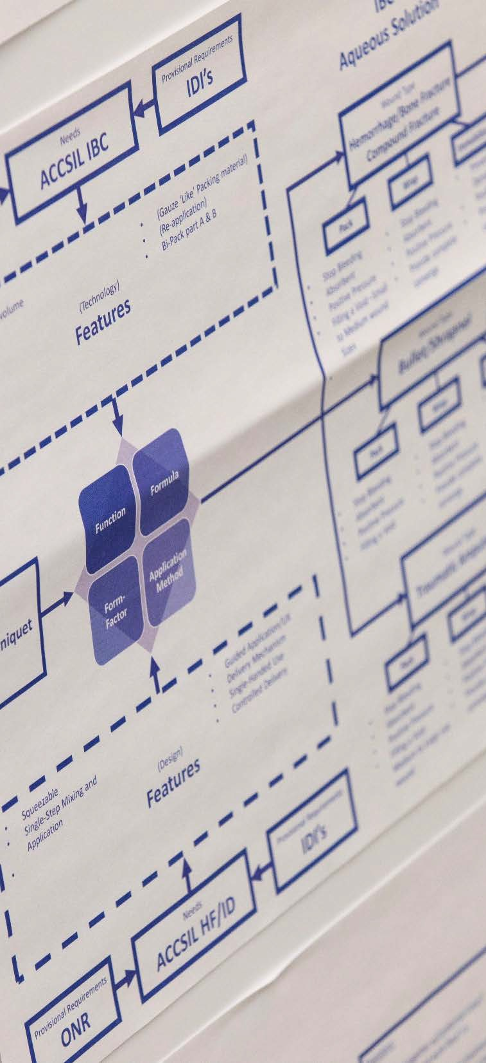
HCD Benefits
Better Compliance Because It Aligns With Workflow
The better you conduct research, the more time and effort you save later.
Everything as an integrated system.
Considering the whole system leads to the understanding of what is desirable combined with “the real world.”
33
2/12/2020

Slide 35
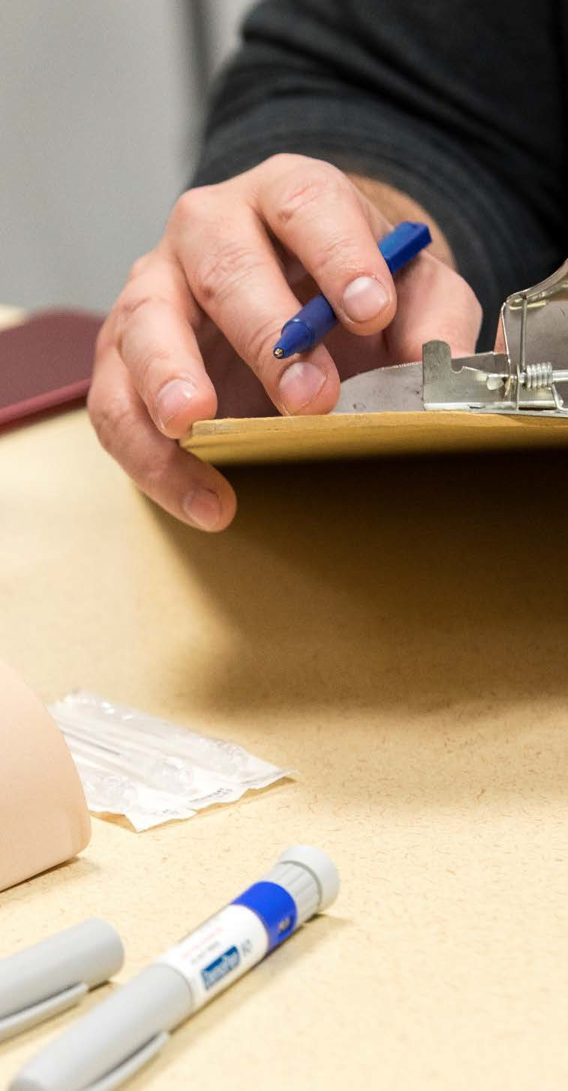
HCD Benefits
Rigor
Rigor is required in the HCD process to ensure that research is performed systematically, consistently, and thoroughly.
Attention to detail and listening to what the user says allows the deeper understanding of the information under question.
HCD evaluations require a specific skillset.
Measure development is hard work and needs the rigor of HCD.
34
2/12/2020
Notes:
While we want to empower stakeholders in the measure development process, remember everyone has a role to play and HCD professionals can leverage their experience and expertise to guide better design.

Slide 36


HCD Tools
A snapshot of techniques useful in Human Centric Design:
Build Rapport: It is important the build rapport with the users to allow participants to get comfortable, so they open up and share important insights.
Open-Ended Techniques: HCD interviewers use open-ended questions when eliciting feedback to allow the users to provide insights in answering questions.
Qualitative Synthesis: Most of the feedback acquired in HCD data collection efforts is qualitative in nature. To then translate this into quantitative results the HCD researchers need to look for common themes that show up in responses. These themes are then categorized and evaluated for similarities and differences to capture the nuances in feedback and the resulting impact on design recommendations.
5 Whys: The 5 Whys is an effective interviewing technique where asking “WHY?” five times in an iterative manner with increasingly targeted questions allows the HCD expert to get to the true root cause of an issue.
35
2/12/2020
Notes:
Build Rapport: This is especially important in the medical field.
Open-Ended Techniques: It is important that leading questions are not asked that taint getting accurate information from users. It is also important in asking open-ended questions, that they not be too broad and fail to get useful answers

Slide 37
HCD Pitfalls To Be Aware Of
We would be remiss if we did not also mention the potential pitfalls in the use of Human Centric Design:
Its Time-Consuming: Investing in HCD evaluations to get user inputs to aid production of an end product users can use takes time to design, collect data, interpret, test, and iterate.
Subjective in Nature: In terms of questions asked and interpretations of motives and actions expressed or observed.
Individuals are Moving Targets: Design needs to evolve with the changing needs of the user. Continued use by a product can also lead to identification of new needs with increased expertise. HCD process must include continual evaluation and be adaptive to potentially changing needs.
Limited Guarantees: Human-Centered Design does guarantee good products. It can lead to improvements of bad ones. Moreover, good Human-Centered Design will avoid failures. It will ensure that products do work, that people can use them. But it may not solve all problems and is just one tool in the toolbox
36
2/12/2020

Slide 38
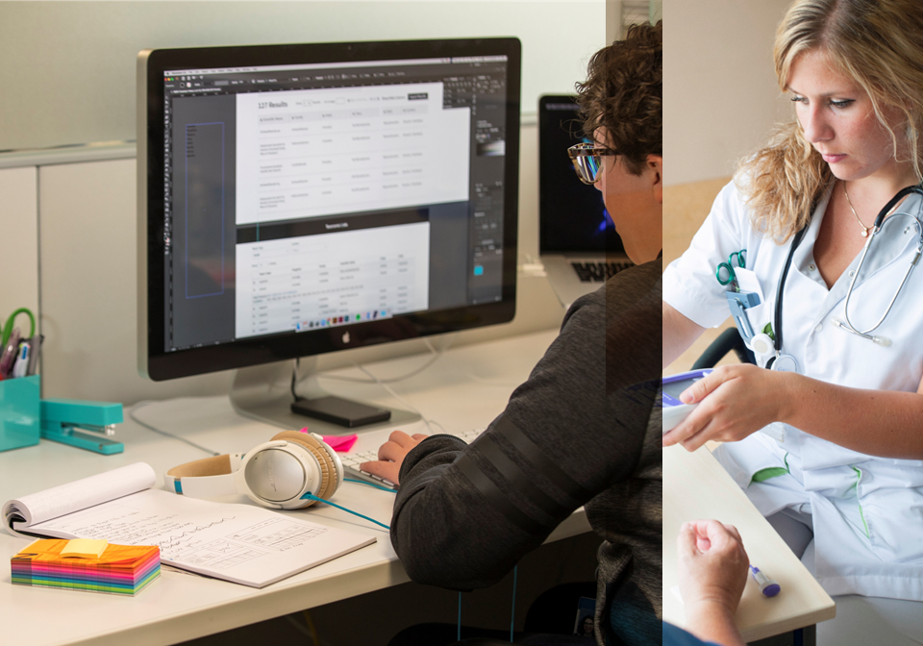
Section 2: Using HCD
In the Blueprint for the CMS Measures Management System

Slide 39
Blueprint for the CMS Measures Management System
CMS Blueprint is divided into 6 sections:
SECTION 1: INTRODUCTION
Overview of the guiding principles of the CMS quality measure development and background information on the MMS.
SECTION 2: THE MEASURE LIFECYCLE
Describes the procedural steps necessary to develop and maintain a measure.
SECTION 3: IN-DEPTH TOPICS
Provides detailed information on important measure management topics. The topics range from CMS priorities planning to the details of risk adjustment.
SECTION 4: FORMS & TEMPLATES
Contains all the forms and templates referenced in the Blueprint.
SECTION 5: GLOSSARY & ACRONYMS
Contains a glossary and a list of acronyms used in the Blueprint.
SECTION 5: APPENDICES
38
2/12/2020

Slide 40
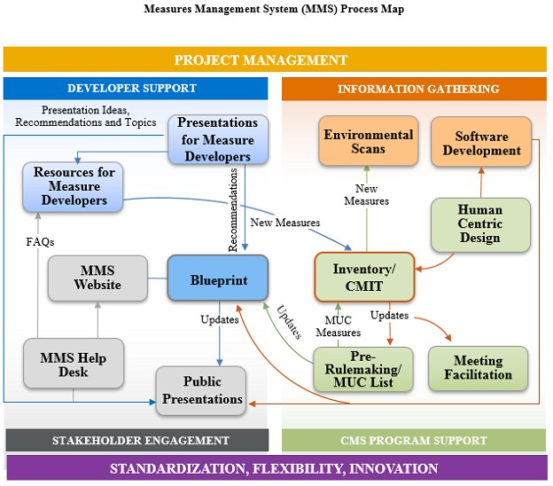
CMS MMS Process Map
https://www.cms.go v/Medicare/Quality- Initiatives-Patient- Assessment- Instruments/MMS/M MS-Content-Page
39
2/12/2020
Notes:
This is an overview of how the MMS project is set up. While user-centric design has it’s own ‘bubble’ in the chart, HCD techniques are integrated into every aspect of the work done under MMS.

Slide 41
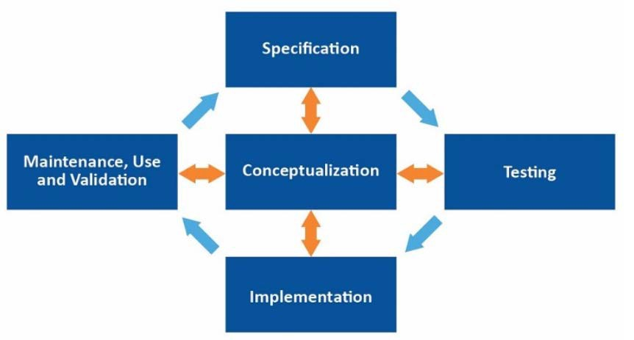
The Measure Lifecycle
Greatest area for HCD impact is in Measure Lifecycle:
40
2/12/2020

Slide 42
The Measure Lifecycle Steps
Greatest area for HCD impact is in Measure Lifecycle
5 Phases of the Lifecycle:
Conceptualization: Develop measure concepts and then narrow down to specific measures. The developer conducts an environmental scan and requests input from a broad group of stakeholders, including patients.
Specification: Identify the population, the recommended practice, the expected outcome and determine how it will be measured.
Testing: Assess the suitability of the quality measure’s technical specifications and acquire empirical evidence to help assess the strengths and weaknesses of a measure.
Implementation: Identify measures to submit for the CMS selection and rollout processes, adopt measures into CMS programs, and seek endorsement.
Use, Continuing Evaluation, and Maintenance: Ensure that the measure continues to add value to quality reporting measurement programs and that its construction continues to be sound.
Process is nonlinear, as indicated in the diagram.
41
2/12/2020

Slide 43
Empowering Users
CMS advocates USE of THE MMS BLUEPRINT by anyone, saying:
“While CMS measure developers are required to use it, it is also a great resource for non-CMS contracted measure developers who want to submit measures for consideration by CMS. The processes outlined in the Blueprint help ensure measures meet the evaluation criteria used by CMS and the National Quality Forum (NQF) including: the importance to measure and report on the topic, scientific acceptability of measure properties, feasibility, usability and use, and harmonization.”
HCD experts can collaborate with CMS measure developers in their use of the Blueprint to optimize results.
https://www.cms.gov/Medicare/Quality-Initiatives-Patient-Assessment-Instruments/MMS/MMS-
Blueprint
42
2/12/2020
Notes:
Ideally, HCD experts will be collaborating throughout these processes as laid out in the Blueprint to make sure that collective knowledge — both about measure development processes and about human-centered design (HCD) — is used to optimize the results from measure development, and to make sure that the measures created are reflecting the needs and interests of the populations that they are serving.

Slide 44
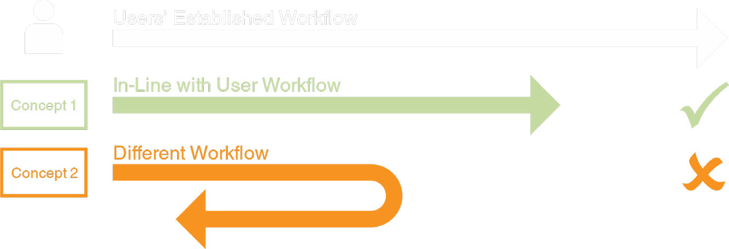
Main HCD Takeaways
“A PROBLEM FULLY DEFINED IS NEARLY SOLVED.”
Clearly defining and understanding the problem leads to better outcomes
DESIGN THE PRODUCT/SYSTEM AROUND THE USER
The product or system should fit within a user’s existing workflow and established mental models for optimal adoption and acceptance.
43
2/12/2020

Slide 45

Meaningful Measures
44
2/12/2020

Slide 46
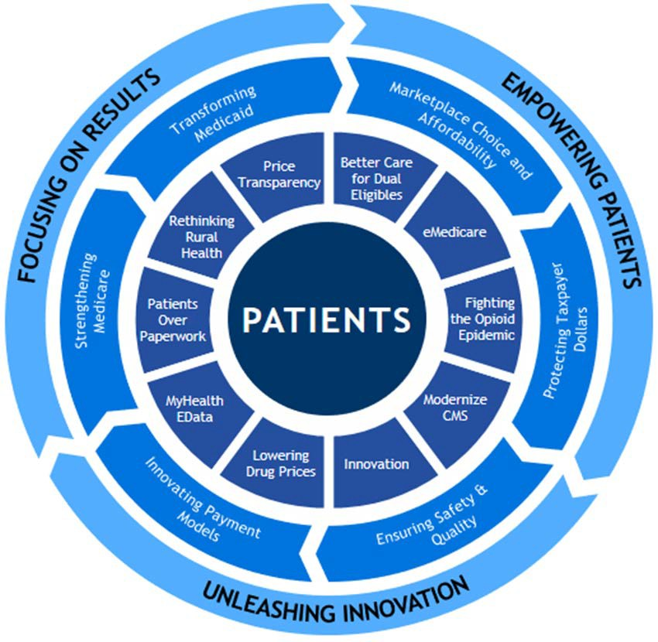
CMS Strategic Priorities
CMS Objective: Improve the nation’s health and quality of life.
Enterprise Key Result #1: Improve the quality and affordability of health care for all Americans.
Enterprise Key Result #2: Drive American health care towards payment for value, not volume.
Enterprise Key Result #3: Lower America’s rate of growth in healthcare spending.
45
2/12/2020

Slide 47
Meaningful Measures Objectives
Meaningful Measures focus everyone’s efforts on the same quality areas and lend specificity, which can help identify measures that:
Address high-impact measure areas that safeguard public health
Are patient-centered and meaningful to patients,
clinicians and providers
Are outcome-based where possible
Fulfill requirements in programs’ statutes
Address measure needs for population
based payment through alternative payment models
Minimize level of burden for providers
Identify significant opportunity for improvement
Align across programs and/or with other payers
Notes:
Note that health outcomes are what patients really care about rather than receiving aspirin within X amount or time. They care more about recovery, functionally, etc.

Slide 48
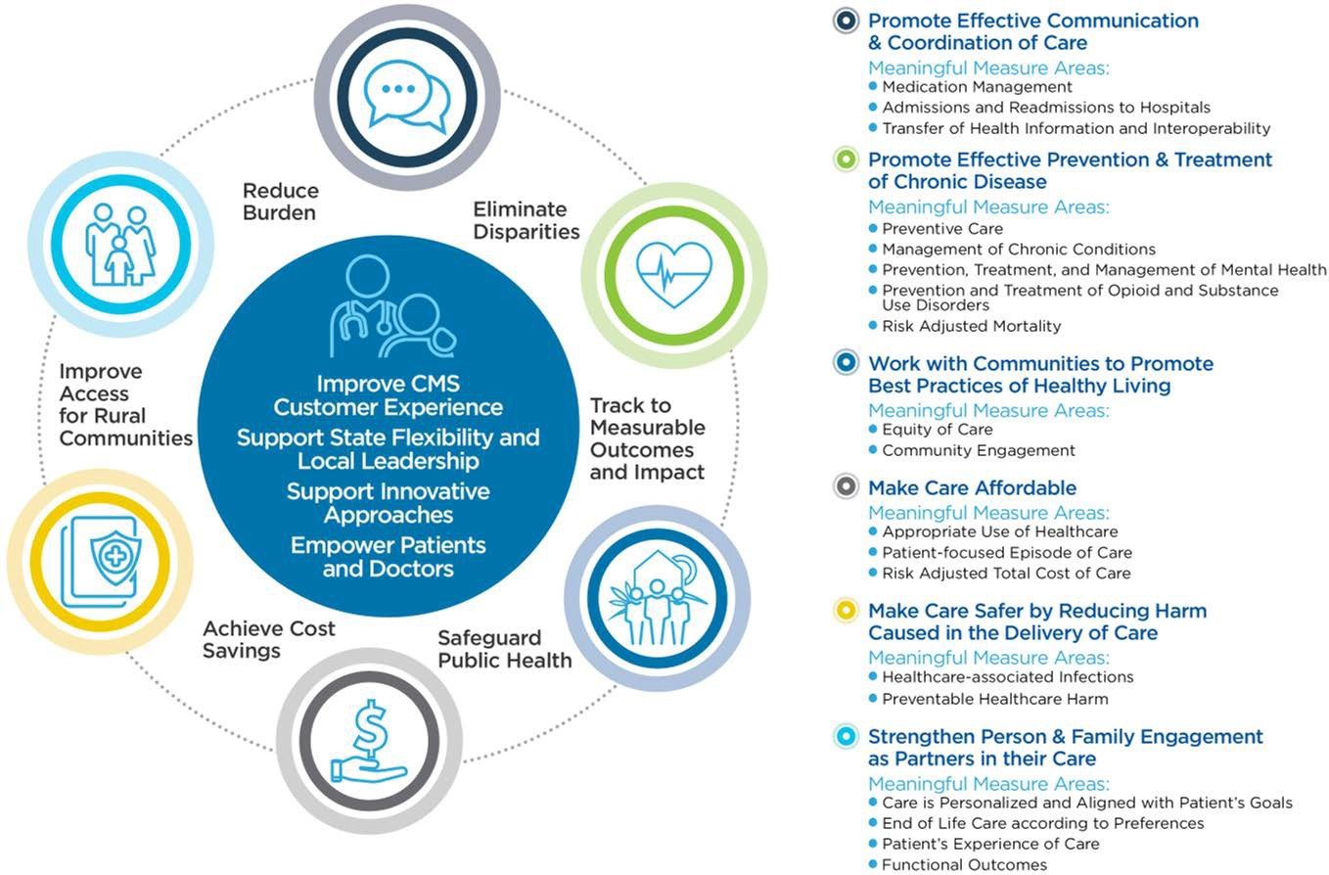
Meaningful Measures Framework
Notes:
The patient and their provider should always be at the center as demonstrated by this framework.
Meaningful Measures 2.0 will incorporate feedback into the existing framework.

Slide 49

Meaningful Measure Development Priorities
Measure Types:
Patient-reported outcome measures
Electronic clinical quality measures (eCQMs)
Measure priorities:
Appropriate use of opioids and avoidance of harm
Nursing home infections and safety measures
Maternal mortality
Sepsis

Slide 50

Discussion
49
2/12/2020

Slide 51
Announcements
Next MMS Info Session:
Date: April, 2020, 2-3pm ET
50
2/12/2020

Slide 52

Battelle
Measures Manager Contact: MMSsupport@Battelle.org
CMS
Kimberly Rawlings (CMS COR) Contact: Kimberly.Rawlings@cms.hhs.gov
51
2/12/2020

