Slide 1
Measure Development Education & Outreach for Specialty Societies & Patient Advocacy Groups
Webinar #7
AUA Measure Development: PSA Screening Shared Decision Making Measures
Presenter:
Suzanne Pope, MBA
American Urological Association
Director of Quality
February 7, 2018
2:00-3:00 EST
Notes:
Welcome to the February edition of the MACRA Education & Outreach Session. My name is Mary Sheehan and I am with Battelle, the Measures Management contractor to CMS. Today’s topic is on the first phase of quality measure development, measure conceptualization. We are excited to have Ms. Suzanne Pope from the American Urological Association (AUA) joining us today to share a firsthand account of working through this quality measure development phase.

Slide 2
Vision and Goals: Webinar Series
Measure Development Education & Outreach for Specialty Societies & Patient Advocacy Groups
An ongoing process to engage clinical specialty societies and patient advocacy groups in quality measure development.
Elicit feedback that will help CMS design toolkits and enduring materials designed specifically for specialty societies and patient advocacy groups interested in measure development.
  Education
  Outreach
  Frequent Communication
  Enduring Materials
  Dedicated Websites
  Measure Development Roadmaps
  Targeted Newsletters and Communication
  Spotlight Opportunities
Notes:
Battelle works with CMS to develop these webinars and to provide opportunities for you to engage in communication with CMS through newsletters, websites, email announcements and developing materials that can benefit agencies interested in developing quality measures. These webinars will occur at least monthly, with several months where we have multiple topics to share. For example, later this month on February 28th we will be hosting another webinar specifically related to eCQMs and will focus on value sets. We will provide the details for that presentation at the end of our session today and in the MACRA newsletter.
The topics for this webinar series throughout the course of the series will be focused on a wide range of issues, challenges and processes related to quality measure development. Please use the presentation platform today to ask questions that may help advance the work that you are doing in measure development. We hope that these sessions can serve as a discussion platform to share ideas with each other on how to navigate the measure development process.

Slide 3
Measure Conceptualization
Measure Development Education & Outreach for Specialty Societies & Patient Advocacy Groups
Agenda Webinar # 7:
American Urological Association (AUA) history with measure development
Determining measure topics
Helpful steps in completing the conceptualization process
Walk through recent example of measure conceptualization process for shared decision making measure
Notes:
I would like to introduce Ms. Suzanne Pope, the Director of Quality from the American Urological Association (AUA) to share her experiences with measure conceptualization. Thanks for joining us, Ms. Pope.
Thank you, Mary, I appreciate it. I want to thank both Battelle and CMS for this opportunity to share our experience.

Slide 4
Measure Conceptualization Webinar #7
AUA Measure Development History
2008: AUA began measure development through PCPI
  Prostate cancer measures
  Collaborated with ASTRO
  Submitted to PQRS
  Obtained NQF endorsement
  Currently maintaining 2 measures
Notes:
Ultimately, five measures went into PQRS and, ten years later, we are still maintaining two measures. PCPI is the steward of one of the measures, and we (AUA) are the steward of the other.

Slide 5
Measure Conceptualization Webinar #7
AUA Measure Development History
2012: Developed stress urinary incontinence measures
  Funded by AUA
  Convened multi-stakeholder panel
  Obtained NQF endorsement for one measure
Notes:
The AUA decided to develop some measures on our own. We chose stress urinary incontinence measures, because we had a clinical practice guideline upon which we could base the measures and we wanted to do something for female urology patients. We convened a multi-stakeholder panel particularly for this issue, which included OB/GYNs, geriatricians, and family physicians. We modeled it on the PCPI process which was a great model for us to really get that stakeholder input, because these patients see more than just urologists.
In the end we came up with five measures, primarily process measures. We were only able to obtain NQF endorsement for one of them. Ultimately, the AUA leadership decided that we would not go through that process again for a while, and so we decided to turn our efforts towards developing a registry.

Slide 6

Measure Conceptualization Webinar #7
AUA Measure Development
Urology-Specific Measures:
  AQUA Registry (QCDR) developed in 2013; launched in 2016
  CMS Quality Payment Program

Slide 7
Measure Conceptualization Webinar #7
AUA Measure Development
Measure Topics:
Prostate Cancer
Bladder Cancer
Castration Resistant Prostate Cancer
Male Sexual Health (infertility, vasectomy)
Female Urology (urinary incontinence, overactive bladder)

Slide 8

Measure Conceptualization Webinar #7
AUA Measure Development
Measure Topics:
Ureteral Stones
Pediatric Urology
Benign Prostatic Hyperplasia
PSA Screening/SDM (QPP measures)

Slide 9
Measure Conceptualization Webinar #7
USPSTF PSA Screening Recommendation
The U.S. Preventive Services Task Force (USPSTF) recommends against prostate-specific antigen (PSA)–based screening for prostate cancer
  2012 recommendation
  Grade D (recommendation against)
  Currently under review; final recommendation expected this year
Notes:
The U.S. Preventive Services Task Force (USPSTF) recommendation against prostate cancer screening is not broken down by age. That is of great concern to the AUA and is currently under review.

Slide 10

Measure Conceptualization Webinar #7
AUA Early Detection of Prostate Cancer Guidelines (2015)
The Panel recommends against PSA screening in men under age 40 years. (Recommendation; Evidence Strength Grade C)
The Panel does not recommend routine screening in men between ages 40 to 54 years at average risk. (Recommendation; Evidence Strength Grade C)
Notes:
We have clinical practice guidelines for early detection of prostate cancer, with the most recent update being in 2015. The guidelines are based upon age range and patient risk factors.

Slide 11
Measure Conceptualization Webinar #7
AUA Early Detection of Prostate Cancer Guidelines
For men ages 55 to 69 years the Panel recognizes that the decision to undergo PSA screening involves weighing the benefits of preventing prostate cancer mortality in 1 man for every 1,000 men screened over a decade against the known potential harms associated with screening and treatment. For this reason, the Panel strongly recommends shared decision-making for men age 55 to 69 years that are considering PSA screening, and proceeding based on a man's values and preferences. (Standard; Evidence Strength Grade B)

Slide 12
Measure Conceptualization Webinar #7
AUA Early Detection of Prostate Cancer Guidelines
To reduce the harms of screening, a routine screening interval of two years or more may be preferred over annual screening in those men who have participated in shared decision-making and decided on screening. As compared to annual screening, it is expected that screening intervals of two years preserve the majority of the benefits and reduce overdiagnosis and false positives. (Option; Evidence Strength Grade C)
The Panel does not recommend routine PSA screening in men age 70+ years or any man with less than a 10 to 15 year life expectancy. (Recommendation; Evidence Strength Grade C)

Slide 13
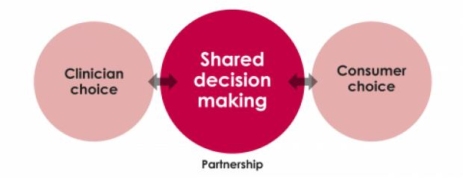
Measure Conceptualization Webinar #7
AUA Initiatives on Shared Decision Making
White Paper on Implementation of Shared Decision Making into Urological Practice (2015)
QI Summit on Shared Decision Making and Prostate Cancer Screening (2016)
Notes:
The AUA holds a yearly QI Summit, a one-day event where physicians, clinicians, researchers, policy makers, patients, and others convene to discuss and share around the chosen topic. In 2016, the topic was shared decision making (SDM) and prostate cancer screening.

Slide 14
Measure Conceptualization Webinar #7
Non-Recommended PSA Measure:
CMS Spotlight Series
  Address measures on non-recommended PSA-based screening
  Focus on:
    Modifying the age range
    Adding a component on shared decision-making
  Involve multi-stakeholder panel
Notes:
The AUA feels very strongly that our guidelines have supporting evidence that shared decision making (SDM) should be a critical component.

Slide 15

Measure Conceptualization Webinar #7
Key Stakeholders
American Urological Association
American Academy of Family Physicians
American Cancer Society
American College of Physicians
American Geriatrics Society
ASTRO (American Society for Radiation Oncology)
American Society of Clinical Oncology
Society of Urologic Oncology
NCQA
Prostate Health Education Network
Prostate Cancer Foundation
Notes:
We realized this was not something that the AUA should do alone. We wanted to involve family physicians, the American Cancer Society (ACS), and geriatrics. We also involved patient groups and anybody who treats these patients. The CMS Spotlight Series was a great opportunity to bring all of these different groups together with CMS to share information and decide on measures together that we could all support.

Slide 16
Measure Conceptualization Webinar #7
Measure Criteria
Important: Evidence based, can affect quality where there is variation or low performance
Feasible: Data are readily collectible for measurement or could be captured without undue burden
Usable: Performance results used (or can be used) to infer quality
Valid: Underlying data are accurate and scores are accurate indicators of provider quality
Reliable: Can distinguish performance among those being measured, results are consistent over time
Goal: Measure that matter (important, usable) and can be measured in a meaningful way (feasible, valid, reliable)

Slide 17
Measure Conceptualization Webinar #7
Elements of a Measure
Numerator – clinical action that meets the conditions of the measure
Denominator – patient population eligible for the measure
Exceptions/Exclusions – patients removed from the denominator
Rationale – description of the need for the measure, focusing on gaps in care, level of available evidence

Slide 18
Measure Conceptualization Webinar #7
AUA Measure Development
Conceptualization Process
Development Process
Approval/Incorporation into AQUA Registry

Slide 19
Measure Conceptualization Webinar #7
Measure Development
Conceptualization Process
Identify urologic condition on which to develop measures
Review evidence (AUA and other guidelines)
Identify/invite members of the technical expert panel - Clinical and technical experts
Notes:
At this point, we had identified the urologic condition. We knew that we wanted it to be PSA with the shared decision making (SDM) element. We reviewed all of the evidence — our guidelines as well as other guidelines and other measures — to see if there was possible harmonization. The technical expert panel (TEP) included members of our guidelines panel as well as measure development experts from our quality improvement and patient safety committee.

Slide 20
Measure Conceptualization Webinar #7
Measure Development
Conceptualization Process
Data Gathering/Environmental Scan
Develop search terms for lit search
Assess gaps in care
Review existing measures/consider harmonization
Identify relevant guidelines
Gather measure development materials, evidence, and other relevant measure sets for panel review
Draft measure concepts
Convene initial conference call(s)
Notes:
This is an iterative process, so we may work on some measures then do a little research and come back together and talk through it again. It can take many weeks or months to go through the process so all stakeholders are comfortable with the candidate measures.

Slide 21
Measure Conceptualization Webinar #7
Measure Development
Development Process
Draft preliminary measures
Consult with AUA Coding experts
Convene additional TEP calls to review/revise draft measures
Participate in CMS Spotlight Series

Slide 22
Measure Conceptualization Webinar #7
Measure Development
Development Process
Finalize measures for public comment period
Convene additional calls with the TEP to address feedback received
Public comment
Notes:
We received a lot of input from folks from that meeting. We went back to the TEP and revised the measures, then back one more time to those stakeholders who were at the CMS Spotlight Series event. The measures were then finalized for public comment.
We called upon our stakeholders to make sure that they were promoting to their members and their constituencies. We also promoted through PCPI as well as through the Council of Medical Specialty Societies (CMSS) so that people were aware that this public comment period was open and that we really wanted to get some feedback. There were no surprises with any of the public comments.

Slide 23
Measure Conceptualization Webinar #7
Promoting Shared Decision Making before PSA Screening for Men Age 55-69
Numerator Statement
Patients (or their caregiver, if appropriate) who participated in shared decision making regarding prostate cancer screening options before the prostate specific antigen (PSA) screening was performed.
Denominator Statement
All men between the ages of 55 to 69 years old who had prostate specific antigen (PSA) screening performed in the measurement period.
Denominator Exclusions
Men with a past or current diagnosis of prostate cancer.
Men with an active diagnosis or history of diagnosis benign prostatic hyperplasia (BPH) or lower urinary tract symptoms.
Denominator Exceptions
Medical reason for the patient (or their caregiver, if appropriate) not participating in shared decision making regarding prostate cancer screening before the PSA screening (e.g. significantly cognitive impaired and no caregiver available)
Patient reason for the patient (or their caregiver, if appropriate) not participating in shared decision making regarding prostate cancer screening before the PSA screening (e.g. patient refuses to participate in shared decision making)
Notes:
We ultimately ended up with two measures. One is for men ages 55-69 promoting shared decision making (SDM).

Slide 24
Measure Conceptualization Webinar #7
Promoting Shared Decision Making before PSA Testing for High Risk Men Age 40-54
Numerator Statement
Patients (or their caregiver, if appropriate) who participated in shared decision making regarding prostate cancer screening before the prostate specific antigen (PSA) screening was performed.
Denominator Statement
All men at high risk* for prostate cancer between the ages of 40 to 54 years old who had prostate specific antigen (PSA) screening performed in the measurement period.
*High Risk: Men who are black or who have a family history of prostate cancer.
Denominator Exclusions
Men with a past or current diagnosis of prostate cancer.
Men with an active diagnosis or history of diagnosis BPH or lower urinary tract symptoms.
Denominator Exceptions
Medical reason for patient (or their caregiver, if appropriate) not participating in SDM for prostate cancer screening (e.g. patient cognitively impaired)
Patient reason for patient (or their caregiver, if appropriate) not participating in SDM for prostate cancer screening (e.g. patient refuses to participate in SDM)
Notes:
The second measure was for men ages 40-54 who are at high risk.
We defined shared decision making (SDM) pretty broadly; we wanted to capture the full amount of shared decision making (SDM) that was happening. It is really any discussion with the patient about the patient’s values and preferences, and the risks and benefits of various treatments down the line. The TEP felt strongly that they did not want to require the use of a certain decision aide or tool because there are several excellent options.

Slide 25

Measure Conceptualization Webinar #7
Lessons Learned
Collaboration with key stakeholders is critical
Take advantage of the CMS Spotlight Series opportunity if available
The process is not quick or easy but it’s worth it
Notes:
Stakeholder collaboration takes time up front to reach out to all of these various groups, but it is certainly worth it for a stronger end result. In particular, getting the patient perspective.
It was great to be able to sit at the table with the CMS folks as well as all of the stakeholders and collaborate on this and get all the different perspectives. I think it was helpful for CMS to see what we were working with and the issues we were facing. We are planning to submit these measures to MIPS this year.

Slide 26

Measure Conceptualization Webinar #7
Collaborate!
Notes:
The AUA is very happy to collaborate with other groups. I think that it makes for better measures in the end that are ultimately better for the patient, and that is what we are all aiming for. Thank you again to CMS and to Battelle for this opportunity.

Slide 27

Measure Conceptualization Webinar #7
Questions

Slide 28
Measure Conceptualization Webinar #7
Measure Development Education & Outreach for Specialty Societies & Patient Advocacy Groups
Planned Upcoming Webinars:
02/28/2018, 1:00-2:00pm EST: A Focus on eCQMs: Value Sets in the Measure Development Process
03/07/2018, 2:00-3:00pm EST: Measure Specification and Testing
Suggestions for future topics?
Email: MMSsupport@battelle.org
Notes:
We have another webinar that we will be offering this month, on the 28th at 1 pm ET. This will be specific to eCQMs. Dr. Robert McClure will speak about value sets throughout the measure development process. If you happen to have an interest in or are working on measures that are eCQMs, you will want to join us. We will be back on our regular scheduled webinar for the first Wednesday of the month on March 7th at our usual 2:00-3:00 pm timeslot and will be on the next phases of measure development, “measure specification and testing.”

Slide 29
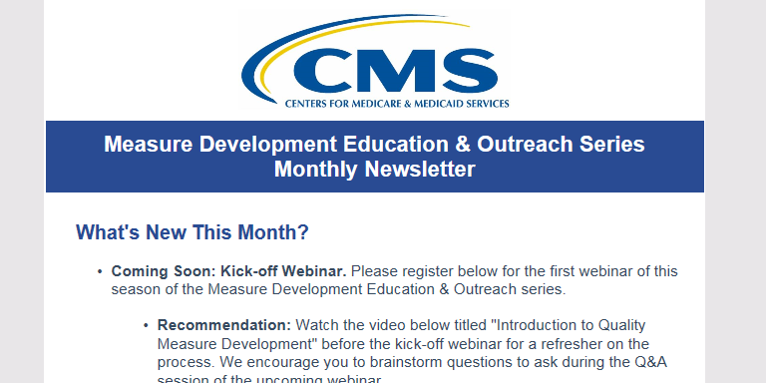

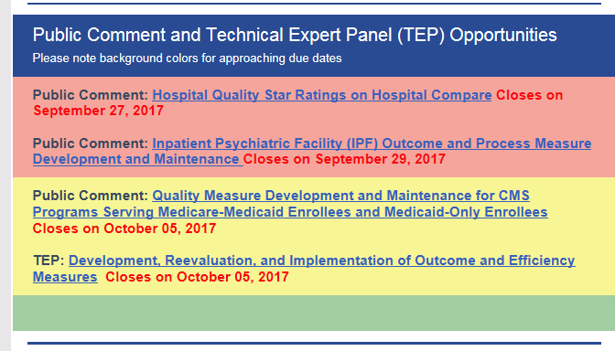
Measure Conceptualization Webinar #7
Measure Development Education & Outreach for Specialty Societies & Patient Advocacy Groups
MACRA Outreach Newsletter:
Notes:
For those of you that receive our MACRA Outreach newsletter, you can expect to see any updates specific to this series and resources that you might find helpful. We will have later this month in our newsletter an update with more information on the webinar that will be held at the end of this month, as well as information for the March webinar. You will also be able to find opportunities for public comment or technical expert panels (TEPs) and when those opportunities might be set to expire. Keep your eye out for those opportunities to be able to participate so that you don’t miss any of those deadlines.
If you are not receiving this newsletter and are interested in getting it monthly, please go ahead and email the MMSSupport@battelle.org email address. Just identify in the subject that you would like to receive the MACRA Education & Outreach Series newsletter.

Slide 30

CMS Spotlight Opportunities
Measure Development Education & Outreach for Specialty Societies & Patient Advocacy Groups
  Reminder:
  If you are currently developing quality measures that you would like to present to CMS contact the MMS Support Desk at MMSsupport@Battelle.org
Notes:
In addition to the newsletter and this webinar series, CMS is interested in engaging with you to talk about developing measures and making sure that they align with the various programs, but specifically with the MIPS program. As a presenter in this Spotlight Session you can expect to give a 30-40 minute presentation, with the remaining 20-30 minutes meant to be an opportunity to receive feedback on your measure from CMS.
You can be in any phase of development to have this meeting with CMS, it is an opportunity to get feedback. It can be held in-person, and it can also be held virtually over a webinar style. If you are not able to attend in-person, we can certainly help arrange that for you. If you would like to participate in a session like this, email the MMSSupport@battelle.org email address and just mention Spotlight Session in the subject line and someone will get back to you about scheduling a session.

Slide 31
Measure Conceptualization Webinar #7
Contact Information
Battelle
Measures Management System Contractor: Battelle
Contact: MMSsupport@Battelle.org
CMS
Golden Davis: Golden.Davis@cms.hhs.gov
Kim Rawlings: Kimberly.Rawlings@cms.hhs.gov

