Slide 1

Technical Expert Panels and Public Comment
Ways for Stakeholders to Provide Input on Quality Measures
Presenters:
Brenna Rabel, Battelle
Victoria Danner, Rainmakers Strategic Solutions

Slide 2
Objectives
Review two opportunities for stakeholders, including patients and caregivers, to provide input on the measure development and implementation process
  Technical Expert Panel (TEP)
    For stakeholders: Discuss what a TEP is and how stakeholders can get involved
    For measure developers: Review of the Person and Family Engagement Toolkit for Quality Measure Development
  Public Comment
    For stakeholders: Discuss different types of public comment, the goal of public comment, and how stakeholders can submit feedback

Slide 3
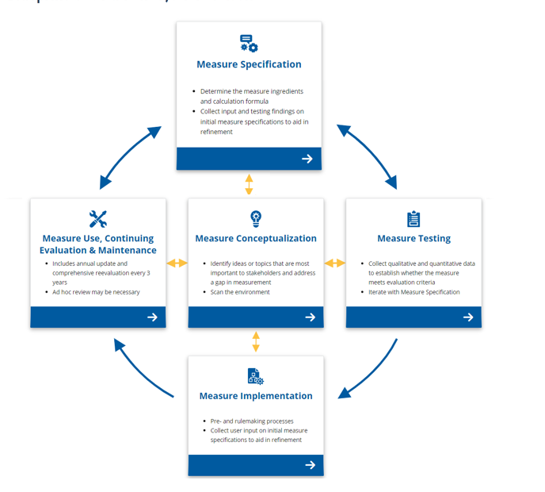
Blueprint Measure Lifecycle

Slide 4

Technical Expert Panels

Slide 5
TEP Role
Review new measure ideas and help decide which measures to develop further
Review results from the testing of measures that are currently in development
Advise the measure developer on which measures to recommend to CMS
Provide feedback and recommendations on policies impacting national public reporting and value-based payment programs
Guide the development of key national documents guiding the future of quality measurement and quality activities
Give feedback on other quality measurement and measure development topics

Slide 6
Who Should be on a TEP?
TEPs are most effective when they have diverse stakeholders including:
  Individuals: persons participating in their health and wellness
  Family members and caregivers: people supporting an individual receiving healthcare
  Clinicians: healthcare professionals providing care for individuals
  Facility representatives: representatives from organizations providing services and support to individuals
  Measure developers: organizations that develop, implement, and maintain quality measures
  Other stakeholder groups: such as health insurance providers, academic researchers, and local, state, and federal government agencies

Slide 7
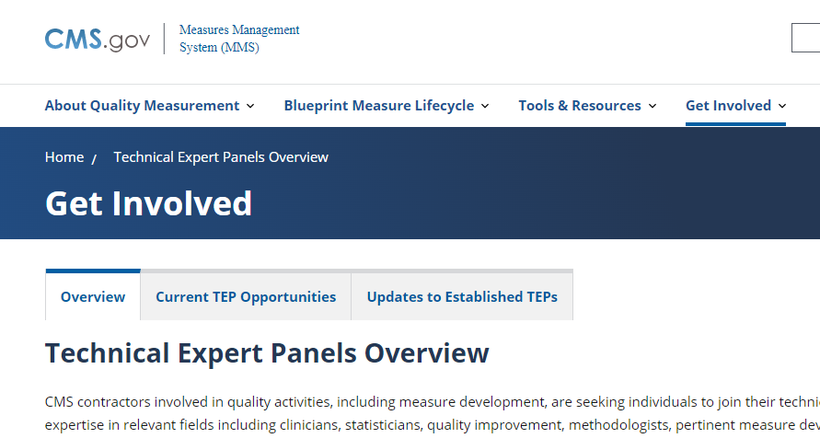
Finding Opportunities on MMS Hub
CMS-funded measure developers post opportunities for TEPs on the MMS Hub
CMS-funded developers also post information on recent TEPs
  TEP rosters
  Meeting summaries
https://mmshub.cms.gov/get-involved/technical-expert-panel/overview

Slide 8

Person and Family Engagement Toolkit for Quality Measure Development: Walk Through
Victoria X. Danner, MAA, PMP
PFE Coordinator
Persons and Family Engagement for Quality Measure Development
Rainmakers Strategic Solutions LLC
victoria.danner@rainmakerssolutions.com

Slide 9
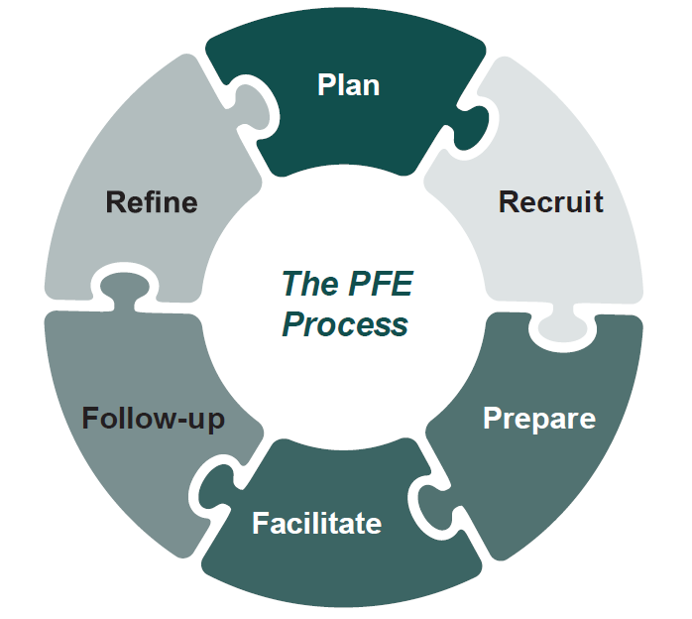
The PFE Process
The Person and Family Engagement (PFE) Process is a step-by-step guide for measure developers, health organizations, patient groups, and research institutions to progress through planning, recruitment, and engagement with PFE Partners to produce quality measures designed with unique person and family input.

Slide 10

Person and Family Engagement Toolkit:
A Guide for Measure Developers
Updated annually in April
Serves as a roadmap of the PFE Process to engage persons and families throughout the measure development process
Provides resources, templates, and tools to facilitate successful engagement, orientation, and communication strategies
Can be found at: https://www.cms.gov/Medicare/Quality-Initiatives-Patient-Assessment-Instruments/MMS/Downloads/Person-and-Family-Engagemen.pdf

Slide 11
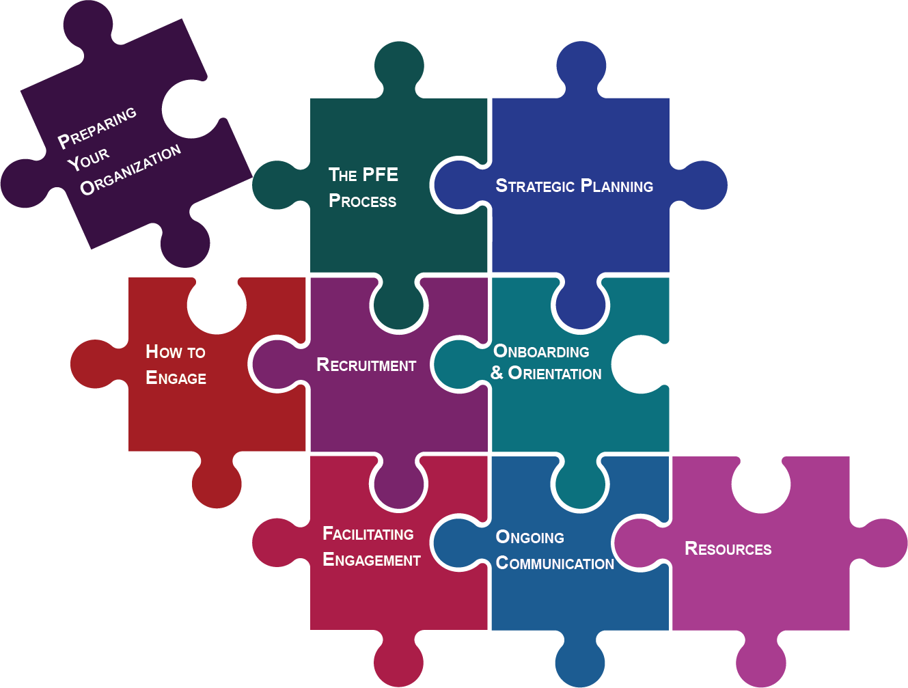
What’s Inside?
Eight (8) Sections focus on a different aspect, or phase, of the PFE process and provide related information, key considerations, helpful hints, and resources. These Sections address:
Preparing Your Organization
The PFE Process
Strategic Planning
How to Engage
Recruitment
Onboarding and Orientation
Facilitating Engagement
Ongoing Communication
Section nine (9) provides ready-to-use tools, templates, and handouts for PFE-focused projects.

Slide 12

Planning for Your TEP with the Toolkit
Preparing Your Organization
Strategies to prepare your organization and staff for PFE
  Training and Staffing
  Budget and Honoraria
The PFE Process
A systematic process for engaging with persons and families
  Prepared Staff
  Approachable Framework

Slide 13

Strategies for Engagement
Strategic Planning
Guidance on what to plan for and how to assess your PFE efforts
  PFE Goals
  PFE Collaboration
How to Engage
Strategies for selecting the right topics and mechanisms
  Selecting an Engagement Mechanism
  Defining the PFE Partner Role and Characteristics

Slide 14

Finding Your PFE Partners
Recruitment
Guidance on how to recruit persons and families
  Process and contacts
  Timeline
Onboarding & Orientation
Processes to bring persons and families into PFE and prepare them to engage with your organization
  Charter and Information Packets
  Q&A and Office Hours

Slide 15

Engaging Your PFE Partners
Facilitating Engagement
Meeting facilitation, preparation, and follow up with persons and families
  Prepare PFE Partners
  Refinement and Follow Up
Ongoing Communication
Guidance on how to continue communication with persons and families
  Maintaining Active Engagement
  Supporting PFE Partners

Slide 16

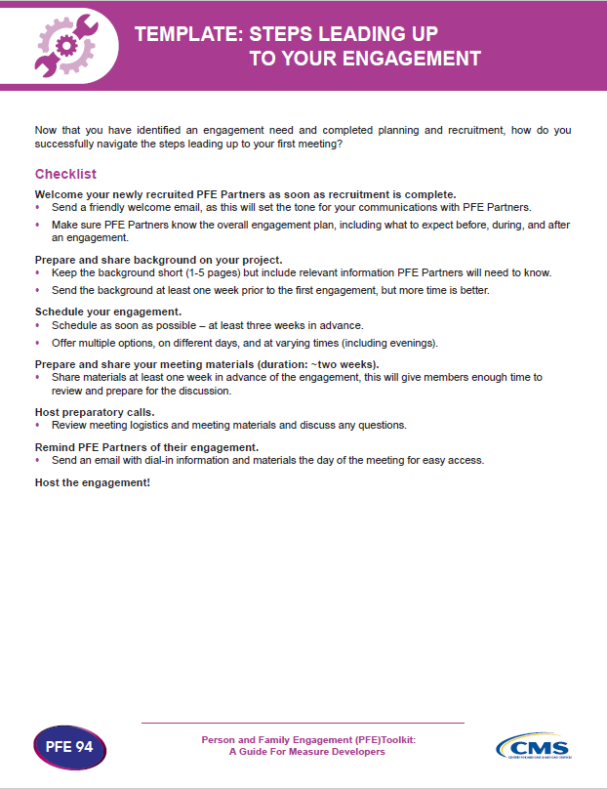
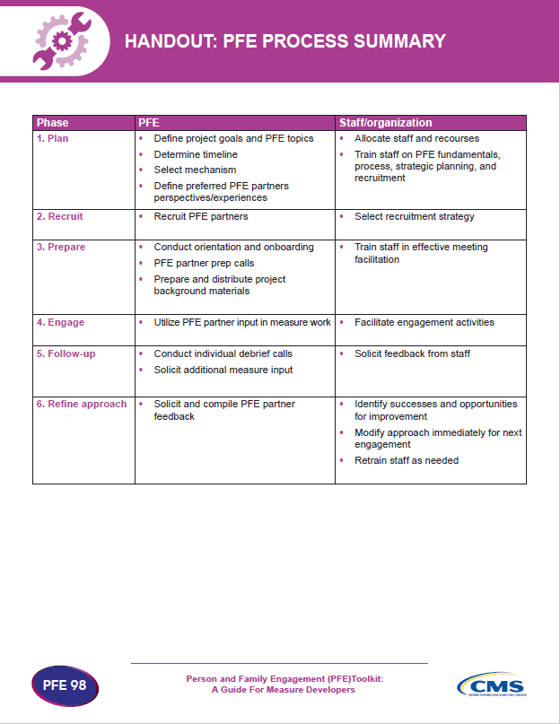
Resources
TOOLS
TEMPLATES
HANDOUTS

Slide 17

Public Comment

Slide 18
Public Comment
Measure developers and other CMS contractors solicit public comment on measures under development
Feedback can provide critical suggestions not previously considered by the measure developer or the TEP
Ensures a transparent process with balanced input
The public may comment on proposed new measures and measures proposed to continue in a CMS program
As part of the measure endorsement process, the CMS consensus-based entity (CBE), solicits public comments on measures seeking initial endorsement or maintenance of endorsement

Slide 19
Types of Public Comment Opportunities
Comment on measures under development
Comment on a proposed rule
Opportunities are posted to MMS Hub website
Comments submitted directly to measure developers
Opportunity to provide feedback on a measure before it is submitted for use in a program
Proposed rules are published on the Federal Register: https://www.federalregister.gov/
Comments are posted publicly
Opportunity to provide feedback on measures or policies specific to a given CMS program

Slide 20
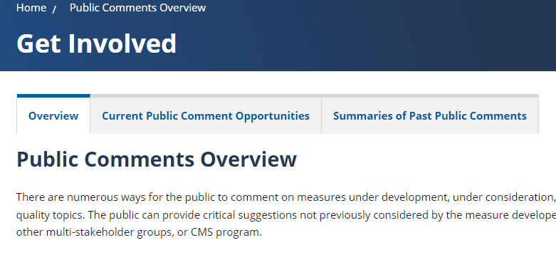
Navigating Public Comment Opportunities on MMS Hub
MMS Hub has current and previous public comment opportunities
The current opportunities include measures information and submission instructions
Previous opportunities provide summaries of comments

Slide 21
Finding a Proposed Rule
Two options:
  Go to https://www.federalregister.gov/ and create an account (it’s free!)
    Set up a subscription for documents from Centers for Medicare & Medicaid Services
    You’ll receive email notifications when new proposed rules are posted for comment
  Go to https://www.federalregister.gov/ and do a keyword search
    No need for an account, but it can be difficult to find what you are looking for because of the volume of documents housed there

Slide 22
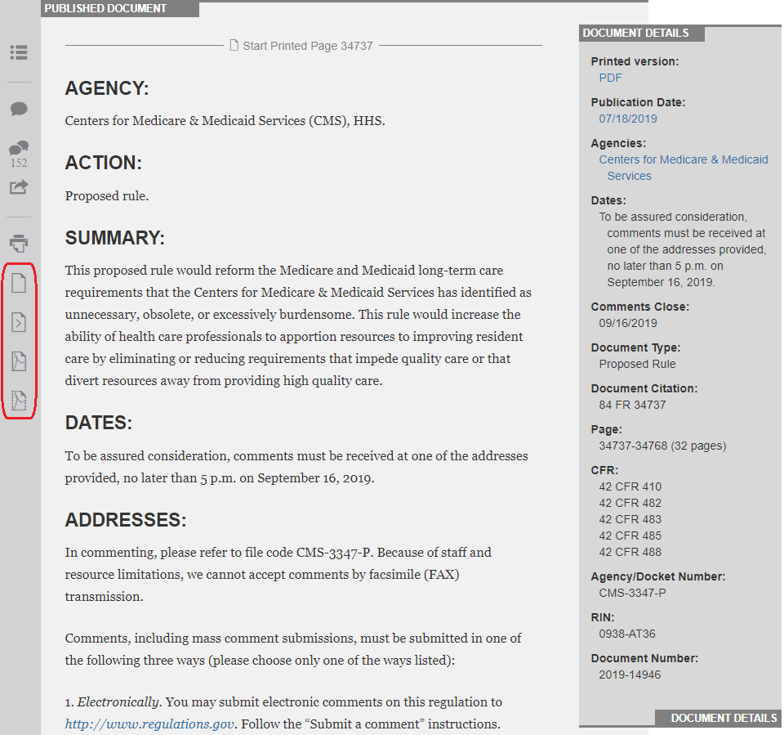
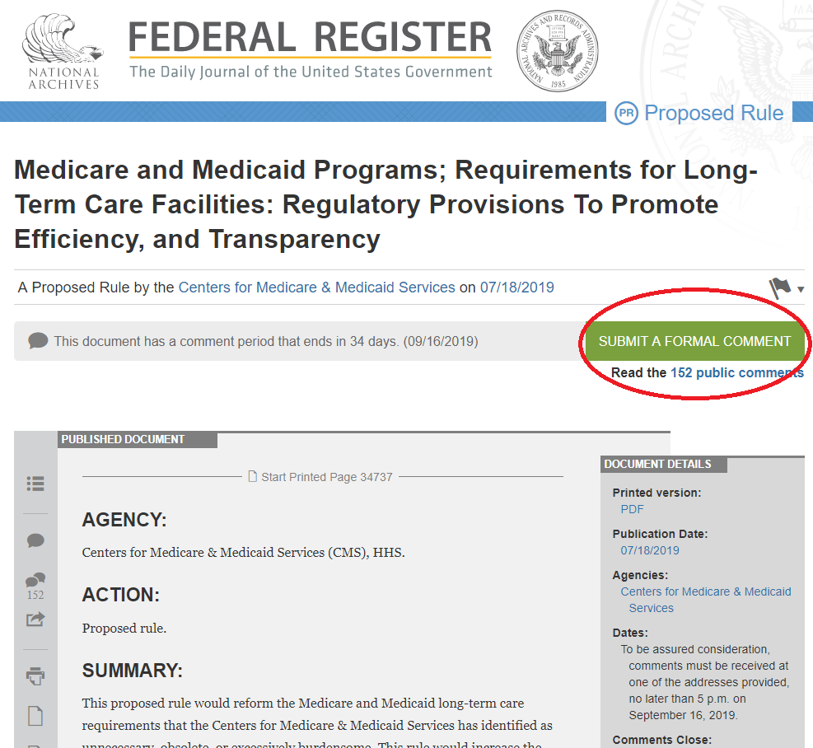
Submitting a Comment on a Proposed Rule

Slide 23
Tips for Writing a Comment
Comments are public
  Do not include any personal health information in your comments
If you are providing comments on behalf of an organization, include that organization’s name and your contact information
Be specific about your support or concerns for a measure
  Cite examples from the literature or from your lived experiences

Slide 24
Stay Up-to-Date on Public Comment Opportunities
Sign up for the MMS Newsletter for monthly announcements
Subscribe to the Federal Register
Visit the MMS Hub
https://public.govdelivery.com/accounts/USCMS/subscriber/new
https://www.federalregister.gov/
https://mmshub.cms.gov/get-involved/public-comments/overview

Slide 25
Questions

Slide 26
Announcements
November 30 Info Session from 2-3pm ET
  “Measure Lifecyle Overview”
  Registration: https://bit.ly/Nov30InfoSessionRegistration

Slide 27
Contact Information
CMS
Gequincia Polk
Contact: gequincia.polk@cms.hhs.gov
Melissa Gross Contact: Melissa.Gross@cms.hhs.gov
Battelle
Contact: MMSSupport@battelle.org

